Slide 1
Prepared by- dr.ashutosh Dwivedi assistant professor harishchandra P.g. college

Slide 2
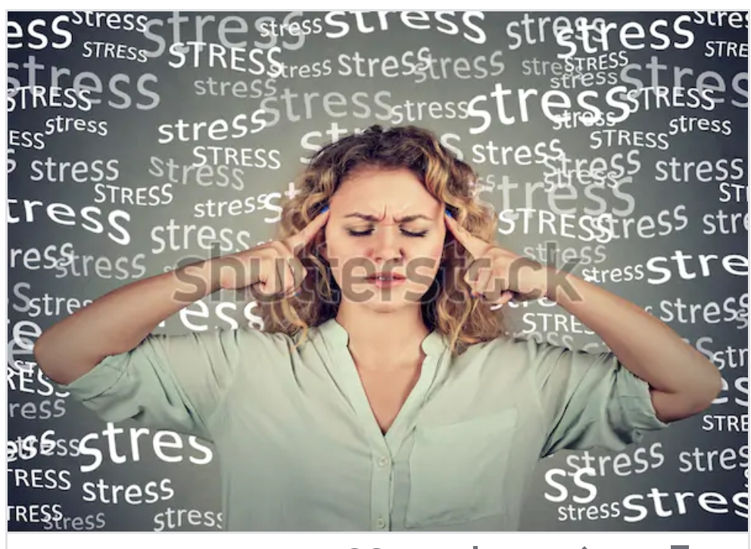
Stress and physiology of stress and role of stress on immune system
Topic related to MA 2nd (SEM)
Paper_4(Unit-4)- psychobiology of motivation learning and memory

Slide 3
What is Stress?
The modern world, which is said to be a world of achievement, is also a world of stress. Ones finds stress everywhere, whether it be within the family, business organisation. Right from the time of birth till the last breath, an individual faces stressful situations.

Slide 4
The concept of stress was first introduced in life sciences by Hans Selye in 1936,who defined it as “the nonspecific response of body to any demand for change.”

Slide 5
Symptoms of stress
Its very hard to know how easily stress can creep up on you. You don’t notice How much it’s affecting you. It’s very important to be aware of the common signs of stress:
Cognitive Symptoms:
Inability to concentrate
Memory problems
Poor judgement
Seeing only the negative

Slide 6
Emotional symptoms:
Depression or general unhappiness
Loneliness and isolation
Other mental or emotional problems
Physical Symptoms:
Eating more or lessSleeping too much or too little
Neglecting Responsibility
Using alcohol,or drugs to relax
Nervous habbits (e.g. Nail biting, pacing)

Slide 7
Physiology of Stress
Stress is unique in the category of diseases. It has no biological carrier such as a germ or virus. Rather, it is the result of how our mind and body function and interact. It is psychosomatic in the true sense of the word- psyche means ‘mind’ and soma means ‘body’. It is the consequence of how we do not regulate, the mental and physical functioning of our being. It is the ‘ disease’ created by the abuse of our minds and bodies and can lead to totally different symptoms in different people. These may be as contd.........

Slide 8
Innocuous as temper tantrums or as destructive as a heart attack. Stress may express itself through alcoholism or depression. Though it’s symptoms are many, it’s causes often go unrecognised and untreated.
In following lines we see that how our glands help us in stressful situations:
Hypothalamus: during time of stress the hypothalamus a collection of nuclei that connects the brain and the endocrine system, signals the pituitary gland to produce a harmone which in turn signals the adrenal glands to increases the production of cortisol. An increase in cortisol can provide the energy required to deal with prolonged or extreme challenge.

Slide 9
Pituitary: This gland known as a master gland. It produces many hormones that travel throughout the body. In production of many hormone one hormone is known as. Adrenocorticotropin (ACTH): ACTH stimulates the cortisol, a “stress hormone”. It helps maintain blood pressure and blood glucose( sugar) levels, and is produced in large amount when we are in stress. Too much ACTH will result in too much cortisol production; called Cushing’s disease. Low ACTH will result as: Adrenal Insufficiency.
Adrenal Axis: Also known as suprarenal glands. Adrenal gland produce hormone that help regulate your metabolism immune blood pressure response to stress and other essential functions.

Slide 10
Role of stress on immune system
We know that the nervous system has considerable control over the immune system. Unfortunately, the term stress applies to a wide variety of events and different kinds of stress stress produce different effects on the body.
Some studies show how stress play a key role in disregulation of immune system.
Kiecolt – Glaser and Glaser confirmed this by comparing the immune function of exam- stressed medical students givan hypnosis and relaxation training with that of students without training. The outcomes of this study was: those who practices conscientiously did actually have significantly contd.....

Slide 11
better immune function during exams than students who practiced erratically or not at all.
Sarrah Pressman,Sheldon Cohen study for the stress immunity and disease, found that socila isolation and feelings of loneliness each independently weakened first year students immunity.
When we overview all the segments we have to tell taht there are negative correlation in stress and immune system.

Slide 13
Thank you

