Slide 1
PROJECTIVE MODULE
(CONTINUED....)
Dr. Sangita Srivastava
Associate Professor
Department of Mathematics
HCPG College.

Slide 3
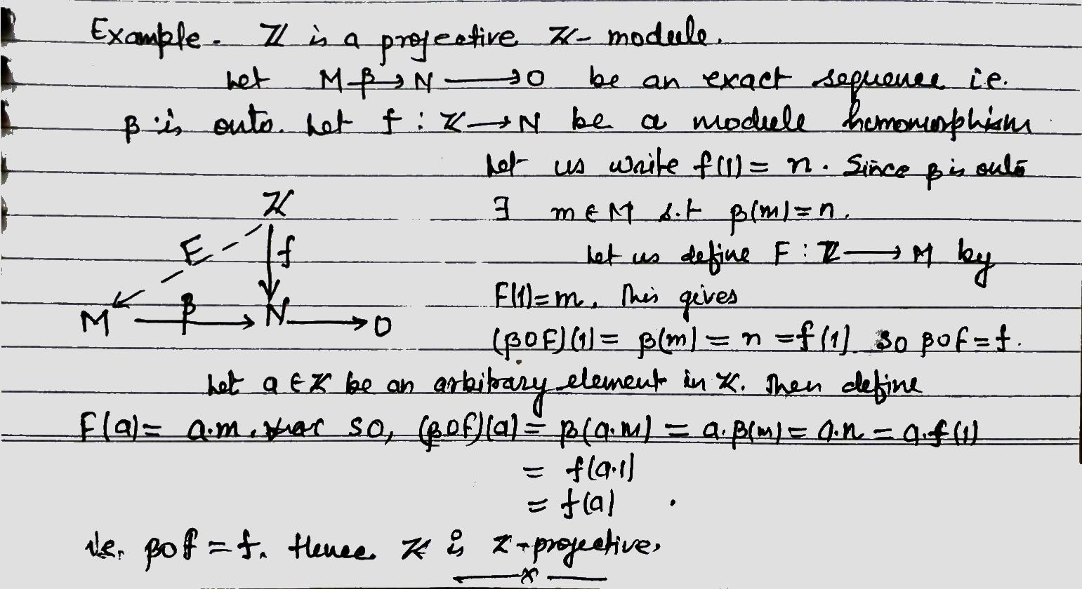

Slide 9
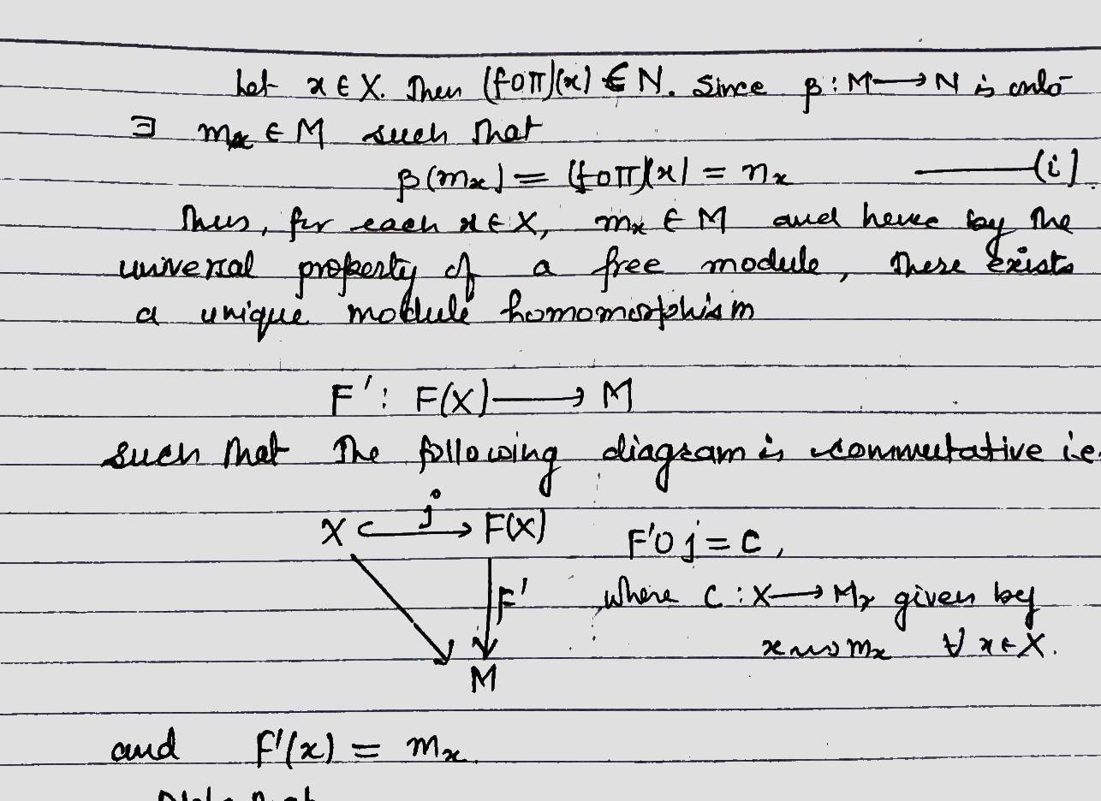

Slide 11
