Slide 1
TYPES OF PROSPETUS
Presented By,
Dr. Vandana Pandey
Professor
Department of commerce
HCPG College Varanasi

Slide 2
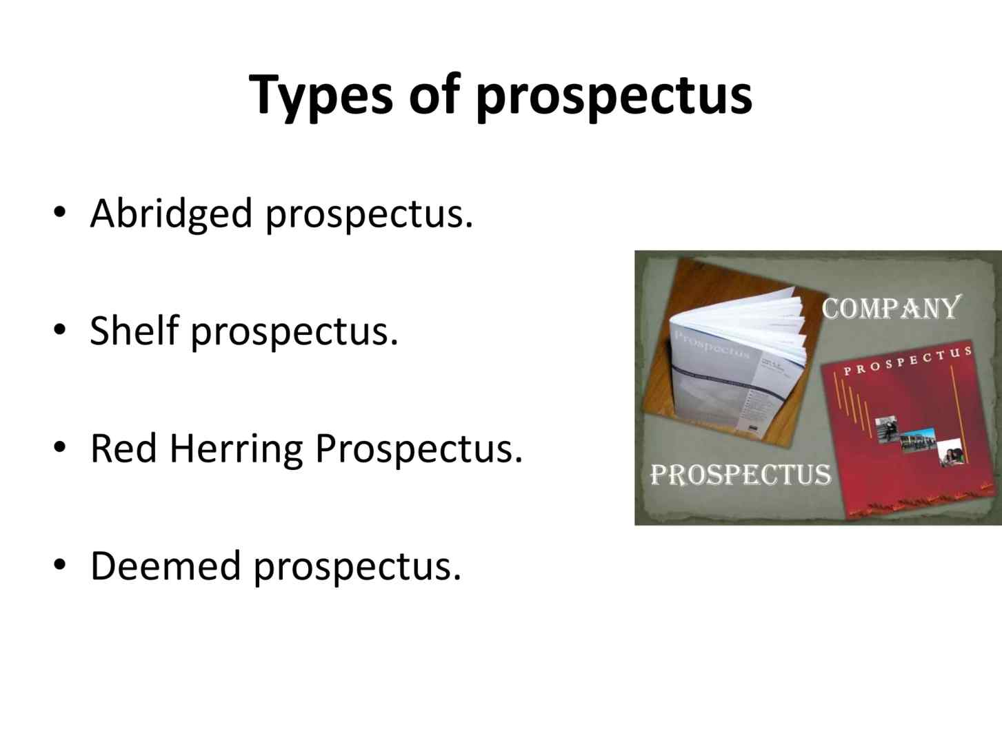
TYPES OF PROSPECTUS

Slide 3
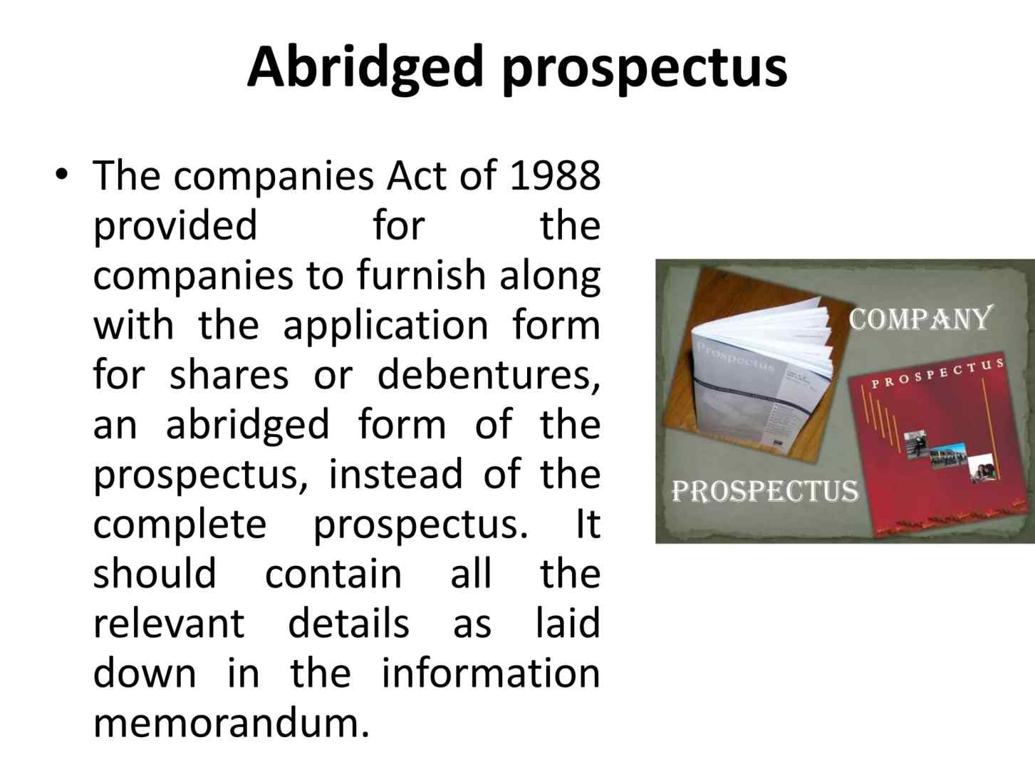
ABRIDGED PROSPECTUS

Slide 4
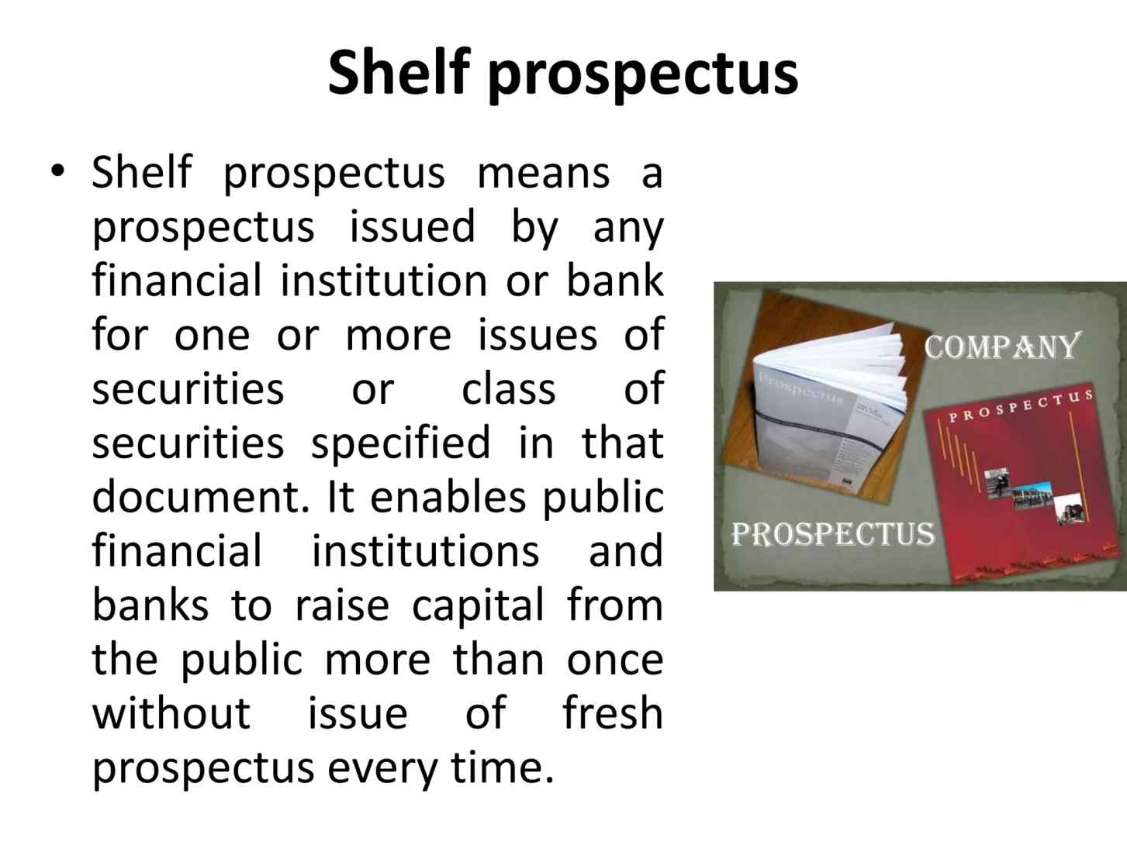
SHELF PROSPECTUS

Slide 5
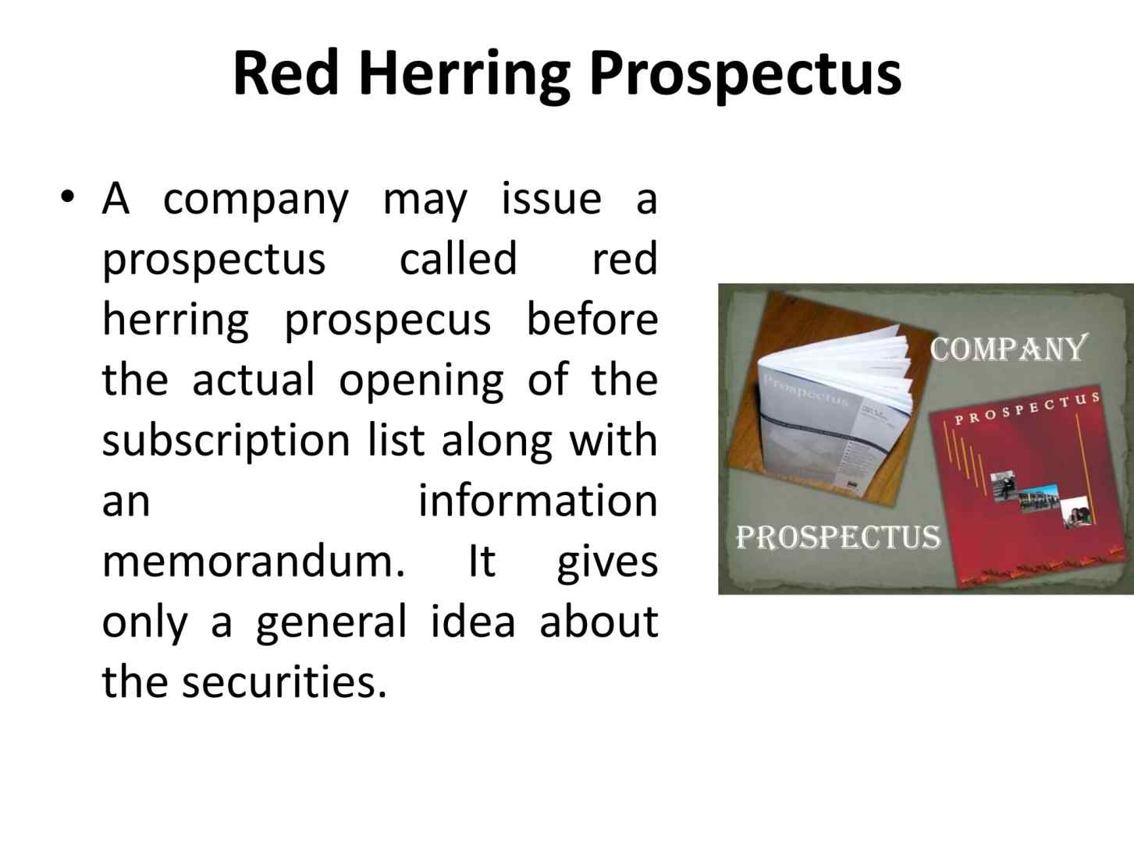
RED HERRING PROSPECTUS

Slide 6
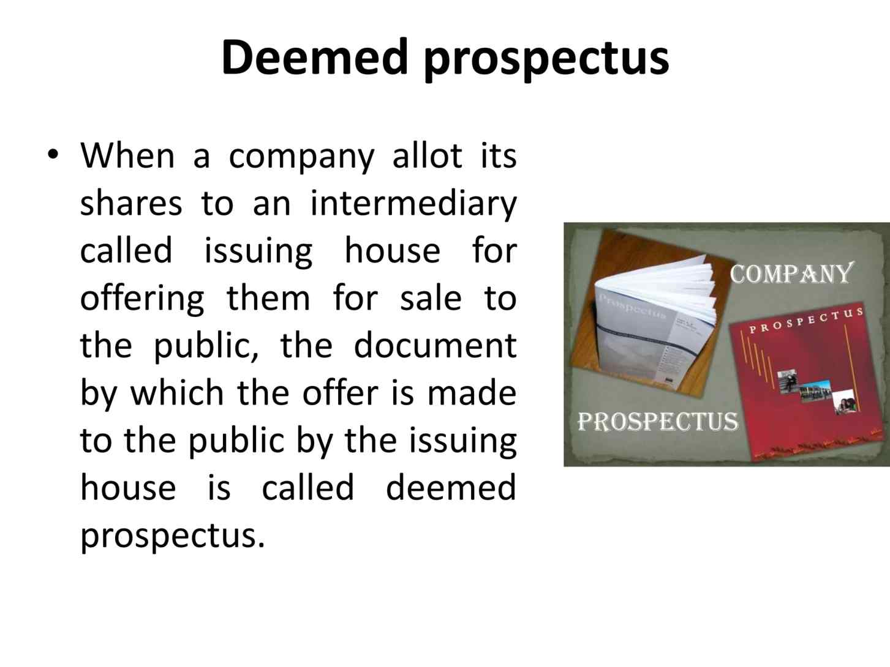
DEEMED PROSPECTUS

Slide 7
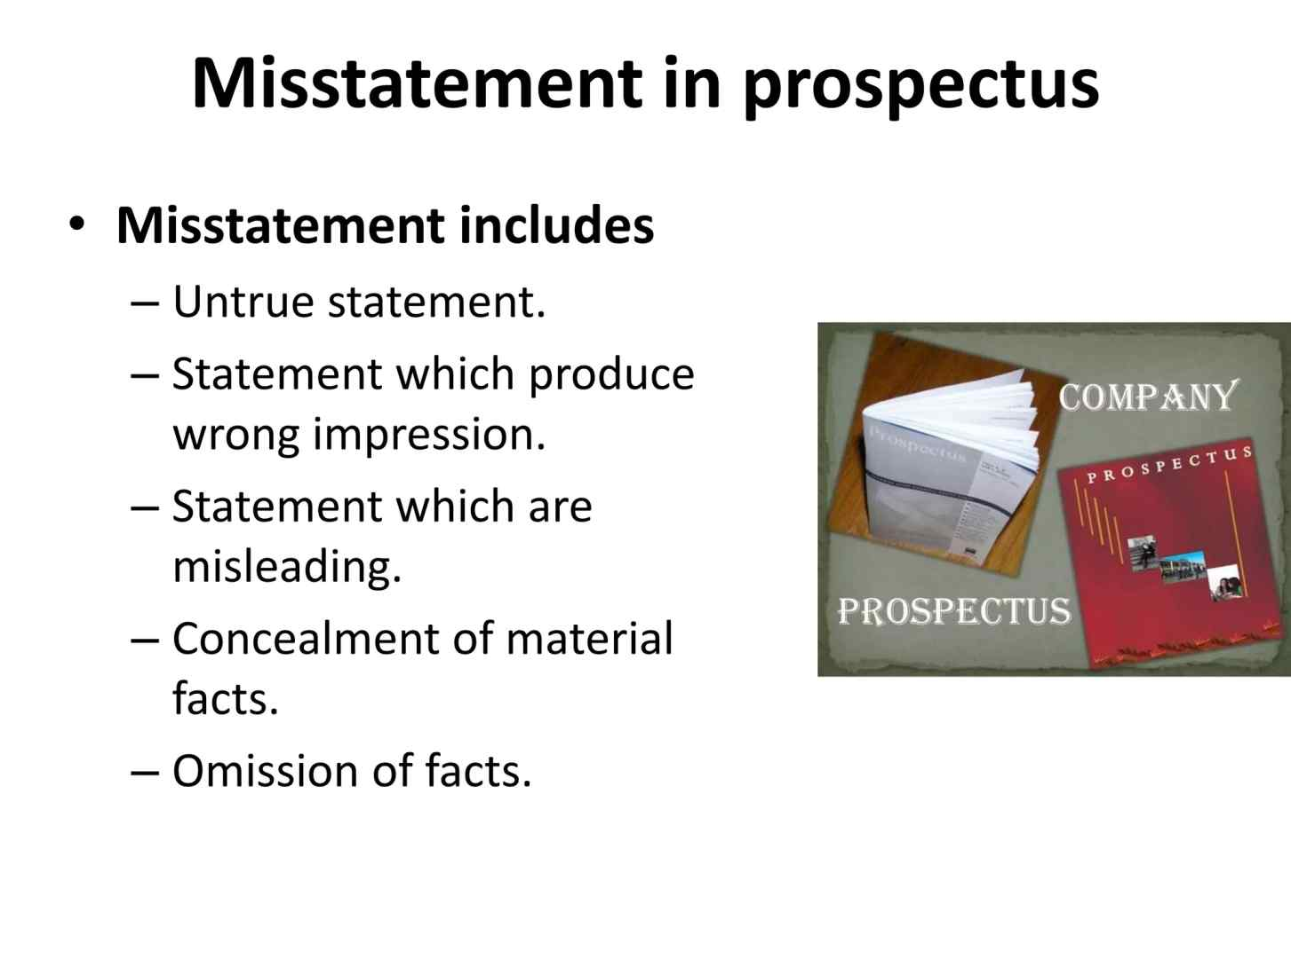
PROSPECTUS

Slide 8
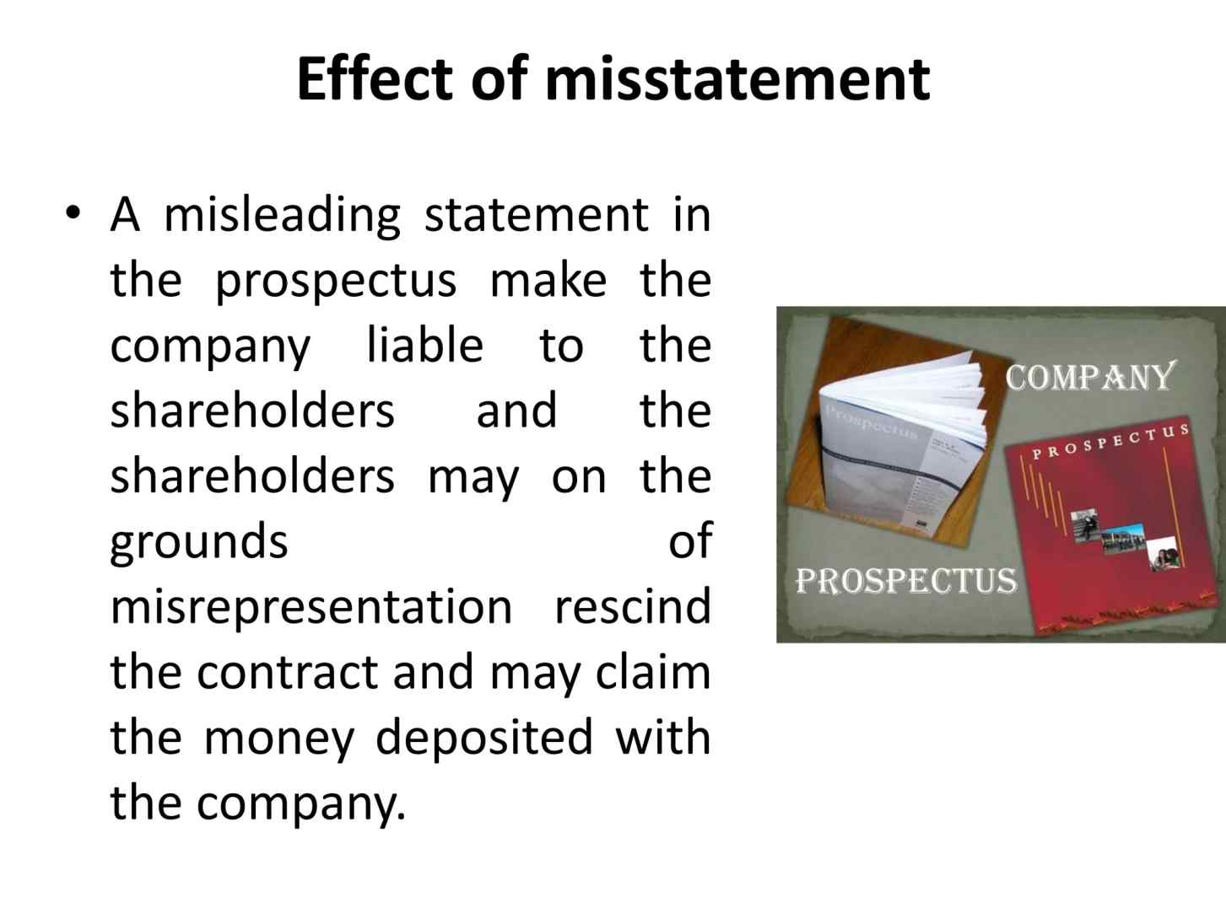
EFFECT

Slide 9
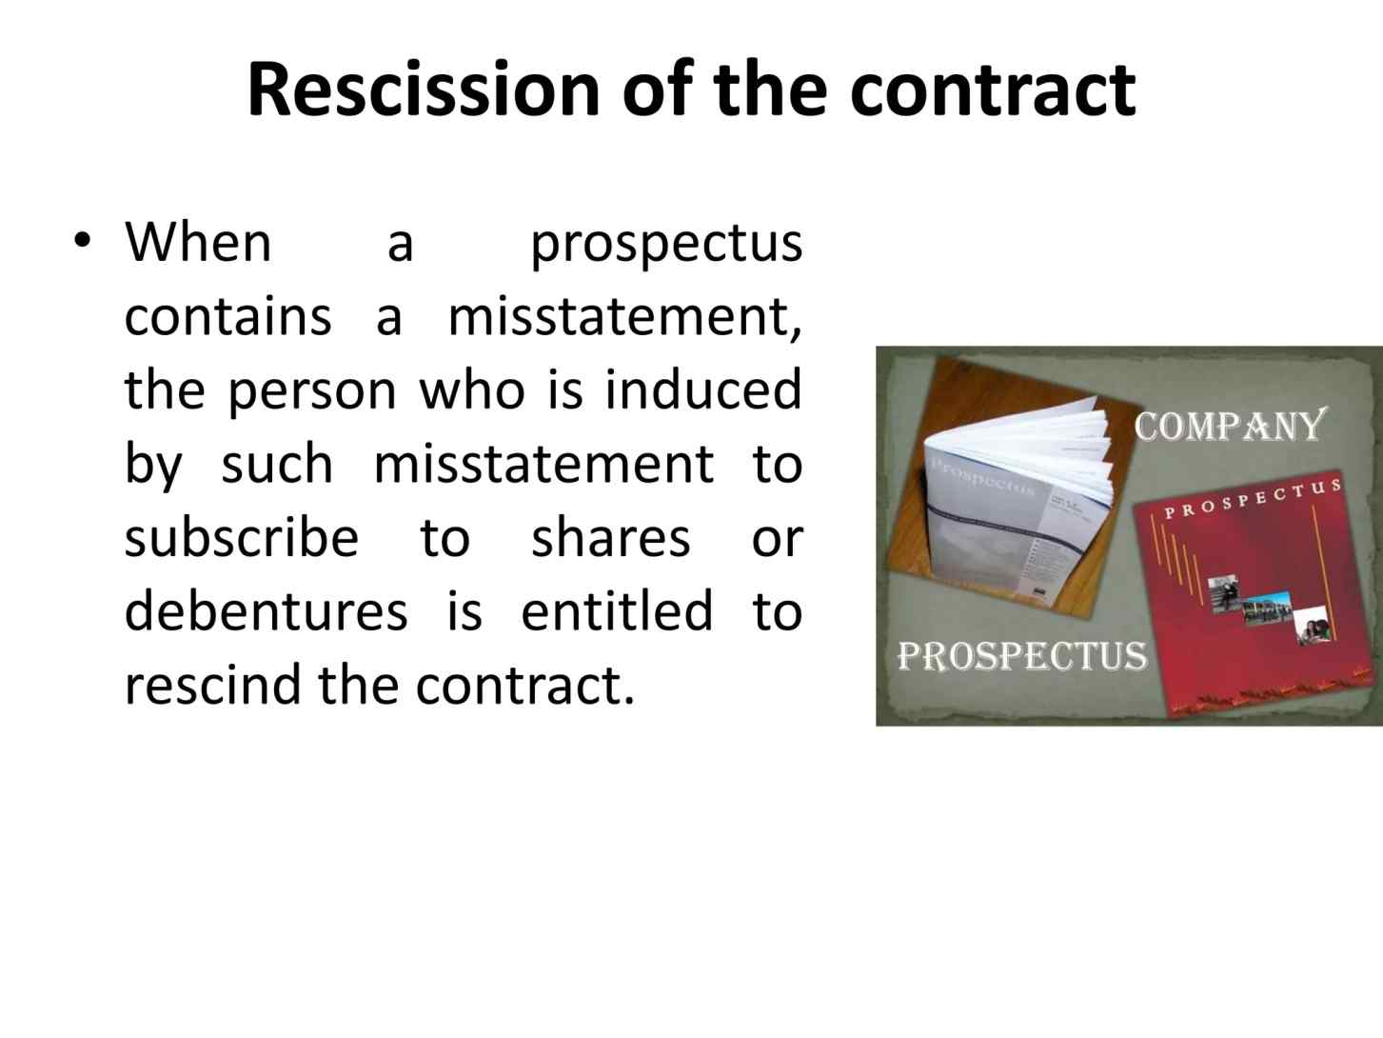

Slide 10
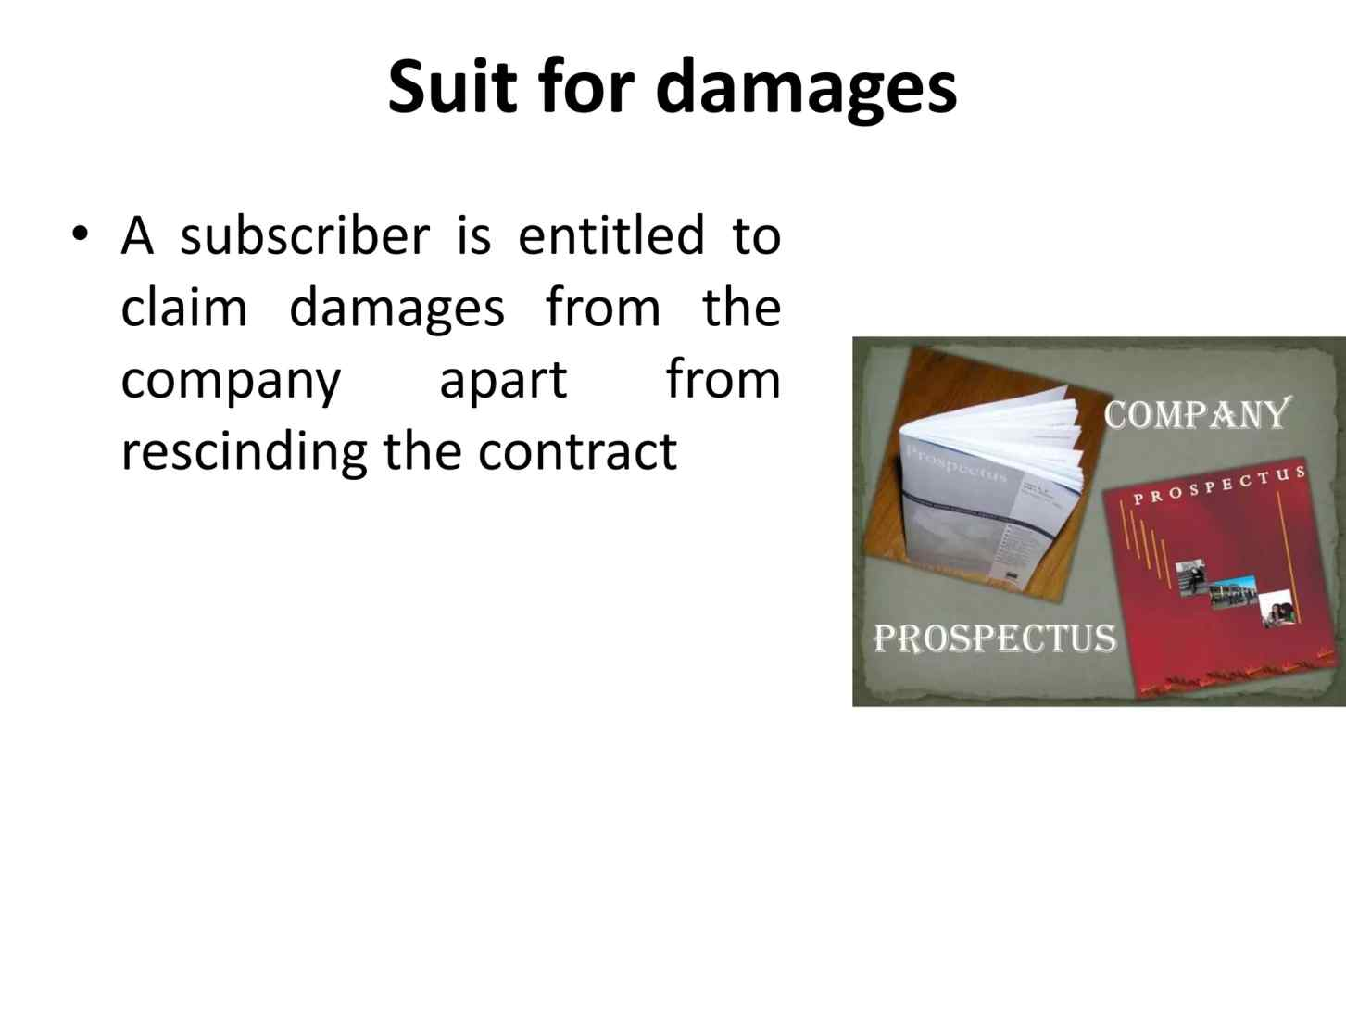
SUIT

Slide 11
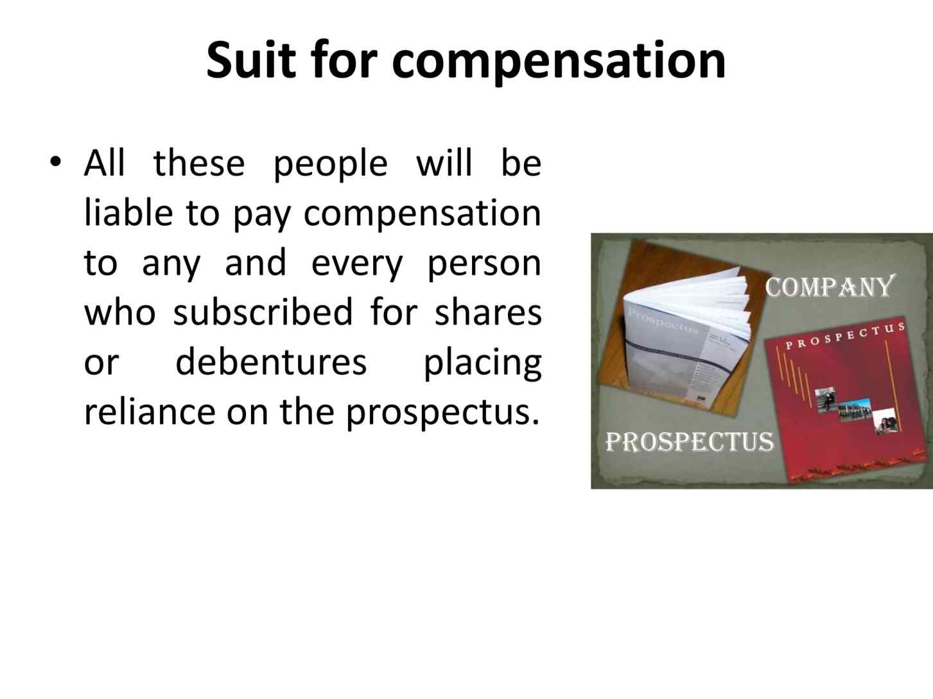
SUIT

Slide 12
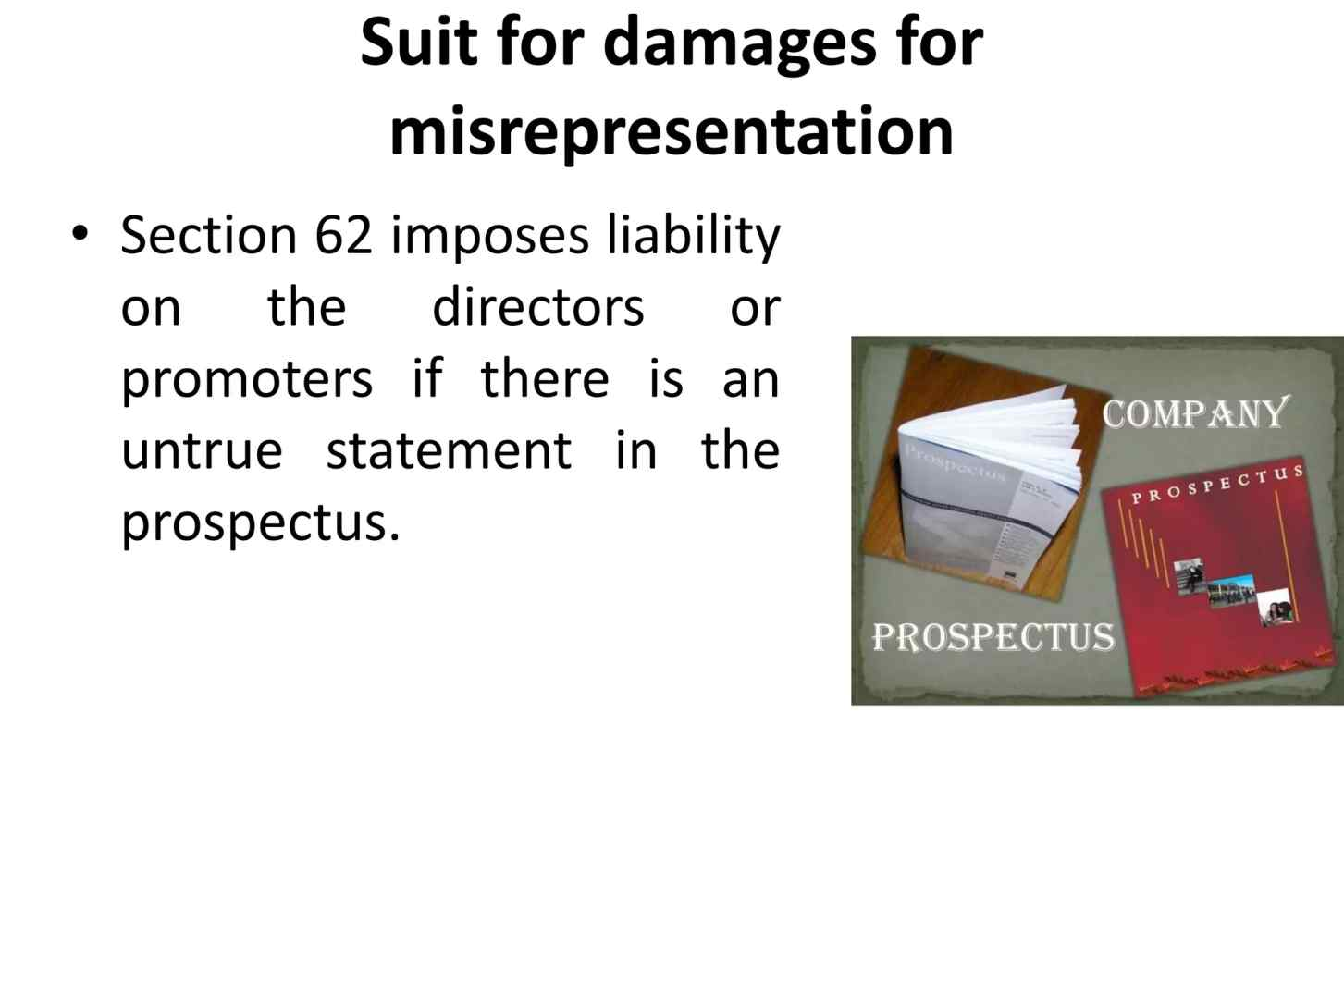
SUIT

Slide 13
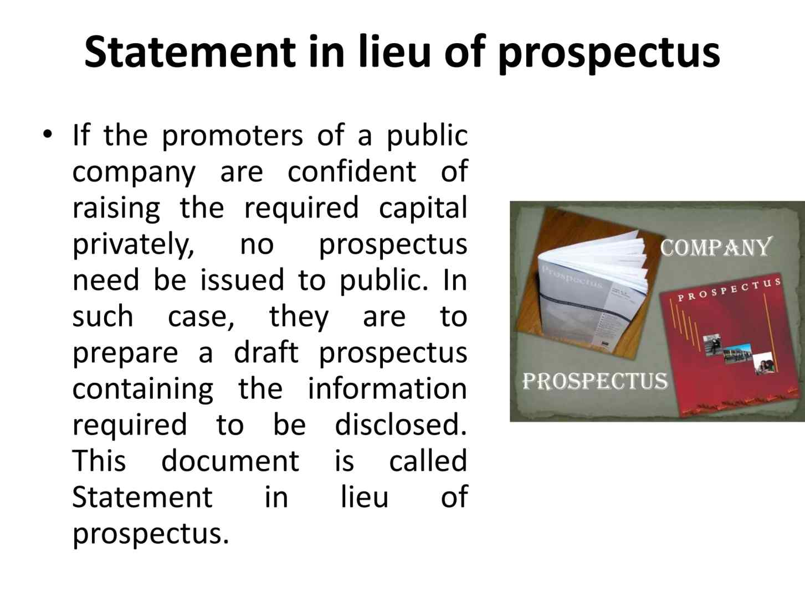
STATEMENT IN LIEU OF PROSPECTUS

Slide 14
Thank you

