Slide 1
B.Ed.
3rd semester
Dr. Anuradha Rai
Associate Professor (B. Ed)
Harish Chandra P.G. College,
Varanasi
http://www.free-powerpoint-templates-design.com

Slide 2
Pedagogy of school subjects
Economics Teaching

Slide 3
Content of Economics as a school subject at a glance: Its pedagogic implications in terms of interdisciplinary approach.
A

Slide 4
What is Economics
Subject under social sciences
Study Of Resources
.
Choices under the condition of Scarcity

Slide 5


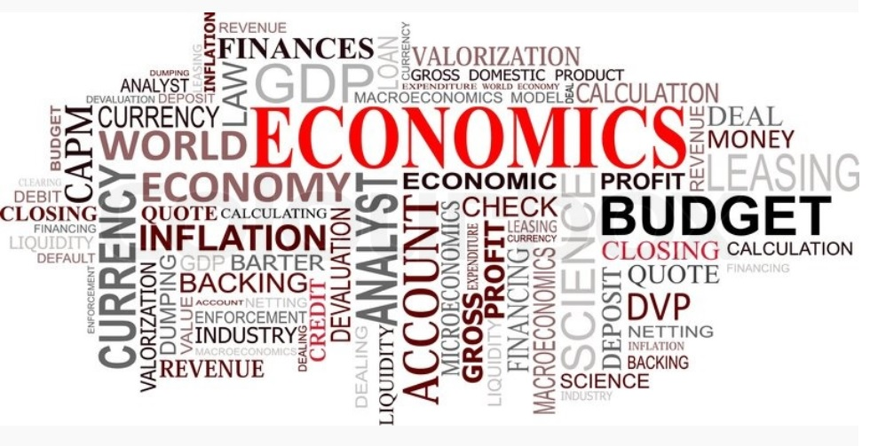


What is Economics
CONSUMPTION
EXCHANGE DISTRIBUTION
PRODUCTION
Revenue

Slide 6
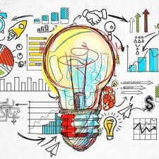
Economics content
Micro Economics
Macro
Economics
Utility
Income
Demand
Money
Unemployment
G.D.P.
Population
Economic-planning

Slide 7
Economics content as a school subject
Understanding Basic Concepts related with Micro Economics
1
2
Understanding Basic concepts related with Macro Economics
3
4
Observation of Economic activity in surroundings
Developing basic skills for Economic citizenship

Slide 8
Economics is not separate subject until higher secondary stage . It is a part of social studies which include 4 chapters in 9th class.
Content of Economics in secondary level school curriculum
People as Resource
Activities by men and women,
Quality of population,
employment
A Story of Palampur
This chapter consists introduction of some basic terms like production, land, labor, agriculture etc.
Food security in India
Poverty as a Challenge
What is FoodSecurity?,
Why Food Security?
Who are food insecure Food Security inIndia,
What is BufferStock?
What is the Public Distribution System?,
Current Status of Public Distribution system
Poverty as seen by Social Scientists, Poverty Estimates,Vulnerable Groups,inter state disparities,Global Poverty scenario Causes ofPoverty,Anti-povertymeasures,The Challenges Ahead

Slide 9
Similarly, in class 10 th also It is a part of social studies which include 4 chapters in
Content of Economics in secondary level school curriculum
MONEY AND CREDIT:
Money as a medium of exchange
Modern forms of money
Loan activities of Banks
Two different credit situations
Terms of credit
Formal sector credit in India
Self Help Groups for the Poor
DEVELOPMENT
What Development Promises - Different people different goals, Income and other goals
National Development, How to compare different countries or states? Income and other criteria ,Public Facilities Sustainability of development
GLOBALISATION AND THE INDIAN ECONOMY:
Production across countries
Interlinking production across countries
Foreign Trade and integration of markets
What is globalization?
Factors that have enabled Globalization
World Trade Organization
Impact of Globalization on India
The Struggle for a fair Globalization
SECTORS OF THE INDIAN ECONOMY:
Sectors of Economic ActivitiesComparing the three sectors
–Primary, Secondary and Tertiary Sectors in India
Division of sectors as organized and unorganized
–Sectors in terms of ownership: Public and Private Sectors

Slide 10
Content of Economics in11 th grade
Paper 1
Statistics for Economics
Paper 2
Micro Economics
Introduction of statistics
collection organization and presentation of the data
Statistical Tools and Interpretation
Introduction of micro economics
Consumer's Equilibrium and Demand
Producer Behavior and Supply
Forms of Market and Price Determination under Perfect Competition with simple applications.

Slide 11
Content of Economics in12 th grade
Paper 1
Introductory Macro Economics
Paper 2
Indian Economic Development
National Income and Related Aggregates
Money and Banking
Determination of Income and Employment
Government Budget and the Economy
Balance of Payments
Development Experience (1947-90) and Economic Reforms since 1991
Current challenges facing Indian Economy
Development Experience of India

Slide 12
Its pedagogic implications in terms of interdisciplinary approach.

Slide 13
Economics :subject in social science
Civics
History
geography
Economics

Slide 14
Pedagogic Implication
Interdisplinary teaching enhances understanding of concepts and theories in broader perspective
Interdisplinary teaching develops learners awareness towards economics problems.
Interdisplinary teaching enables learner to apply the knowledge beyond the subject classroom .

Slide 15


