Slide 1
SPECTROSCOPY AND ITS APPLICATIONS
DR. ANIL KUMAR
ASSOCIATE PROFESSOR OF CHEMISTRY
HARISH CHANDRA P G COLLEGE, VARANASI

Slide 3
Spectrocopy:
It is a tool for elucidation of structure of chemical compounds.
There are so many types of spectroscopy such as
UV-Visible spectroscopy
IR spectroscopy
Raman spectroscopy
NMR spectroscopy
Rotational or Microwave spectroscopy
ESR spectroscopy
Photo acoustic spectroscopy
Auger spectroscopy

Slide 5
UV and Visible spectroscopy

Slide 7
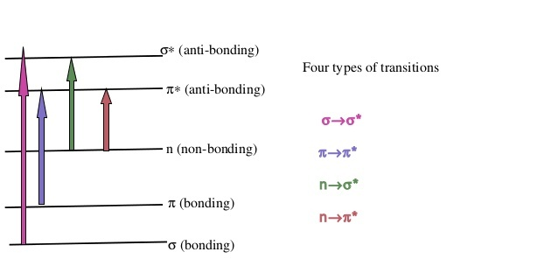
n- π *< n-σ*<π-π*<σ-σ*

Slide 8
IR SPECTROSCOPY

Slide 10
Applications of IR and Raman Spectroscopy
Identification of shape of AB₂, AB₃ and AB₄ molecule.
AB₂ type molecule:
The structural information requires whether such molecules are linear or non linear.
If linear whether symmetrical B-A-B or asymmetrical B-B-A
The nature of Raman and IR spectra provide sufficient information regarding structural aspect of molecule.
The presence of PR branch indicates that molecule is linear

Slide 11
It posseses centre of symmetry or not.
It can be decided by the rule of mutual exclusion principle.
CO₂ molecule is linear
It is indicated by the presence of PR branch in IR spectra.
Vibration | Raman | _{IR} | _{Wave no cm}⁻¹
Symmetric stretching | active | Inactive | 1330
Bending | Inactive | Active(PQR) | 667.3
Asymmetric stretching | Inactive | Active(PR) | 2349.3

Slide 12
It is also evident that no vibration is simultaneously Raman and IR active.
The rule of mutual exclusion principle shows that CO₂ molecule has centre of symmetry.
Nitrous oxide N₂O
The presence of PR branch indicates that N₂ O molecule is linear.
wavenumber cm⁻¹ | IR | Raman
589 | Active strong PQR | -
1285 | Active strong PR | Active strong polariosed
2224 | Active strong PR | Active strong depolarised

Slide 13
It does not have centre of symmetry.
Atleast two vibrations are simultaneously IR and Raman active.
The probable structure is:

Slide 14
AB₃ type molecule:
Six fundamental vibrational modes
3 N - 6 = 3 x 4 - 6 = 6.
Some of these are degenerate because of symmetry of molecule.
For symmetric, planar and pyramidal one stretching and one bending mode are doubly degenerate.
For planar AB₃ molecule-
One vibration is Raman active
One vibration is IR active
Two vibrations are both Raman and IR active.
The symmetric bending mode is Raman inactive
Because it causes no change in polarizability of molecule.

Slide 15
Pyramidal AB₃ molecule:
All vibrations are Raman as well as IR active.
They causes change in both dipole moment as well as polarizability of molecule.
NO₃ planar |  | ClO₃ pyramidal
Raman | IR | Raman | IR
690 cm⁻¹ | 680 cm⁻¹ | 450 cm⁻¹ (depolarised) | 434
- | 830 cm⁻¹ | 610 cm⁻¹ (polarised) | 624
1044 cm⁻¹ | - | 940 cm⁻¹ (depolarised) | 950
1355 cm⁻¹ | 1350 cm⁻¹ | 982 cm⁻¹ (polarised) | 994

Slide 16
Non symmetric AB₃ molecule
In this case more than four frequencies/vibrations have been observed
ClF₃ has a non symmetric AB₃ structure.
It show six strong absorption in IR spectrum.
Some of these also appear simultaneously in Raman spectra.
Thus the molecule is neither planar nor pyramidal.
It has T shaped structure.

Slide 17
NMR Spectroscopy
Nucleus with odd atomic number or an odd mass number has a nuclear spin
It can be observed by NMR spectrum.
For example ¹H, ¹³C, ¹⁵N, ¹⁹F, ³¹P.
It can be studied by NMR.
There are two spin state
Alpha spin state I = +1/2
Beta spin state I = -1/2
β spin state has higher energy.

