Slide 1
Resarch Methodology
M.Com 3rd Semester

Slide 2
SAMPLING METHODS
Dr.Vandana Pandey Associate Professor Department of Commerce HCPG COLLEGE VARANASI

Slide 3
LEARNING OBJECTIVES
Learn the reasons for sampling
Develop an understanding about different sampling methods
Distinguish between probability & non probability sampling
Discuss the relative advantages & disadvantages of each sampling methods

Slide 4
What is research?
“Scientific research is systematic, controlled, empirical, and critical investigation of natural phenomena guided by theory and hypotheses about the presumed relations among such phenomena.”
– Kerlinger, 1986
Research is an organized and systematic way of finding answers to questions

Slide 5
Important Components of Empirical Research
Problem statement, research questions, purposes, benefits
Theory, assumptions, background literature
Variables and hypotheses
Operational definitions and measurement
Research design and methodology
Instrumentation, sampling
Data analysis
Conclusions, interpretations, recommendations

Slide 6
SAMPLING
A sample is “a smaller (but hopefully representative) collection of units from a population used to determine truths about that population” (Field, 2005)
Why sample?
Resources (time, money) and workload
Gives results with known accuracy that can be calculated mathematically
The sampling frame is the list from which the potential respondents are drawn
Registrar’s office
Class rosters
Must assess sampling frame errors
5

Slide 7
SAMPLING……
What is your population of interest?
To whom do you want to generalize your results?
All doctors
School children
Indians
Women aged 15-45 years
Other
Can you sample the entire population?

Slide 8
SAMPLING…….
3 factors that influence sample representative- ness
Sampling procedure
Sample size
Participation (response)
When might you sample the entire population?
When your population is very small
When you have extensive resources
When you don’t expect a very high response

Slide 9
8
SAMPLING BREAKDOWN

Slide 10
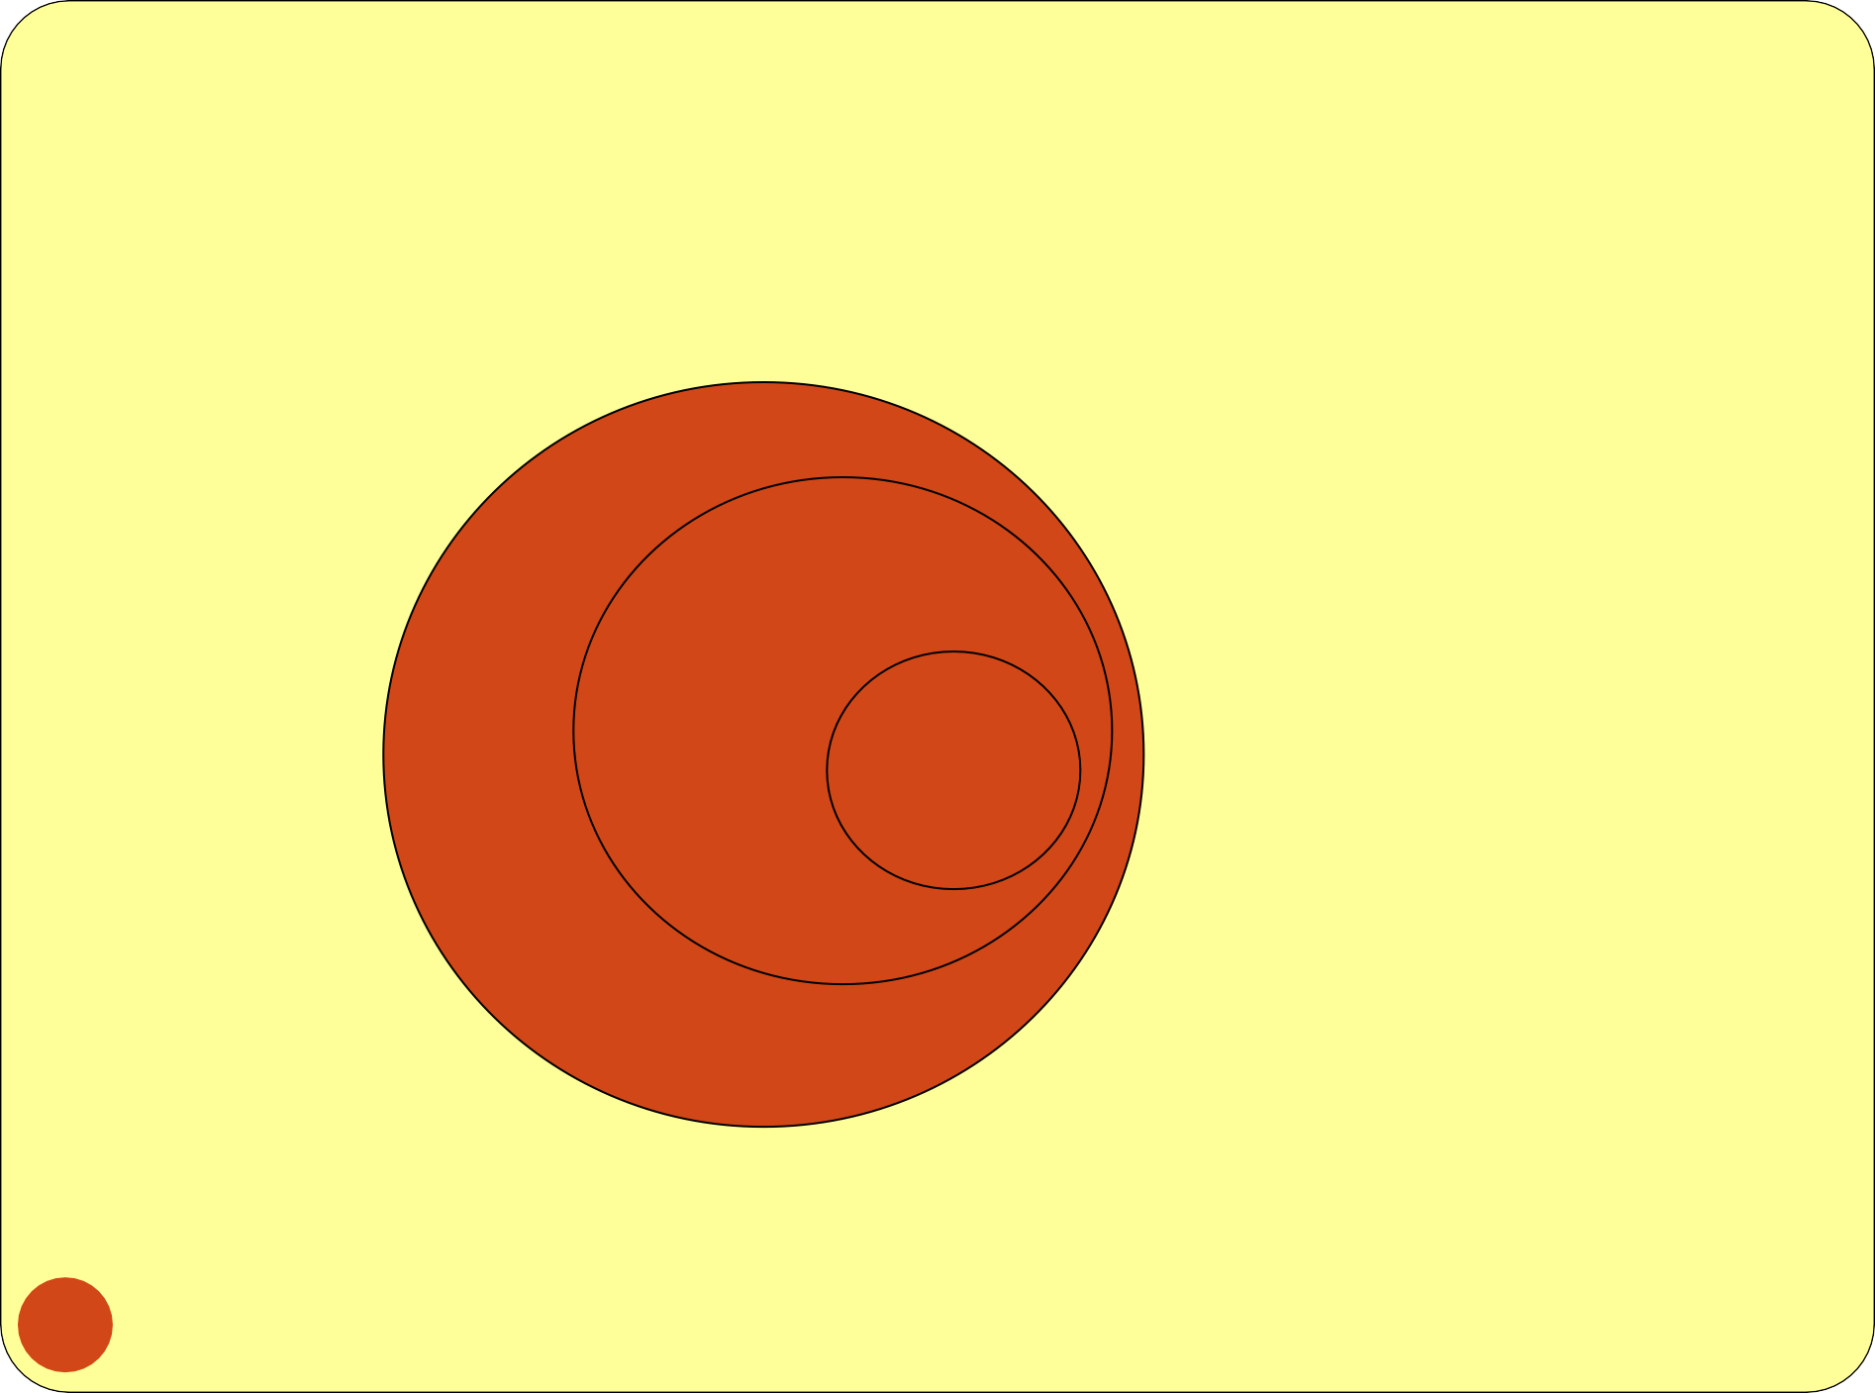
SAMPLING…….
STUDY POPULATION
SAMPLE
TARGET POPULATION

Slide 11
Types of Samples
Probability (Random) Samples
Simple random sample
Systematic random sample
Stratified random sample
Multistage sample
Multiphase sample
Cluster sample
Non-Probability Samples
Convenience sample
Purposive sample
Quota

Slide 12
Process
The sampling process comprises several stages:
Defining the population of concern
Specifying a sampling frame, a set of items or events possible to measure
Specifying a sampling method for selecting items or events from the frame
Determining the sample size
Implementing the sampling plan
Sampling and data collecting
Reviewing the sampling process

Slide 13
Population definition
A population can be defined as including all people or items with the characteristic one wishes to understand.
Because there is very rarely enough time or money to gather information from everyone or everything in a population, the goal becomes finding a representative sample (or subset) of that population.

Slide 14
Population definition…….
Note also that the population from which the sample is drawn may not be the same as the population about which we actually want information. Often there is large but not complete overlap between these two groups due to frame issues etc .
Sometimes they may be entirely separate - for instance, we might study rats in order to get a better understanding of human health, or we might study records from people born in 2008 in order to make predictions about people born in 2009.

Slide 15
SAMPLING FRAME
In the most straightforward case, such as the sentencing of a batch of material from production (acceptance sampling by lots), it is possible to identify and measure every single item in the population and to include any one of them in our sample. However, in the more general case this is not possible. There is no way to identify all rats in the set of all rats. Where voting is not compulsory, there is no way to identify which people will actually vote at a forthcoming election (in advance of the election)
As a remedy, we seek a sampling frame which has the property that we can identify every single element and include any in our sample .
The sampling frame must be representative of the population

Slide 16
PROBABILITY SAMPLING
A probability sampling scheme is one in which every unit in the population has a chance (greater than zero) of being selected in the sample, and this probability can be accurately determined.
. When every element in the population does have the same probability of selection, this is known as an 'equal probability of selection' (EPS) design. Such designs are also referred to as 'self-weighting' because all sampled units are given the same weight.

Slide 17
PROBABILITY SAMPLING…….
Probability sampling includes:
Simple Random Sampling,
Systematic Sampling,
Stratified Random Sampling,
Cluster Sampling
Multistage Sampling.
Multiphase sampling

Slide 18
NON PROBABILITY SAMPLING
Any sampling method where some elements of population have no chance of selection (these are sometimes referred to as 'out of coverage'/'undercovered'), or where the probability of selection can't be accurately determined. It involves the selection of elements based
on assumptions regarding the population of interest, which forms the criteria for selection. Hence, because the selection of elements is nonrandom, nonprobability sampling not allows the estimation of sampling errors..
Example: We visit every household in a given street, and
interview the first person to answer the door. In any
household with more than one occupant, this is a
nonprobability sample, because some people are more
likely to answer the door (e.g. an unemployed person who spends most of their time at home is more likely to answer than an employed housemate who might be at work
when the interviewer calls) and it's not practical to calculate these probabilities.

Slide 19
NONPROBABILITY
SAMPLING…….
Nonprobability Sampling includes: Accidental Sampling, Quota Sampling and Purposive Sampling. In addition, nonresponse effects may turn any probability design into a nonprobability design if the characteristics of nonresponse are not well understood, since nonresponse effectively modifies each element's probability of being sampled.

Slide 20
SIMPLE RANDOM SAMPLING
Applicable when population is small, homogeneous & readily available
All subsets of the frame are given an equal probability. Each element of the frame thus has an equal probability of selection.
It provides for greatest number of possible samples. This is done by assigning a number to each unit in the sampling frame.
A table of random number or lottery system is used to determine which units are to be selected.

Slide 21
SIMPLE RANDOM SAMPLING……..
Estimates are easy to calculate.
Simple random sampling is always an EPS design, but not all
EPS designs are simple random sampling.
Disadvantages
If sampling frame large, this method impracticable.
Minority subgroups of interest in population may not be
present in sample in sufficient numbers for study.

Slide 22
REPLACEMENT OF SELECTED UNITS
Sampling schemes may be without replacement ('WOR' - no element can be selected more than once in the same sample) or with replacement ('WR' - an element may appear multiple times in the one sample).
For example, if we catch fish, measure them, and immediately return them to the water before continuing with the sample, this is a WR design, because we might end up catching and measuring the same fish more than once. However, if we do not return the fish to the water (e.g. if we eat the fish), this becomes a WOR design.

Slide 23
SYSTEMATIC SAMPLING
Systematic sampling relies on arranging the target population according to some ordering scheme and then
selecting elements at regular intervals through that ordered list.
Systematic sampling involves a random start and then proceeds with the selection of every kth element from then onwards. In this case, k=(population size/sample size).
It is important that the starting point is not automatically the first in the list, but is instead randomly chosen from within the first to the kth element in the list.
A simple example would be to select every 10th name
from the telephone directory (an 'every 10th' sample, also referred to as 'sampling with a skip of 10').

Slide 24
SYSTEMATIC SAMPLING……
As described above, systematic sampling is an EPS method, because all elements have the same probability of selection (in the example given, one in ten). It is not 'simple random sampling' because different subsets of the same size have different selection probabilities - e.g. the set {4,14,24,...,994} has a one-in-ten probability of selection, but the set {4,13,24,34,...} has zero probability of selection.

Slide 25
SYSTEMATIC SAMPLING……
ADVANTAGES:
Sample easy to select
Suitable sampling frame can be identified easily
Sample evenly spread over entire reference population
DISADVANTAGES:
Sample may be biased if hidden periodicity in population
coincides with that of selection.
Difficult to assess precision of estimate from one survey.

Slide 26
STRATIFIED SAMPLING
Where population embraces a number of distinct categories, the frame can be organized into separate "strata." Each stratum is then sampled as an independent sub-population, out of which individual elements can be randomly selected.
Every unit in a stratum has same chance of being selected.
Using same sampling fraction for all strata ensures proportionate representation in the sample.
Adequate representation of minority subgroups of interest can be ensured by stratification & varying sampling fraction between strata as required.

Slide 27
STRATIFIED SAMPLING……
Finally, since each stratum is treated as an
independent population, different sampling approaches can be applied to different strata.
Drawbacks to using stratified sampling.
First, sampling frame of entire population has to be prepared separately for each stratum
Second, when examining multiple criteria, stratifying variables may be related to some, but
not to others, further complicating the design, and potentially reducing the utility of the strata.
Finally, in some cases (such as designs with a large number of strata, or those with a specified
minimum sample size per group), stratified
sampling can potentially require a larger sample than would other methods

Slide 28
STRATIFIED SAMPLING…….
Draw a sample from each stratum

Slide 29
POSTSTRATIFICATION
Stratification is sometimes introduced after the
sampling phase in a process called "poststratification“.
This approach is typically implemented due to a lack of prior knowledge of an appropriate stratifying variable or when the experimenter lacks the necessary information to create a stratifying variable during the sampling phase. Although the method is susceptible to the pitfalls of post hoc approaches, it can provide several benefits in the right situation. Implementation usually follows a simple random sample. In addition to allowing for stratification on an ancillary variable, poststratification can be used to implement weighting, which can improve the precision of a sample's
²e⁸ stimates.

Slide 30
OVERSAMPLING
Choice-based sampling is one of the stratified sampling strategies. In this, data are
stratified on the target and a sample is taken
from each strata so that the rare target class will be more represented in the sample. The model is then built on this biased sample. The
effects of the input variables on the target
are often estimated with more precision with
the choice-based sample even when a smaller overall sample size is taken, compared to a
random sample. The results usually must be adjusted to correct for the oversampling.

Slide 31
CLUSTER SAMPLING
Cluster sampling is an example of 'two-stage sampling' .
First stage a sample of areas is chosen;
Second stage a sample of respondents within
those areas is selected.
Population divided into clusters of homogeneous units, usually based on geographical contiguity.
Sampling units are groups rather than individuals.
A sample of such clusters is then selected.
All units from the selected clusters are studied.

Slide 32
CLUSTER SAMPLING…….
Advantages :
Cuts down on the cost of preparing a sampling frame.
This can reduce travel and other administrative costs.
Disadvantages: sampling error is higher for a simple random sample of same size.
Often used to evaluate vaccination coverage in
EPI

Slide 33
CLUSTER SAMPLING…….
Identification of clusters
List all cities, towns, villages & wards of cities with their population falling in target area under study.
Calculate cumulative population & divide by 30, this gives sampling interval.
Select a random no. less than or equal to sampling interval having same no. of digits. This forms 1st cluster.
Random no.+ sampling interval = population of 2nd cluster.
Second cluster + sampling interval = 4th cluster.
Last or 30th cluster = 29th cluster + sampling interval

Slide 34
CLUSTER SAMPLING…….
Two types of cluster sampling methods.
One-stage sampling. All of the elements within selected clusters are included in the sample.
Two-stage sampling. A subset of elements within selected clusters are randomly selected for inclusion in the sample.

Slide 35
CLUSTER SAMPLING…….
• | Freq | c f | cluster
• | I 2000 | 2000 | 1
• | II 3000 | 5000 | 2
XVI
3500 52500 17
XVII | 4000 | 56500 | 18,19
XVIII | 4500 | 61000 | 20
XIX | 4000 | 65000 | 21,22
XX | 4000 | 69000 | 23
III 1500 |  | 6500
IV 4000 |  | 10500 | 3
V 5000 |  | 15500 | 4, 5
• | VI 2500 | 18000 | 6
• | XXI | 2000 | 71000 | 24
• | XXII | 2000 | 73000
• | XXIII | 3000 | 76000 | 25
VII 2000 | 20000 | 7
VIII 3000 | 23000 | 8
IX |  | 3500 | 26500 | 9 | XXIV |  | 3000 | 79000 | 26
X |  | 4500 | 31000 | 10 | XXV |  | 5000 | 84000 | 27,28
XI |  | 4000 | 35000 | 11, 12 | XXVI |  | 2000 | 86000 | 29
• | XII 4000 |  | 39000 | 13 | • | XXVII 1000 87000
• • • | XIII 3500 XIV 2000 XV 3000 |  | 44000 46000 49000 | 14,15 16 | • • • | 1000 88000 1000 89000 30 1000 90000
 |  |  |  |  | • | 90000/30 = 3000 sampling interval

Slide 36
Difference Between Strata and Clusters
Although strata and clusters are both non- overlapping subsets of the population, they differ in several ways.
All strata are represented in the sample; but only a subset of clusters are in the sample.
With stratified sampling, the best survey results occur when elements within strata are internally homogeneous. However, with cluster sampling, the best results occur when elements within clusters are internally heterogeneous

Slide 37
MULTISTAGE SAMPLING
Complex form of cluster sampling in which two or more levels of
units are embedded one in the other.
First stage, random number of districts chosen in all states.
Followed by random number of talukas, villages.
Then third stage units will be houses.
All ultimate units (houses, for instance) selected at last step are
surveyed.

Slide 38
MULTISTAGE SAMPLING……..
This technique, is essentially the process of taking random
samples of preceding random samples.
Not as effective as true random sampling, but probably solves more of the problems inherent to random sampling.
An effective strategy because it banks on multiple randomizations. As such, extremely useful.
Multistage sampling used frequently when a complete list of all members of the population not exists and is inappropriate.
Moreover, by avoiding the use of all sample units in all selected clusters, multistage sampling avoids the large, and perhaps unnecessary, costs associated with traditional cluster sampling.

Slide 39
MULTI PHASE SAMPLING
Part of the information collected from whole sample & part from
subsample.
In Tb survey MT in all cases – Phase I
X –Ray chest in MT +ve cases – Phase II
Sputum examination in X – Ray +ve cases - Phase III
Survey by such procedure is less costly, less laborious & more purposeful

Slide 40
MATCHED RANDOM SAMPLING
A method of assigning participants to groups in which
pairs of participants are first matched on some characteristic and then individually assigned randomly to groups.
The Procedure for Matched random sampling can be briefed with the following contexts,
Two samples in which the members are clearly paired, or are matched explicitly by the researcher. For example, IQ measurements or pairs of identical twins.
Those samples in which the same attribute, or variable, is measured twice on each subject, under different circumstances. Commonly called repeated measures.
Examples include the times of a group of athletes for
1500m before and after a week of special training; the milk yields of cows before and after being fed a particular diet.

Slide 41
QUOTA SAMPLING
The population is first segmented into mutually exclusive sub-groups, just as in stratified sampling.
Then judgment used to select subjects or units from
each segment based on a specified proportion.
For example, an interviewer may be told to sample 200 females and 300 males between the age of 45 and 60.
It is this second step which makes the technique one of
non-probability sampling.
In quota sampling the selection of the sample is non- random.
For example interviewers might be tempted to interview those who look most helpful. The problem is that these
samples may be biased because not everyone gets a
chance of selection. This random element is its greatest weakness and quota versus probability has been a matter of controversy for many years

Slide 42
CONVENIENCE SAMPLING
Sometimes known as grab or opportunity sampling or accidental or haphazard sampling.
A type of nonprobability sampling which involves the sample being drawn from that part of the population which is close to hand. That is, readily available and convenient.
The researcher using such a sample cannot scientifically make generalizations about the total population from this sample because it would not be representative enough.
For example, if the interviewer was to conduct a survey at a
shopping center early in the morning on a given day, the people that he/she could interview would be limited to those given there at that given time, which would not represent the views of other
members of society in such an area, if the survey was to be conducted at different times of day and several times per week.
This type of sampling is most useful for pilot testing.
In social science research, snowball sampling is a similar technique,
where existing study subjects are used to recruit more subjects into the sample.

Slide 43
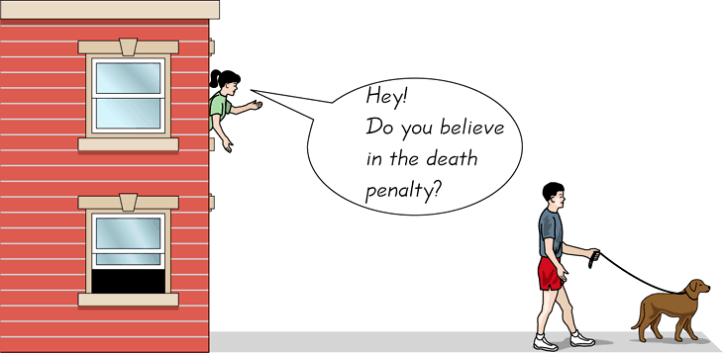
CONVENIENCE SAMPLING…….
Use results that are easy to get
42
42

Slide 44
Judgmental sampling or Purposive sampling
- The researcher chooses the sample based on who they think would be appropriate for the study. This is used primarily when there is a limited number of people that have expertise in the area being researched

Slide 45
PANEL SAMPLING
Method of first selecting a group of participants through a random sampling method and then asking that group for the same information again several times over a period of time.
Therefore, each participant is given same survey or interview at two or more time points; each period of data collection called a "wave".
This sampling methodology often chosen for large scale or nation- wide studies in order to gauge changes in the population with
regard to any number of variables from chronic illness to job
stress to weekly food expenditures.
Panel sampling can also be used to inform researchers about
within-person health changes due to age or help explain changes in continuous dependent variables such as spousal interaction.
There have been several proposed methods of analyzing panel
sample data, including growth curves.

Slide 46
Questions???

Slide 47
What sampling method u recommend?
Determining proportion of undernourished five year olds in a village.
Investigating nutritional status of preschool children.
Selecting maternity records for the study of previous abortions or duration of postnatal stay.
In estimation of immunization coverage in a province, data on seven children aged 12-23 months in 30 clusters are used to determine proportion of fully immunized children in the province.
Give reasons why cluster sampling is used in this survey.

Slide 48
Probability proportional to size sampling
In some cases the sample designer has access to an "auxiliary variable" or "size measure", believed to be correlated to the variable of interest, for each element in the population.This data can be used to improve accuracy in sample design. One option is to use the auxiliary variable as a basis for stratification, as discussed above.
Another option is probability-proportional-to-size ('PPS') sampling, in which the selection probability for each element is set to be proportional to its size measure, up to a maximum of 1. In a simple PPS design, these selection probabilities can then be used as the basis for Poisson sampling. However, this has the drawbacks of variable sample size, and different portions of the population may still be over- or under-represented due to chance variation in selections.To address this problem, PPS may be combined with a systematic approach.

Slide 49
Contd.
Example: Suppose we have six schools with populations of 150, 180, 200, 220, 260, and 490 students respectively (total 1500 students), and we want to use student population as the basis for a PPS sample of size three.To do this, we could allocate the first school numbers 1 to 150, the second school 151 to
330 (= 150 + 180), the third school 331 to 530, and so on to the last school (1011 to 1500).We then generate a random start between 1 and 500 (equal to 1500/3) and count through the school populations by multiples of 500. If our random start was 137, we would select the schools which have been allocated numbers 137, 637, and 1137, i.e. the first, fourth, and sixth schools.
The PPS approach can improve accuracy for a given sample size by concentrating sample on large elements that have the greatest impact on population estimates. PPS sampling is commonly used for surveys of businesses, where element size varies greatly and auxiliary information is often available - for instance, a survey attempting to measure the number of guest-nights spent in hotels might use each hotel's number of rooms as an auxiliary variable. In some cases, an older measurement of the variable of interest can be used as an auxiliary variable when attempting to produce more current estimates.
48

Slide 50
Event sampling
Event Sampling Methodology (ESM) is a new form of sampling method that allows researchers to study ongoing experiences and events that vary across and within days in its naturally-occurring environment. Because of the frequent sampling of events inherent in ESM, it enables researchers to measure the typology of activity and detect the temporal and dynamic fluctuations of work experiences. Popularity of ESM as a new form of research design increased over the recent years because it addresses the shortcomings of cross-sectional research, where once unable to, researchers can now detect intra-individual variances across time. In ESM, participants are asked to record their experiences and perceptions in a paper or electronic diary.
There are three types of ESM:# Signal contingent – random beeping notifies participants to record data.The advantage of this type of ESM is minimization of recall bias.
Event contingent – records data when certain events occur

Slide 51
Contd.
Event contingent – records data when certain events occur
Interval contingent – records data according to the passing of a
certain period of time
ESM has several disadvantages. One of the disadvantages of ESM is it can sometimes be perceived as invasive and intrusive by participants. ESM also leads to possible self-selection bias. It may be that only certain types of individuals are willing to participate in this type of study creating a non-random sample. Another concern is related to participant cooperation. Participants may not be actually fill out their diaries at the specified times. Furthermore, ESM may substantively change the phenomenon being studied. Reactivity or priming effects may occur, such that repeated measurement may cause changes in the participants' experiences.This method of sampling data is also highly vulnerable to common method variance.[6]

Slide 52
contd.
Further, it is important to think about whether or not an appropriate dependent variable is being used in an ESM design. For example, it might be logical to use ESM in order to answer research questions which involve dependent variables with a great deal of variation throughout the day.Thus, variables such as change in mood, change in stress level, or the immediate impact of particular events may be best studied using ESM methodology. However, it is not likely that utilizing ESM will yield meaningful predictions when measuring someone performing a repetitive task throughout the day or when dependent variables are long-term in nature (coronary heart problems).

Slide 53
THANKYOU

