Slide 1
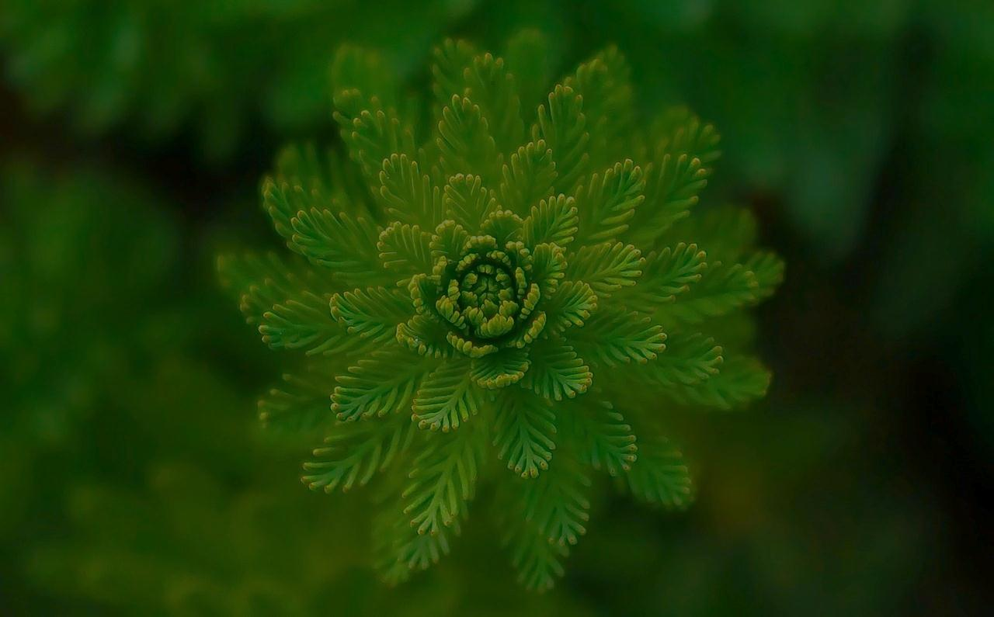
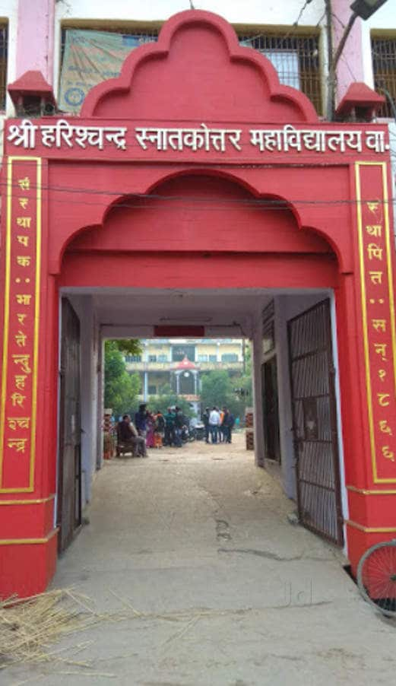
Root-Stem Transition
Dr. Dheeraj Kumar Singh
Assistant Professor
Department of Botany
Harish Chandra PG College
Varanasi—221001

Slide 2
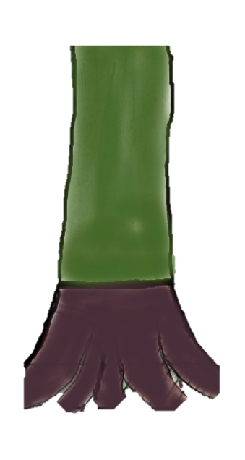
Learning objectives:
Understand Root-Stem Transition in Plants
Different types of Root-Stem Transitions
Fumaria Type
Cucurbita Type
Lathyrus Type
Annemarrhena Type

Slide 3
Root-Stem Transition
Root and stem are continuous but the arrangement of vascular bundles is different
In Stem: Conjoint and Collateral
In Root: Radial
At a specific portion known as ‘transition region’ there will be transition between
these types

Slide 4
Root-Stem Transition
Following ‘all or some’ activities may takes place during transition
Forking- Splitting in vascular bundle (VB)
Rotation- 180⁰ change in orientation of VB
Fusion- Fusion of two or more VB
Multiplication- Increase in number of VB

Slide 9
Thank You

