Slide 1
PROJECTIVE MODULE
DR. Sangita Srivastava
Associate Professor,
Department of Mathematics,
HCPG College, Varanasi.

Slide 8
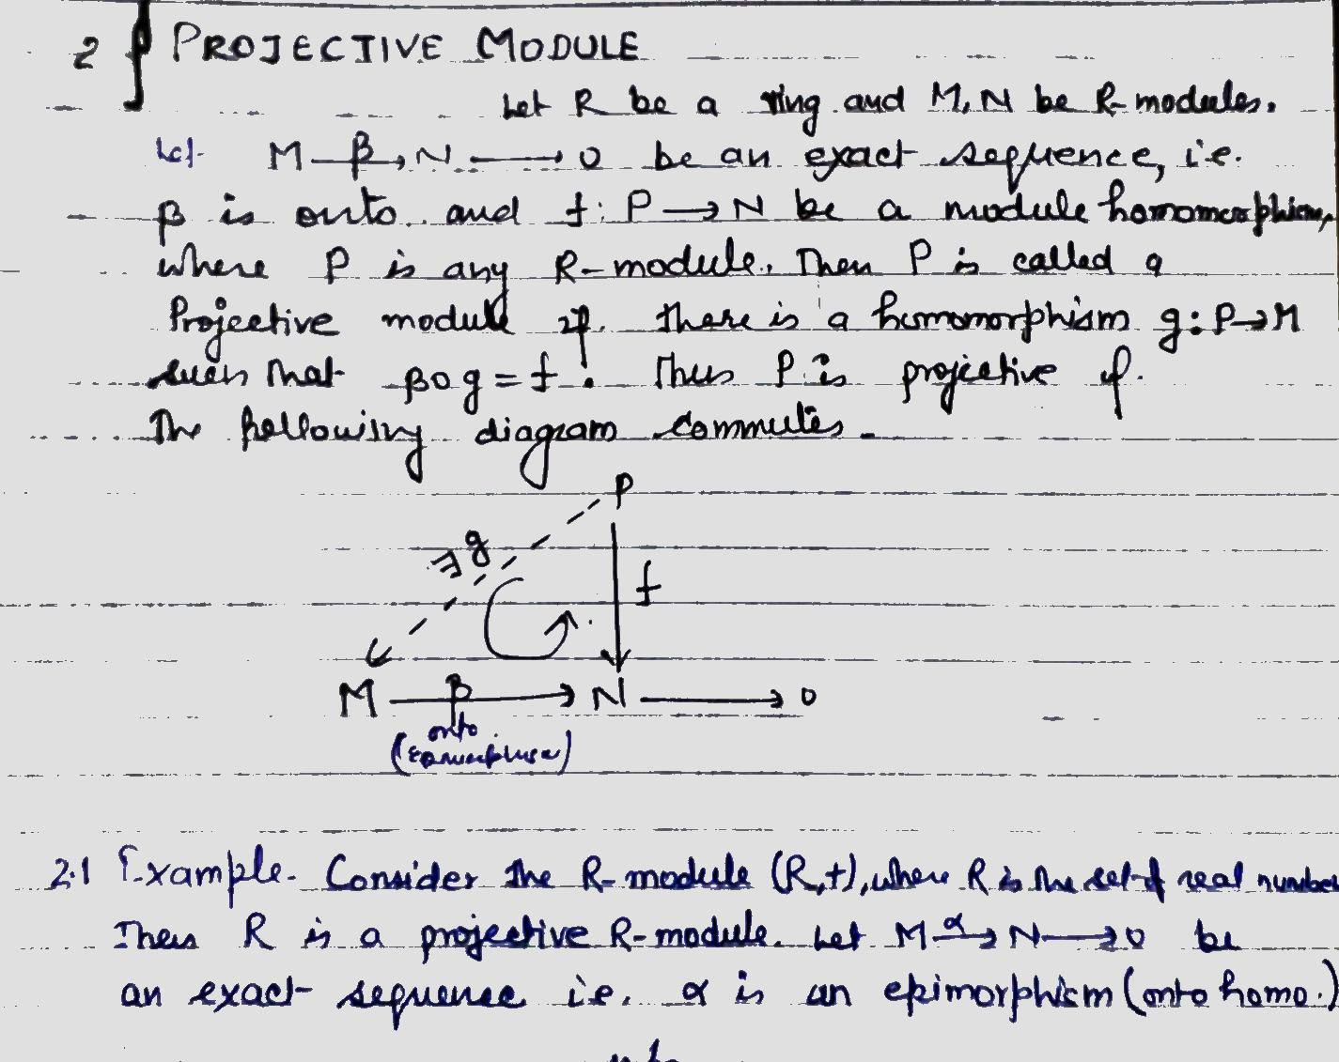

Slide 9
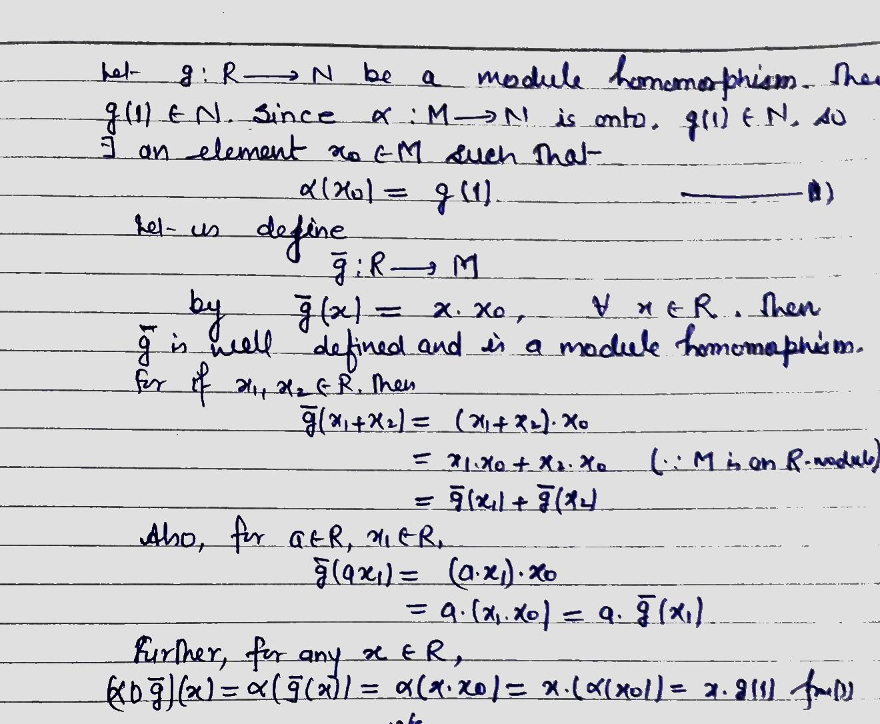

Slide 14
