Slide 1
Effect of group on behaviour
Topic related to Ma4th sem
Paper1st (unit-4) applied social psychology
dr.ashutosh Dwivedi
Assistant professor
H.c.p.g. varanasi

Slide 2
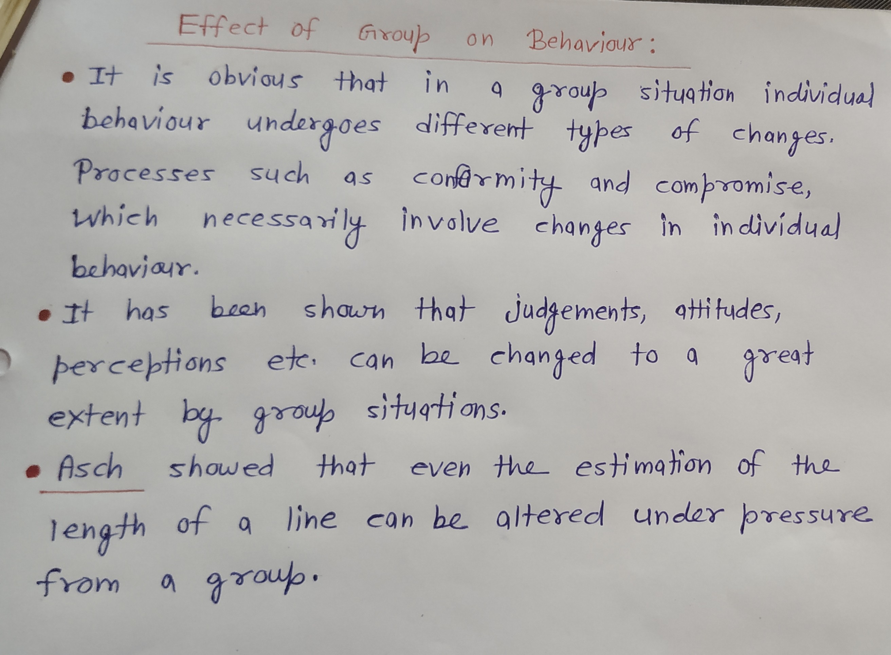

Slide 12
Thank you

