Slide 1

FUNDAMENTALS OF PLASMA PHYSICS
A.K. DWIVEDI

Slide 2
OCCURRENCE OF PLASMAS IN NATURE
It has often been said that 99% of the matter in the universe is in the plasma state; that is, in the form of an electrified gas with the atoms dissociated into positive ions and negative electrons. This estimate may not be very accurate, but it is certainly a reasonable one in view of the fact that stellar interiors and atmospheres, gaseous nebulae, and much of the interstellar hydrogen are plasmas. In our own neighborhood, as soon as one leaves the earth's atmosphere, one encounters the plasma comprising the Van Allen radiation belts and the solar wind. It would seem that we live in the I% of the universe in which plasmas do not occur naturally.
The reason for this can be seen from the Saha equation, which tells us the amount of ionization to be expected in a gas in thermal equilibrium:
Here n_{i} and n_{n} are, respectively, the density (number per m³) of ionized atoms and of neutral atoms, T is the gas temperature in °K, k is Boltzmann's constant, and U_{i} is the ionization energy of the gas-that is the number ergs required to remove the outermost electron from an atom.

Slide 3

=
As the temperature is raised, the degree of ionization remains low until U_{i} is only a few times KT. Then n_{i}/n_{n} rises abruptly, and the gas is in a plasma state. Further increase in temperature makes n_{n}. less than n_{i}, and the plasma eventually becomes fully ionized. This is the reason plasmas exist in astronomical bodies with temperatures of millions of degrees, but not on the earth. Life could not easily coexist with a plasma-at least, plasma of the type we are talking about. The natural occurrence of plasmas at high temperatures is the reason for the designa­ tion "the fourth state of matter."
DEFINITION OF PLASMA
Any ionized gas cannot be called a plasma, of course; there is always some small degree of ionization in any gas. A useful definition is as follows:
A plasma is a quasineutral gas of charged and neutral particles which exhibits collective behavior.
“quasineutrallity” means that the plasma is "quasineutral"; that is, neutral enough when n_{i} =n_{e} =n, where n is a common density called the plasma density, but not so neutral that all the interesting electromagnetic forces vanish.
"collective behavior"
Consider the forces acting on a molecule of, say, ordinary air. Since the molecule is neutral, there is no net electromagnetic force on it, and the force of gravity is negligible. The molecule moves undisturbed until it makes a collision with another molecule, and these collisions control the particle's motion. A macroscopic force applied to a neutral gas, such as from a loudspeaker generating sound waves, is transmitted to the individual atoms by collisions. The situation is totally different in a plasma, which has charged particles. As these charges move around, they can generate local concentrations of positive or negative charge, which give rise to electric fields. Motion of charges also generates currents, and hence magnetic fields. These fields affect the motion of other charged particles far away.
In fact, the most interesting results concern so-called "collisionless" plasmas, in which the long-range electromagnetic forces are so much larger than the forces due to ordinary local collisions that the latter can be neglected altogether. By "collective behavior" we mean motions that depend not only on local conditions but on the state of the plasma in remote regions as well.
-₋
-
-
-
-₋
-₋
-
₋-

Slide 4


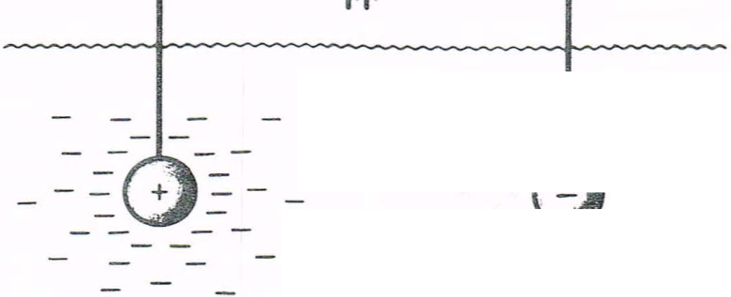
PLASMA
++
+
₊+
+
+ ₊
₊++
₊ +
+
₊ +
+
+
+ ₊+ +₊ +
+
+
+
FIGURE 1
Debye shielding.
DEBYE SHIELDING
A fundamental characteristic of the behavior of a plasma is its ability to shield out electric potentials that are applied to it. Suppose we tried to put an electric field inside a plasma by inserting two charged balls connected to a battery (Fig. 1). The balls would attract particles of the opposite charge, and almost immediately a cloud of ions would surround the negative ball and a cloud of electrons would surround the positive ball. (We assume that a layer of dielectric keeps the plasma from actually recombining on the surface, or that the battery is large enough to maintain the potential in spite of this.) If the plasma were cold and there were no thermal motions, there would be just as many charges in the cloud as in the ball; the shielding would be perfect, and no electric field would be present in the body of the plasma outside of the clouds. On the other hand, if the temperature is finite, those particles that are at the edge of the cloud, where the electric field is weak, have enough thermal energy to escape from the electrostatic potential well.
Imagine that the potential ¢ on the plane x= 0 is held at a value ¢₀ by a perfectly transparent grid (Fig. 2). We wish to compute ¢(x). For simplicity, we assume that the ion-electron mass ratio M/m is infinite, so that the ions do not move but form a uniform background of positive charge. To be more precise, we can say that M/m is large enough that the inertia of the ions prevents them from moving significantly on the time scale of the experiment.

Slide 5

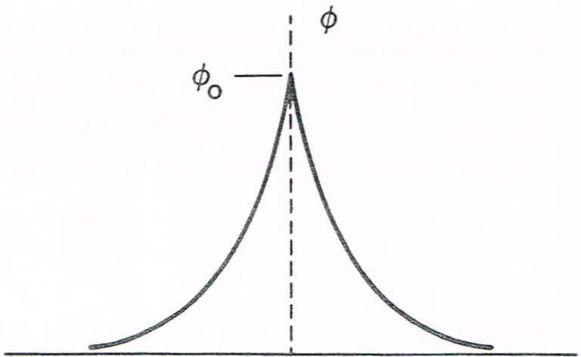



0
X
FIGURE 2
Potential distribution near a grid in a plasma.
Poisson's equation in one dimension is
(Z=1)
[1]
If the density far away is n∞, we have
n_{i} = n∞
But, n_{e} =n∞ exp (eø/ KT_{e})
Substituting for n_{i} and n_{e} in Eq. [ 1], we have
In the region where (eø/ KT_{e}) «1, we can expand the exponential in a Taylor series:
[2]
No simplification is possible for the region near the grid, where (eø/ KT_{e}) may be large. Fortunately, this region does not contribute much to the thickness of the cloud (called a sheath), because the potential falls very rapidly there. Keeping only the linear terms in Eq. [2], we have

Slide 6
Defining,
where n stands for n∞, we can write the solution of Eq. [3] as
ø = ø₀ exp (-|x|/ʎ_{D}) [4]
The quantity ʎ_{D}, called the Debye length, is a measure of the shielding distance or thickness of the sheath.
Note that as the density is increased, ʎ_{D} decreases, as one would expect, since each layer of plasma contains more electrons. Furthermore, ʎ_{D} increases with increasing KT_{e}. Without thermal agitation, the charge cloud would collapse to an infinitely thin layer. Finally, it is the electron temperature which is used in the definition of ʎ_{D} because the electrons, being more mobile than the ions, generally do the shielding by moving so as to create a surplus or deficit of negative charge.
The following are useful forms of Eq. [ 3]:
ʎ_{D}=69 (T/n)^{1/2} m, T in ⁰K
ʎ_{D}=7430 (kT/n)^{1/2} m, kT in eV [5]
If the dimensions L of a system are much larger than ʎ_{D} , then whenever local concentrations of charge arise or external potentials are introduced into the system, these are shielded out in a distance short compared with L, leaving the bulk of the plasma free of large electric potentials or fields.
A criterion for an ionized gas to be a plasma is that it be dense enough that ʎ_{D} is much smaller than L.

Slide 7

THE PLASMA PARAMETER
The picture of Debye shielding that we have given above is valid only if there are enough particles in the charge cloud. Clearly, if there are only one or two particles in the sheath region, Debye shielding would not be a statistically valid concept. Using Eq. [5], we can compute the number N_{D} of particles in a "Debye sphere":
(Tin °K) [6]
In addition to ʎ_{D} « L, "collective behavior" requires
N_{D}>> 1
[7]
CRITERIA FOR PLASMAS
We have given two conditions that an ionized gas must satisfy to be called a plasma. A third condition has to do with collisions. The weakly ionized gas in a jet exhaust, for example, does not qualify as a plasma because the charged particles collide so frequently with neutral atoms that their motion is controlled by ordinary hydrodynamic forces rather than by electromagnetic forces. If ɷis the frequency of typical plasma oscillations and τ is the mean time between collisions with neutral atoms, we require ɷτ >1 for the gas to behave like a plasma rather than a neutral gas.

Slide 8

The three conditions a plasma must satisfy are therefore:
l. ʎ_{D} « L.
2. N_{D}>>1.
3. ꞷτ > 1.
PLASMA OSCILLATIONS
If the electrons in a plasma are displaced from a uniform background of ions, electric fields will be built up in such a direction as to restore the neutrality of the plasma by pulling the electrons back to their original positions. Because of their inertia, the electrons will overshoot and oscillate around their equilibrium positions with a characteristic frequency known as the plasma frequency. This oscillation is so fast that the massive ions do not have time to respond to the oscillating field and may be considered as fixed. In Fig., the open rectangles represent typical elements of the ion fluid, and the rectangles the alternately displaced elements of the electron fluid. The resulting charge bunching causes a spatially periodic E field, which tends to restore the electrons to their neutral positions.
-+ +--+ +-
-+ +--+ +-
-+ +--+ +-
-+ +--+ +-
-+ +--+ +-
-+ +--+ +-
E ←---- --→←--- ---→
Figure: Mechanism of Plasma Oscillations
We shall derive an expression for the plasma frequency ɷ_{p} in simplest case, making the following assumptions: (1) There is no magnetic field; (2) there are no thermal motions (KT = 0); (3) the ions are fixed in space in a uniform distribution; (4) the plasma is infinite in extent; and (5) the electron motions occur only in the x direction. As a consequence of the last assumption, we have
There is, therefore, no fluctuating magnetic field; this is an electrostatic oscillation.

Slide 9
The electron equations of motion and continuity are
The only Maxwell equation we shall need is the one that does not involve B: Poisson's equation. This case is an exception to the general rule that Poisson's equation cannot be used to find E. This is a high-frequency oscillation; electron inertia is important, and the deviation from neutrality is the main effect in this particular case. Consequently, we write
Equation [4] can easily be solved by the procedure of linearization. By this we mean that the amplitude of oscillation is small, and terms containing higher powers of amplitude factors can be neglected. We first separate the dependent variables into two parts: an "equilibrium“ part indicated by a subscript 0, and a "perturbation" part indicated by a subscript I:
The equilibrium quantities express the state of the plasma in the absence of the oscillation. Since we have assumed a uniform neutral plasma at rest before the electrons are displaced, we have
Equation [2] now becomes
The term (v₁• Δ)v₁ is seen to be quadratic in an amplitude quantity, and we shall linearize by neglecting it. The linear theory is valid as long as |v₁| is small enough that such quadratic terms are indeed negligible. Similarly, Eq. [3] becomes

Slide 10
In Poisson's equation [4], we note that n_{i0} = n_{e0} in equilibrium and that n_{i1} = 0 by the assumption of fixed ions, so we have
The oscillating quantities are assumed to behave sinusoidally:
The time derivative ∂/∂t can therefore be replaced by –iꞷ and the gradient Δ by ikx. Equations [7]-[ 9] now become
Eliminating n₁ and E₁, we have
If v ₁ does not vanish, we must have
The plasma frequency is therefore
Numerically, one can use the approximate formula
ꞷ_{p}/2ᴫ = f_{p} = 9√n [14]
This frequency, depending only on the plasma density, is one of the fundamental parameters of a plasma. Because of the smallness of m, the plasma frequency is usually very high. For instance, in a plasma of density n = 10¹⁸ m⁻³, we have
f_{p}=9(10¹⁸)^{1/2}=9x10⁹ sec⁻¹ = 9 GHz [15]

Slide 11

APPLICATIONS OF PLASMA PHYSICS
Plasmas can be characterized by the two parameters n and KT_{e}. Plasma applications cover an extremely wide range of n and KT_{e}: nvaries over 28 orders of magnitude from 10⁶ to 10³⁴ m⁻³, and KT can vary over seven orders from 0. 1 to 10⁶ eV. Some of these applications are discussed very briefly below.
Gas Discharges (Gaseous Electronics)
The earliest work with plasmas was that of Langmuir, Tonks, and their collaborators in the 1920's. This research was inspired by the need to develop vacuum tubes that could carry large currents, and therefore had to be filled with ionized gases. The research was done with weakly ionized glow discharges and positive columns typically with KT_{e} = 2 eV and 10¹⁴ < n < 10¹⁸ m⁻³. It was here that the shielding phenomenon was discovered; the sheath surrounding an electrode could be seen visually as a dark layer. Gas discharges are encountered nowadays in mercury rectifiers, hydrogen thyratrons, ignitrons, spark gaps, welding arcs, neon and fluorescent lights, and lightning discharges.
Controlled Thermonuclear Fusion
Modern plasma physics had it beginnings around 1952, when it was proposed that the hydrogen bomb fusion reaction be controlled to make a reactor. The principal reactions, which involve deuterium (D) and tritium (T) atoms, are as follows:
D + D ---→ ³He + n + 3.2 MeV
D + D ---→ T + p + 4.0 MeV
D + T ---→ ⁴He + n + 17.6 MeV

Slide 12

The cross sections for these fusion reactions are appreciable only for incident energies above 5 keV. Accelerated beams of deuterons bom­ barding a target will not work, because most of the deuterons will lose their energy by scattering before undergoing a fusion reaction. It is necessary to create a plasma in which the thermal energies are in the 10-keV range. The problem of heating and containing such a plasma is responsible for the rapid growth of the science of plasma physics since 1952. The problem is still unsolved, and most of the active research in plasma physics is directed toward the solution of this problem.
Space Physics
Another important application of plasma physics is in the study of the earth's environment in space. A continuous stream of charged particles, called the solar wind, impinges on the earth's magnetosphere, which shields us from this radiation and is distorted by it in the process. Typical parameters in the solar wind are n=5 X10⁶m⁻³, KT; = 10 eV, KT. =50 eV, B=5 x10⁻⁹ T, and drift velocity 300 km/sec. The ionosphere, extending from an altitude of 50 km to 10 earth radii, is populated by a weakly ionized plasma with density varying with altitude up to n=10¹² m⁻³. The temperature is only 10⁻¹ eV.
Modern Astrophysics
Stellar interiors and atmospheres are hot enough to be in the plasma state. The temperature at the core of the sun, for instance, is estimated to be 2 keV; thermonuclear reactions occurring at this temperature are responsible for the sun's radiation. The solar corona is a tenuous plasma with temperatures up to 200 eV. The interstellar medium contains ion­ ized hydrogen with n =10⁶ m⁻³. Various plasma theories have been used to explain the acceleration of cosmic rays. Although the stars in a galaxy are not charged, they behave like particles in a plasma; and plasma kinetic theory has been used to predict the development of galaxies.

Slide 13
Radio astronomy has uncovered numerous sources of radiation that most likely originate from plasmas. The Crab nebula is a rich source of plasma phenomena because it is known to contain a magnetic field. It also contains a visual pulsar. Current theories of pulsars picture them as rapidly rotating neutron stars with plasmas emitting synchrotron radiation from the surface.
MHD Energy Conversion and Ion Propulsion
Getting back down to earth, we come to two practical applications of plasma physics. Magnetohydrodynamic ( MHD) energy conversion util­ izes a dense plasma jet propelled across a magnetic field to generate electricity. The Lorentz force qv x B, where v is the jet velocity, causes the ions to drift upward and the electrons downward, charging the two electrodes to different potentials. Electrical current can then be drawn from the electrodes without the inefficiency of a heat cycle. The same principle in reverse has been used to develop engines for interplanetary missions.
Solid State Plasmas
The free electrons and holes in semiconductors constitute a plasma exhibiting the same sort of oscillations and instabilities as a gaseous plasma. Plasmas injected into InSb have been particularly useful in studies of these phenomena. Because of the lattice effects, the effective collision frequency is much less than one would expect in a solid with n = 10²⁹ m⁻³. Furthermore, the holes in a semiconductor can have a very low effective mass-as little as 0.01 m_{e} and therefore have high cyclotron frequencies even in moderate magnetic fields.

Slide 14
If one were to calculate N_{D} for a solid state plasma, it would be less than unity because of the low temperature and high density. Quantum mechanical effects (uncertainty principle) , however, give the plasma an effective tem­ perature high enough to make N_{D} respectably large. Certain liquids, such as solutions of sodium in ammonia, have been found to behave like plasmas also.
v
Gas Lasers
The most common method to "pump" a gas laser-that is, to invert the population in the states that give rise to light amplification-is to use a gas discharge. This can be a low-pressure glow discharge for a de laser or a high-pressure avalanche discharge in a pulsed laser. The He-Ne lasers commonly used for alignment and surveying and the Ar and Kr lasers used in light shows are examples of de gas lasers. The powerful C02 laser is finding commercial application as a cutting tool. Molecular lasers make possible studies of the hitherto inaccessible far infrared region of the electromagnetic spectrum. These can be directly excited by an electrical discharge, as in the hydrogen cyanide ( HCN) laser, or can be optically pumped by a C02 laser, as with the methyl fluoride (CH3OH) lasers. Even solid state lasers, such as Nd-glass, depend on a plasma for their operation, since the flash tubes used for pumping contain gas discharge.

Slide 15


