Slide 1
ALGEBRAIC AND GEOMETRIC MULTIPLICITIES
M.Sc. III Semester
Dr Sangita Srivastava.,
Department of Mathematics,
H.C.P.G.College, Varanasi

Slide 2
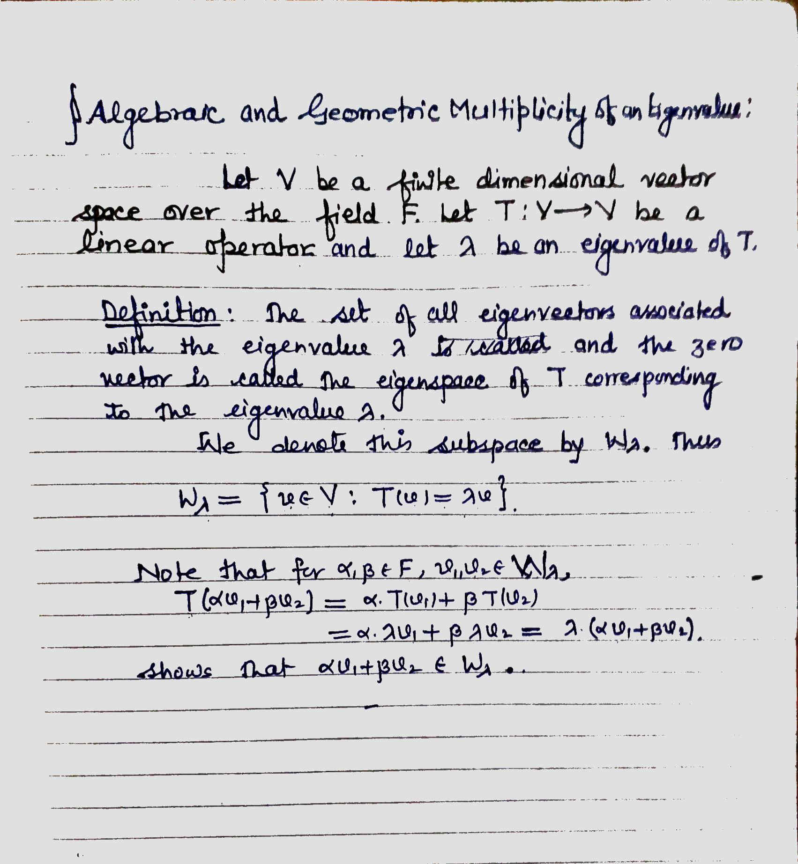

Slide 6
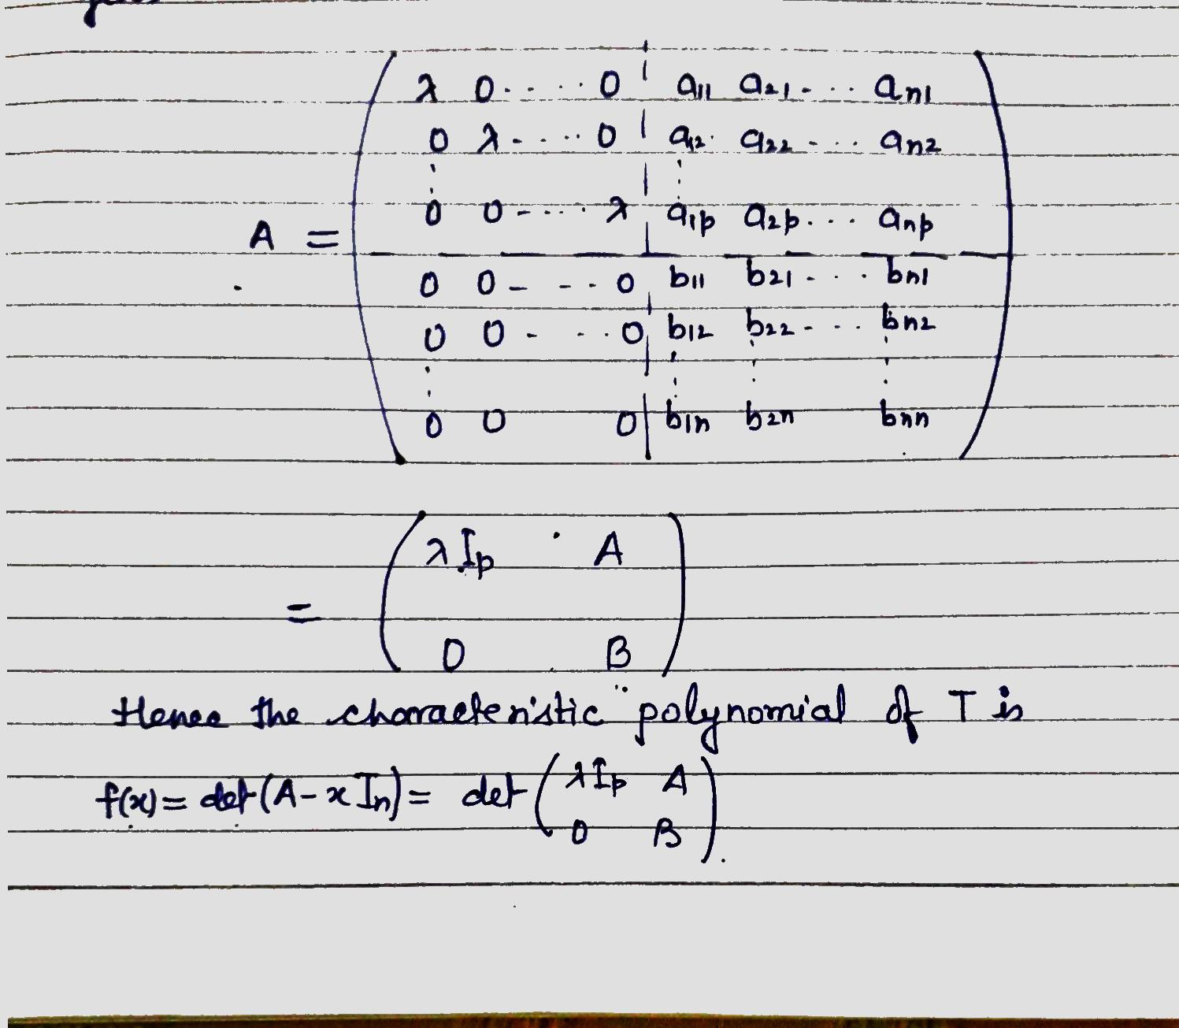

Slide 7
