Slide 1
FUNCTIONAL ANALYSIS
UNIFORM BOUNDNESS THEOREM
OR
UNIFORM BOUNDNESS PRINCIPLE
Dr. SANGITA SRIVASTAVA
Associate Professor
Department of Mathematics
HCPG College.

Slide 4
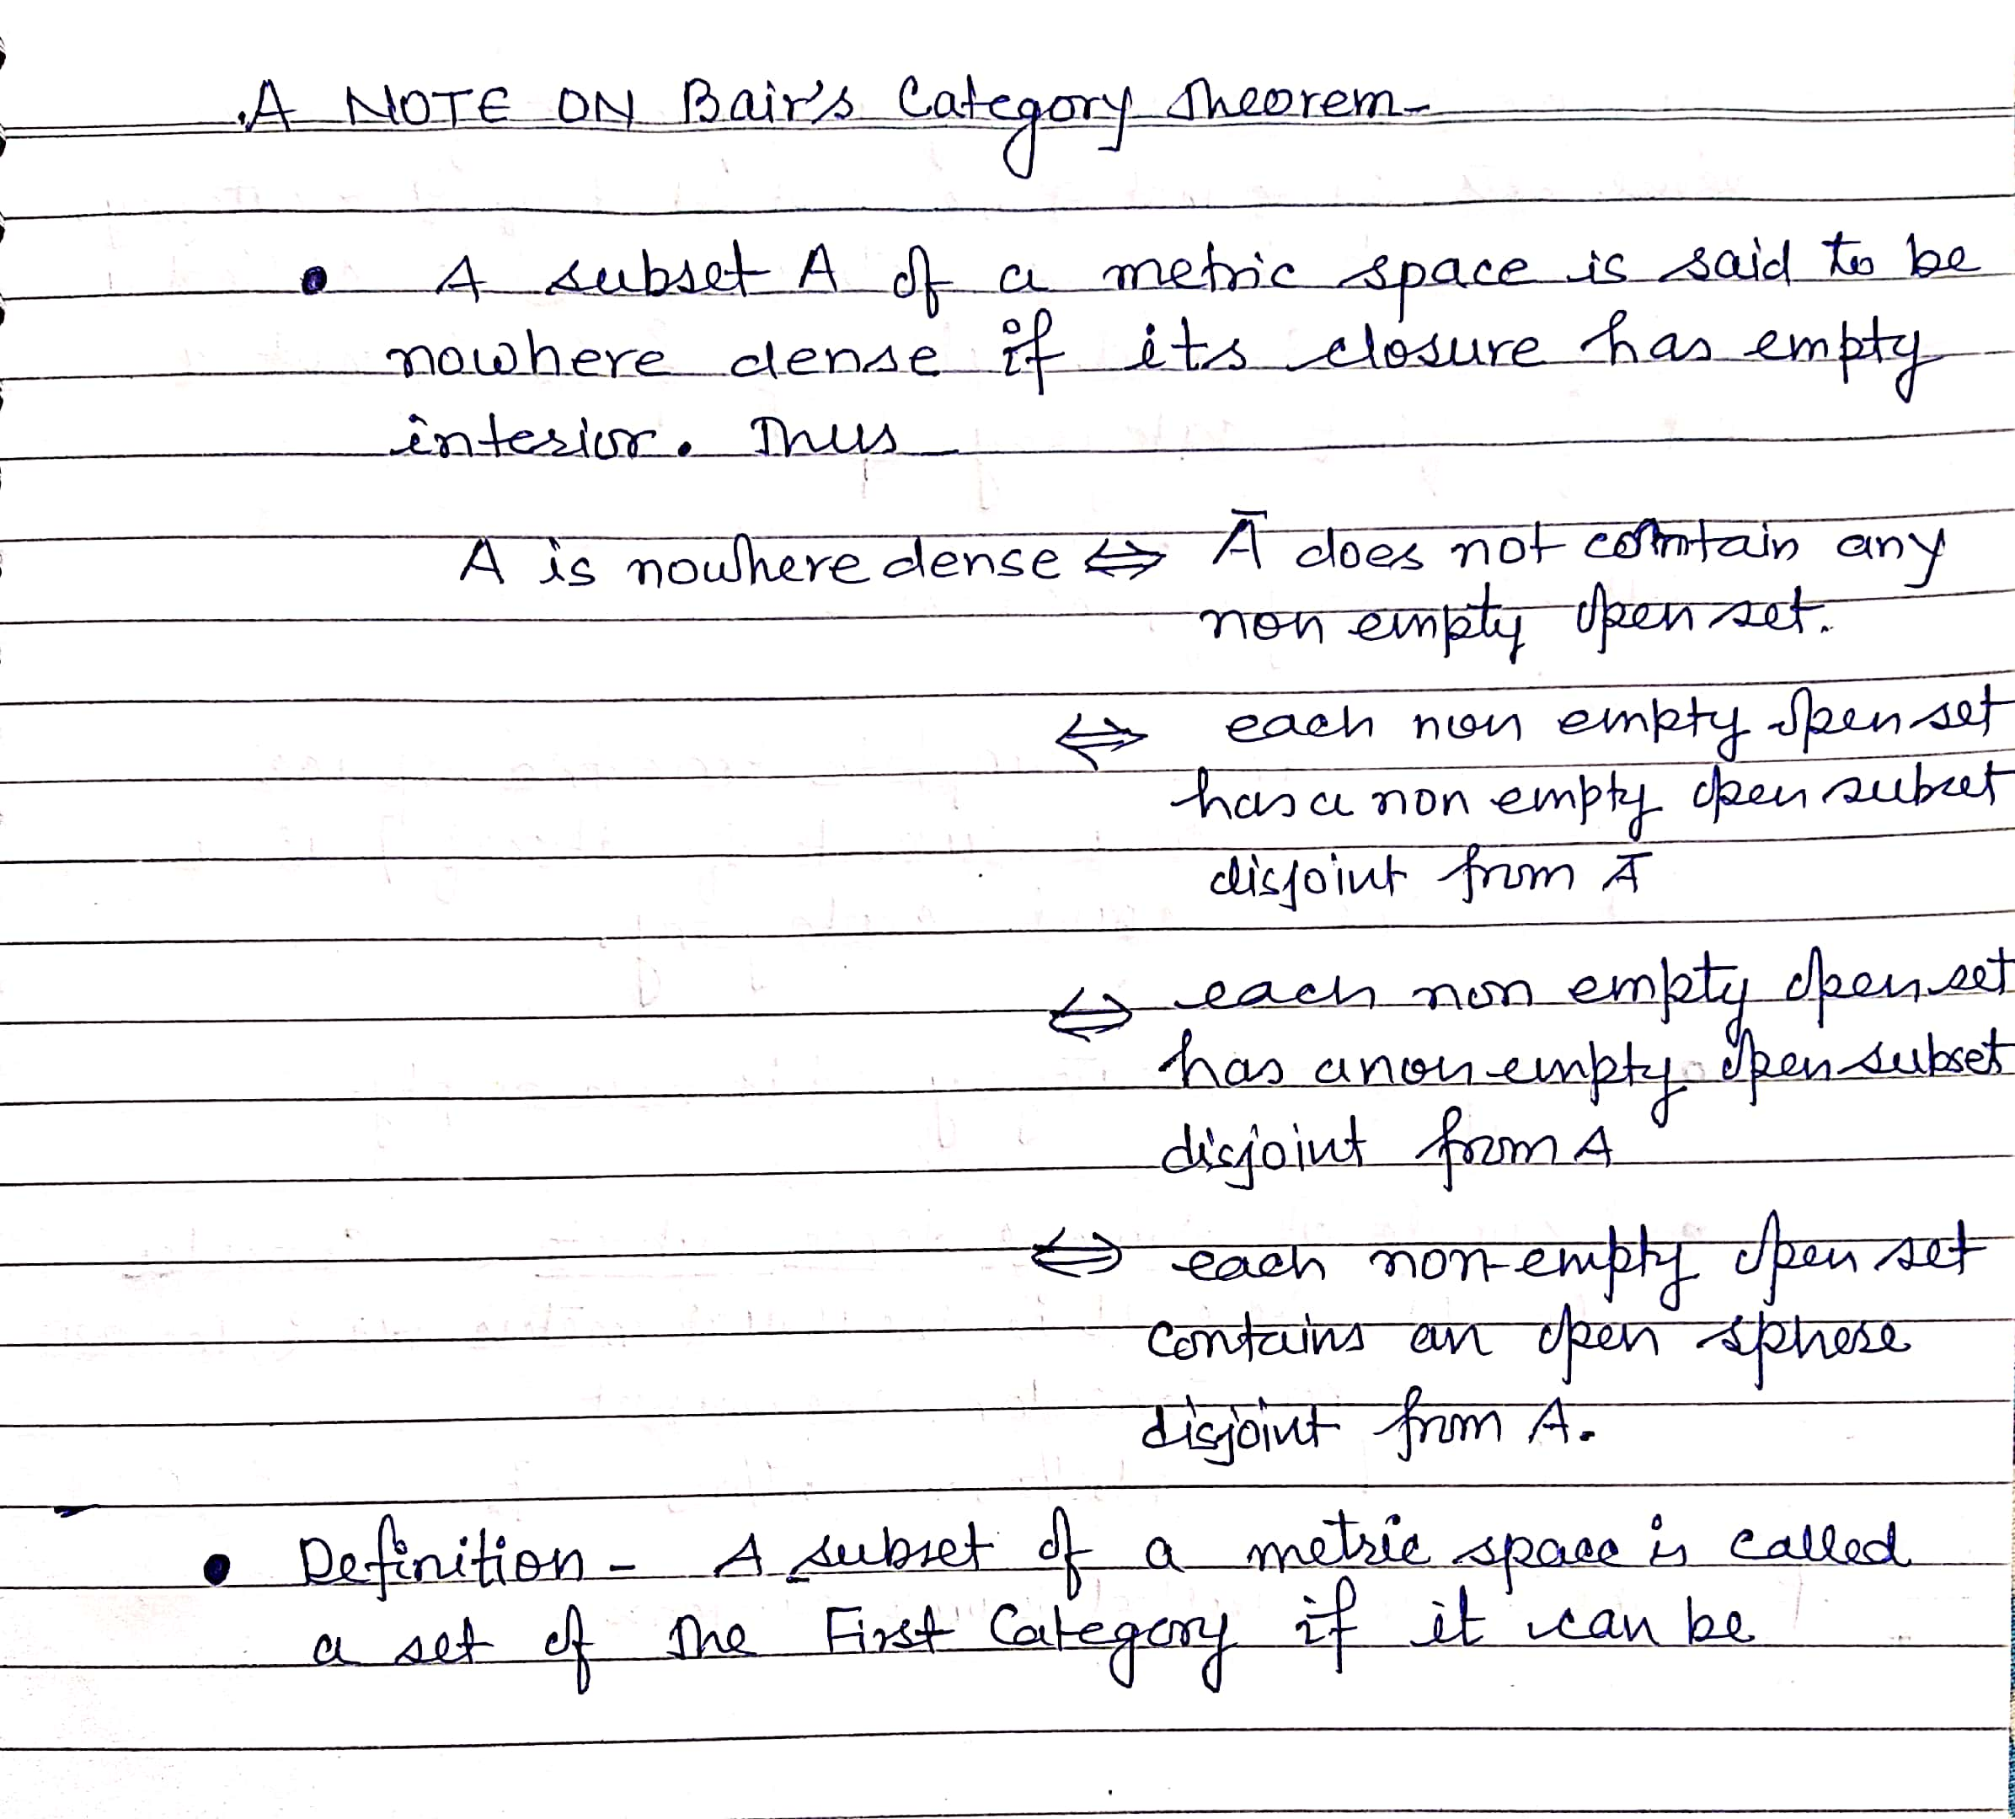

Slide 6
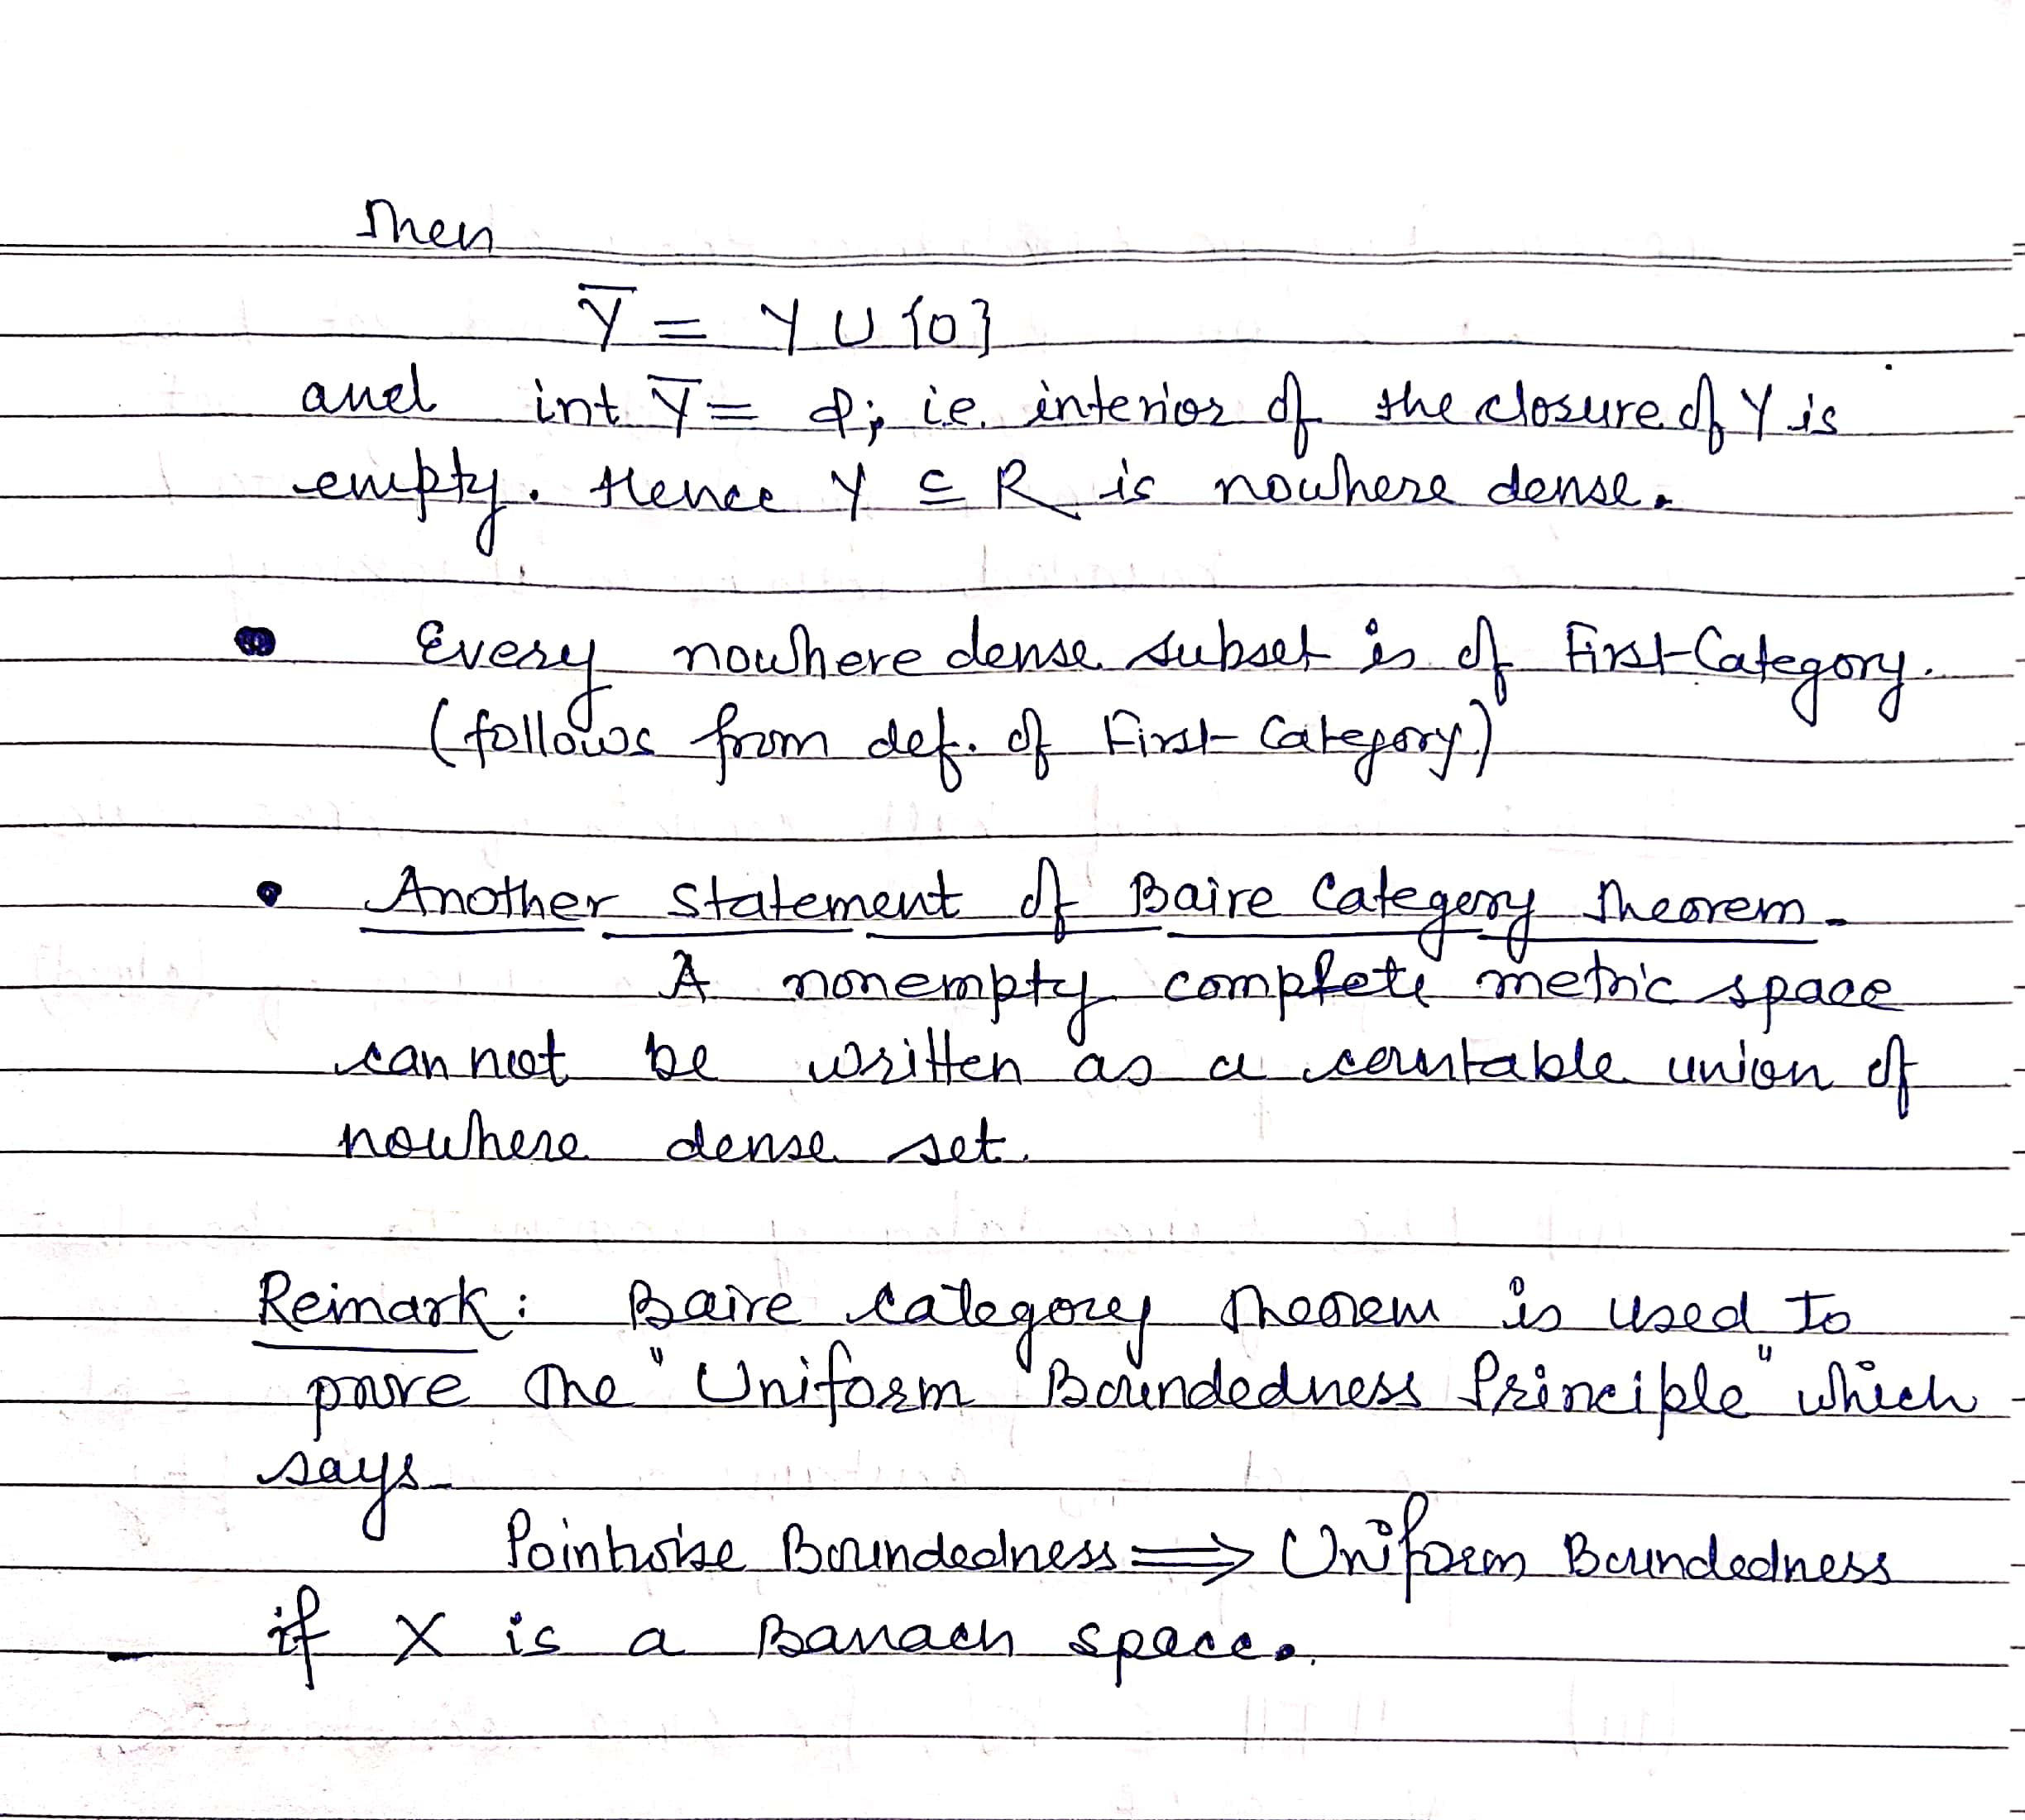

Slide 9
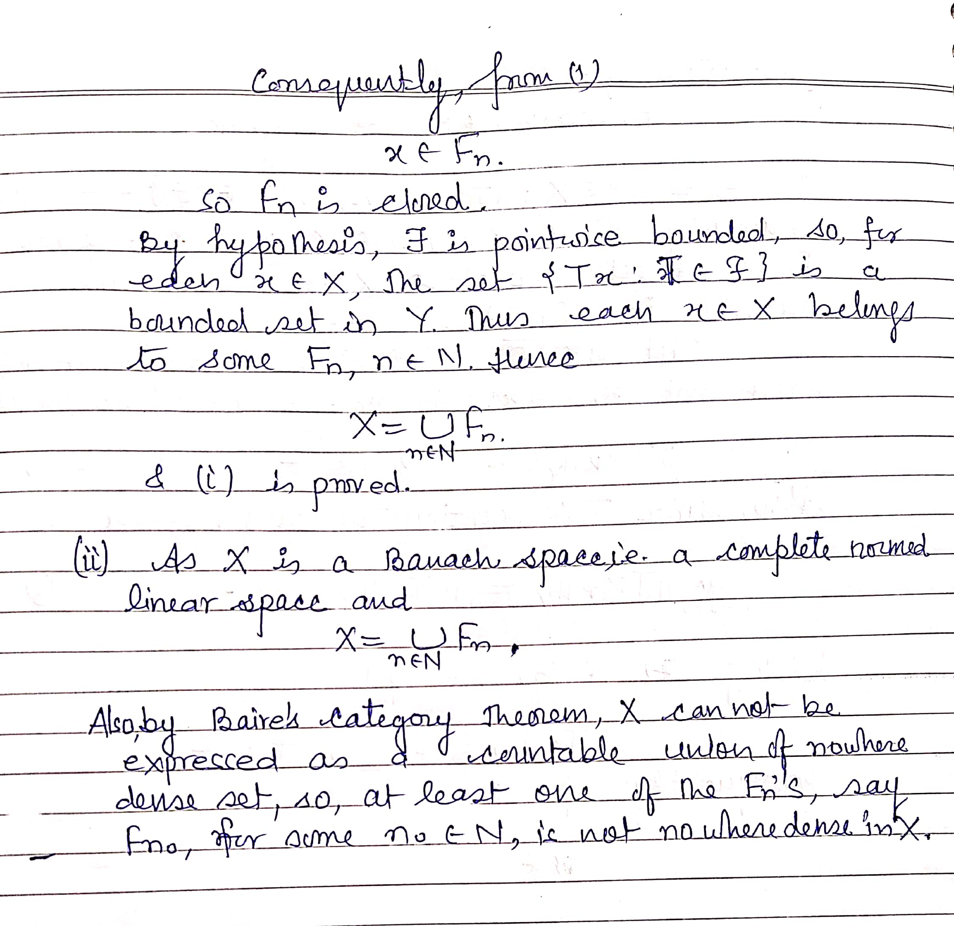

Slide 10
