Slide 1
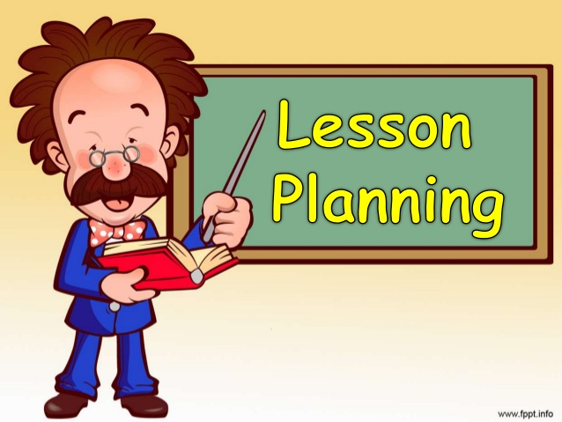
Lesson plan
Dr. Anuradha Rai
Associate Professor (B. Ed)
Harish Chandra P.G. College,
Varanasi

Slide 2

Why Planning ?
Save Time & Energy
Gives Feedback
Opportunity to Improve
Base for further planning
Engineering human mind -the irreparable one

Slide 3
What Is Planning In Teaching
Teaching plan is actually a draft of the activities which is supposed to be performed to achieve the learning objective among the learners. It includes unit plan, lesson plan and teaching plan

Slide 4

What is planning in teaching

Slide 5
Planning of WHAT
Entering Behaviour
Assessment
Teaching learning Activities

Slide 6
Lesson plan includes
Objectives
Teaching learning activities
Assessment related instrument
Assignment activity

Slide 7
Teaching learning activities must have
Content
Teacher student activities
Teaching learning material

Slide 8
Characteristics Of Good Lesson Plan
Accuracy
Activity Based (With Variety)
Opportunity To Rehearse
Proper Time Management
Must include Closure
Wholeness

Slide 9

A good teacher is
Creative
Helping
Available
Learner
Patience
Modern in thinking

Slide 10


