Slide 1
Impact of Industrial Effluent on Water Quality of River Ganga at Varanasi City
Anil Kumar
Reader in Chemistry
Harish Chandra P.G. College Varanasi-221001, anilk642@gmail.com

Slide 2
Introduction
The Ganga is one of the major National holy river in India.
It originate from Gomukh glacier above Gangotri.
After travelling a distance of 2526 km it joins the Bay of Bengal.
It travels a distance of 862 km from Mujaffar nagar district in U.P. and reaches near Varanasi city.

Slide 4
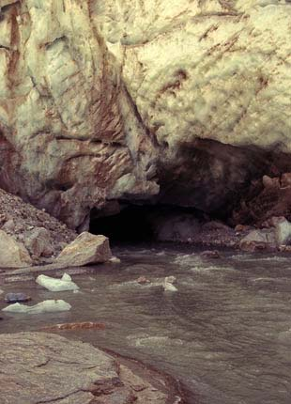

Slide 5
The river Ganga receives pollution lode due to the:
( i ) Discharge of urban sewage
(ii) Industrial Effluents
(iii) Disposal of solid wastes and agricultural run off water from its catchment areas.
The Ganga water is widely used for organized bathing and drinking purposes at many places along the stretch.

Slide 6
Present Study
The present study concern with water quality of Ganga river at Ramnagar and Varanasi city with respect to industrial effluents.
Physico-chemical parameters with an objective of its suitability for various social purposes.
Ramnager is a suburbs of varanasi. Where an industrial estate is located i.e. designated as an industrial estate.

Slide 7
Nowadays a large number of person in every country is suffering from water related diseases due to in -appropriate water quality.
It is now considered not only grave of public health hazard but also a big problem to conservation and aesthetics of natural beauty and resources.
A number of industries related to battery, colour lab dyes, agro foods, chemicals and cement etc. have been established in this industrial estate.
It is found that major inclusion of industrial effluents of these industries are allow to go and meet river Ganga through Ghurha nala.

Slide 8
Sampling Method
The samples were collected during summer, raining and winter seasion in year 2011-12.
Sampling made at 1.0 and 3.0 meters away from bank of Ghurha nala and Ganga river.
Before and after mixing of industrial effluents in Ghurha nala.
Up stream and down stream of Ganga river at confluence of Ghurha nala.

Slide 9
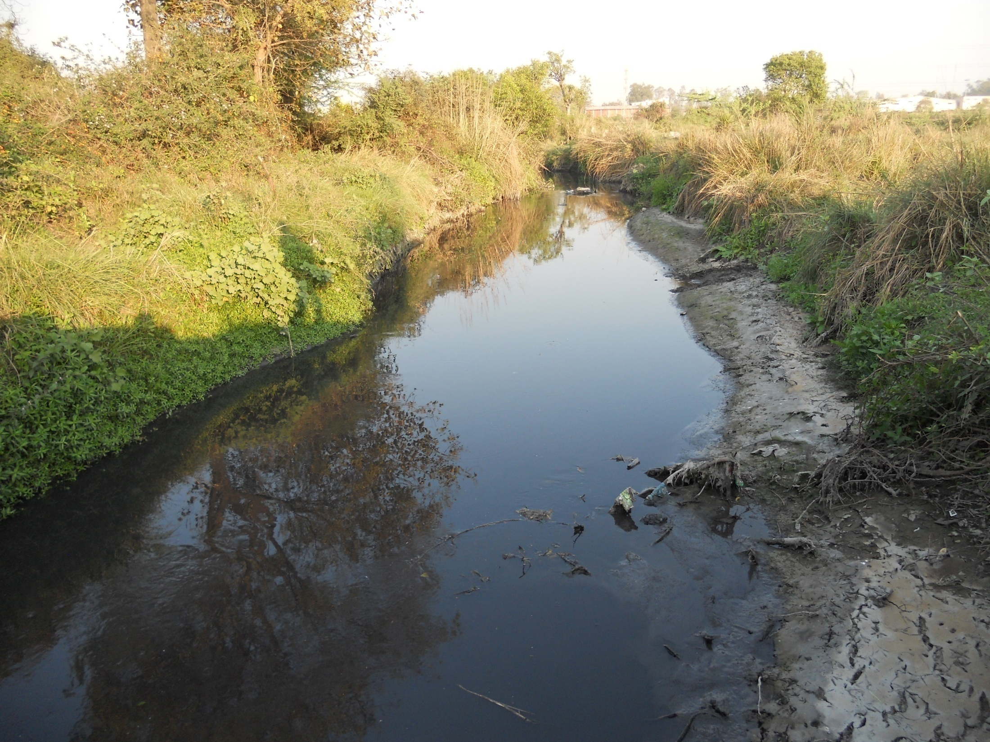

Slide 10
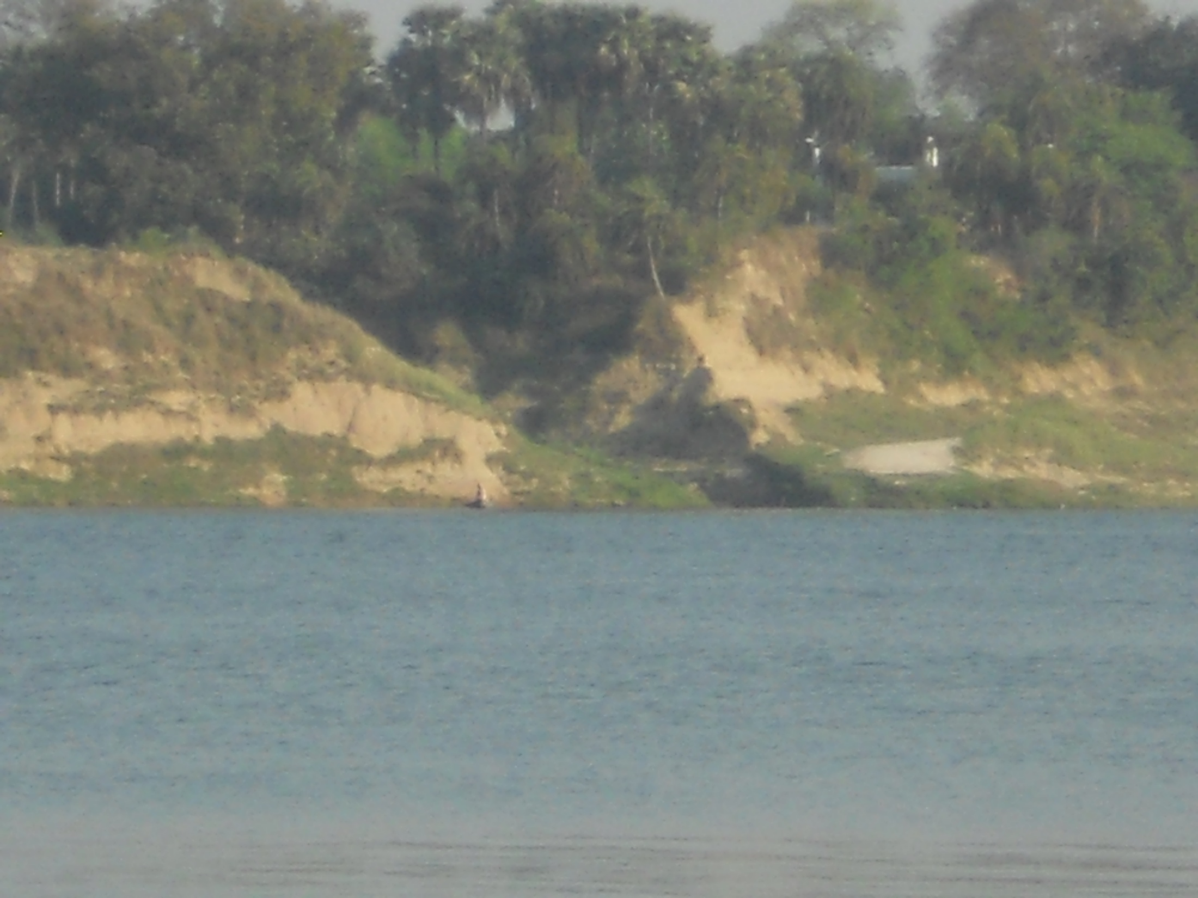

Slide 11
Water Quality Monitoring
This study carry out at ten sampling spots.
Spot 1-4 in Ghurha nala.
Spot no. 1 is before addition of industrial effluent.
Spot no. 2-4 are after mixing industrial effluent.
Spot no.5-10 in Ganga river.
Spot no. 5 at up stream of Ganga river.
Spot no.6-10 are at down stream of Ganga river near Ramnagar and Varanasi city.

Slide 12
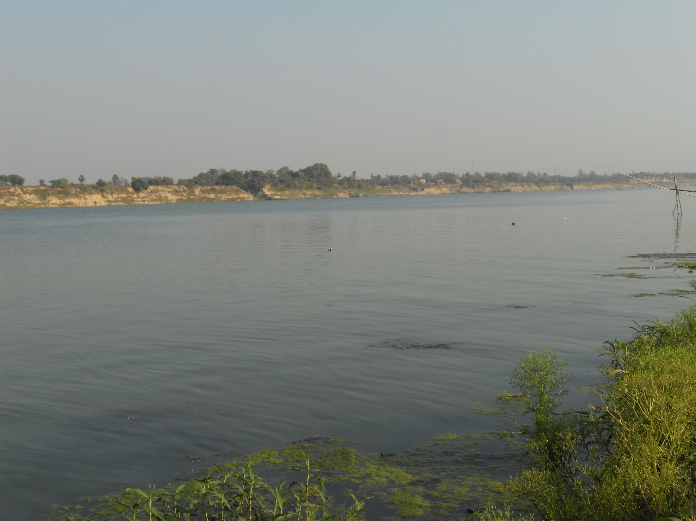

Slide 13
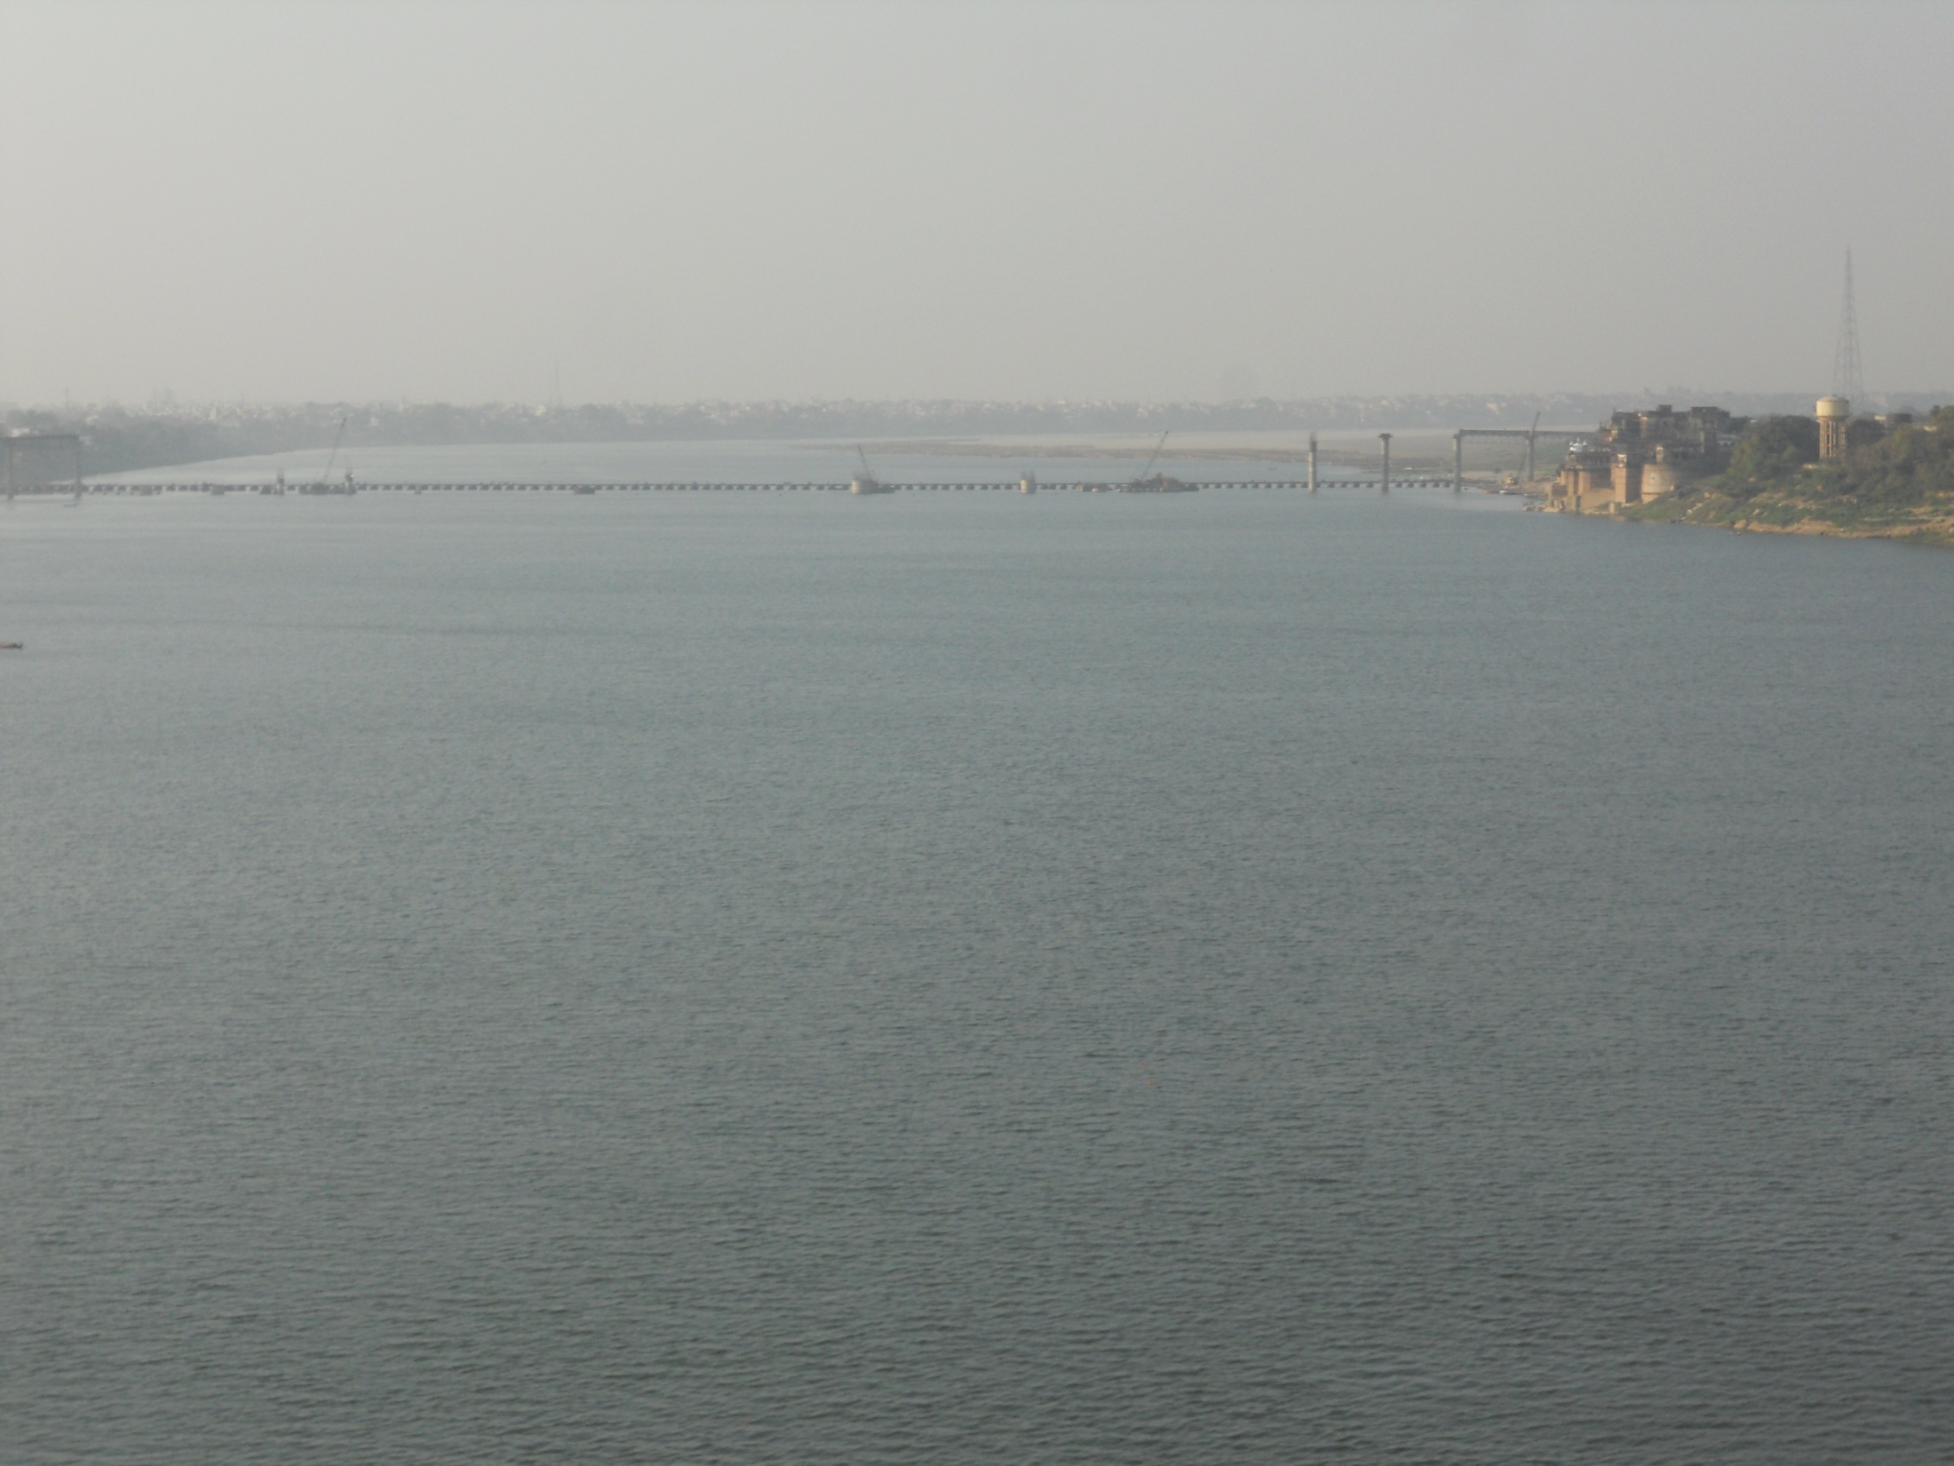

Slide 14
Analysis of Physico-chemical parameters
Industries are suspected to add a large number of pollutants in river Ganga through Ghurha nala and affect the water quality parameters of river water like-
*pH *DO *BOD *COD *TS *TDS *TSS *Specific Conductance *Turbidity *Hardness *Chloride *sulphate etc.
In present study physico-chemical parameters of Ghurha nala and Gaga river water are observed in different seasion such as -

Slide 15
*Summer season
*Rainy season
*Winter season
The range of values obtained for different physico-chemical parameters in Ghurha nala and Ganga river at Ten Points (sampling spots).

Slide 16
Physico- chemical Properties of Ghuraha nala water
parameters | Before mixing industrial effluents |  |  | After mixing industrial effluents
 | S.S. | R.S. | W.S. | S.S | R.S. | WS.
pH | NF | 7.13 | 7.6 | 7.4-7.7 | 6.5-6.6 | 7.2-7.6
Turbidity (NTU) | NF | 38.2 | 25 | 173-215 | 54-56 | 46-50
DO (mg/l) | NF | 6.8 | 9.2 | 1.0-2.0 | 6.4-6.4 | 1.8-2.3
BOD (mg/l) | NF | 0.5 | 0.3 | 0.7-0.9 | 0.8-1.0 | 0.2-0.4
Specific conductance (mS at 30⁰C) | NF | 630 | 409.2 | 835-840 | 872-984 | 639-709

Slide 17
Continue………..
Total hardness (as CaCO3 mg/l) | NF | 360 | 340 | 550-560 | 500-510 | 450-460
Chloride (mg/l) | NF | 20 | 38.34 | 65-66 | 59-61 | 48-51
Sulphate (mg/l)) | NF | 8.2 | 6.3 | 26-27 | 22-24 | 25-26
TDS (mg/l) | NF | 390 | 480 | 840-896 | 456-527 | 639-709
TSS (mg/l) | NF | 195 | 210 | 660-989 | 448-483 | 551-697
TS (mg/l) | NF | 585 | 690 | 1500-1885 | 904-1010 | 1190-1406

Slide 18
Physico-chemical Properties of Ganga River Near Varanasi City
parameters | Up stream of Ganga river before addition of industrial effluents |  |  | Down stream of Ganga river after addition of industrial effluents
 | S.S. | R.S. | W. S. | S.S | R.S. | W.S.
pH | 8.39 | 7.99 | 7.5 | 8.42-8.56 | 7.29-7.98 | 7.5-7.6
Turbidity(NTU) | 19 | 30 | 18 | 20-28 | 34-38 | 21-28
DO (mg/l) | 7.0 | 8.4 | 9.0 | 5.6-7.1 | 5.6-6.8 | 7.6-9.2
BOD (mg/l) | 0.2 | 0.5 | 0.3 | 0.6-0.8 | 1.2-2.3 | 0.3-0.6
Specific conductance(mS at 30⁰ C) | 617 | 428 | 537.8 | 618-623 | 445-470 | 558-539

Slide 19
Continue……….
Total hardness( as CaCO3 mg/l) | 240 | 220 | 280 | 270-310 | 300-400 | 300-350
Chloride (mg/l) | 35.5 | 21.3 | 36.92 | 45-49 | 21.4-25.6 | 39.7-45.4
Sulphate (mg/l) | 7.35 | 4.40 | 8.3 | 12.2-25.3 | 8.8-17.5 | 10.2-23.4
TDS (mg/l) | 300 | 220.2 | 311 | 309-312 | 228-231 | 260-300
TSS (mg/l) | 204.8 | 219.8 | 179 | 271-363 | 212-229 | 277-277
TS ( mg/L) | 504.8 | 440 | 490 | 580-675 | 440-460 | 537-577

Slide 20
Conclusion
The results of physico-chemical characteristics are also suggestive of fact that Ghurha nala water after mixing industrial effluent is highly polluted in summer season than rainy and winter season.
From this investigation we found that Ghurha-nala water loaded with industrial effluent when mixed in Ganga river it affect the water quality of river at down stream near Varanasi.

Slide 21
*Hence there is need to conventional treatment of Ghurha nala water.
*It must be treated in water treatment plant and than mixed in Gaga river.
*If proper measures are taken for the treatment of this untreated industrial effluents and restriction of various anthropogenic activities.
*Then wholesomeness and pristine quality of holy river Ganga may be restored and its environmental health be improved.

Slide 22
Publications
Physico-chemical Characterization of Ganga water at Ramnagar Varanasi, Anil Kumar and co-workers, Nava Gavesana an International Research Journal, vol-3, Issue-1, p. 17-26, 2012
Studies on Distribution of Heavy Metals in Ganga river water and Ghuraha nala water near Ramnagar city Varanasi with reference to industrial effluents, Anil Kumar and coworkers, Nava Gavesana ,vol-3, I.3-4, p-68-73, 2012.
ACKNOWLEDGEMENT
We are thankful to UGC for providing minor project for this work.

Slide 23
THANKS

