Slide 1
Professor (Dr.) Vandana pandey Department of commerce Harishchandra PG college, varanasi.
Human Resource Managment
B.Com VI th semester

Slide 2
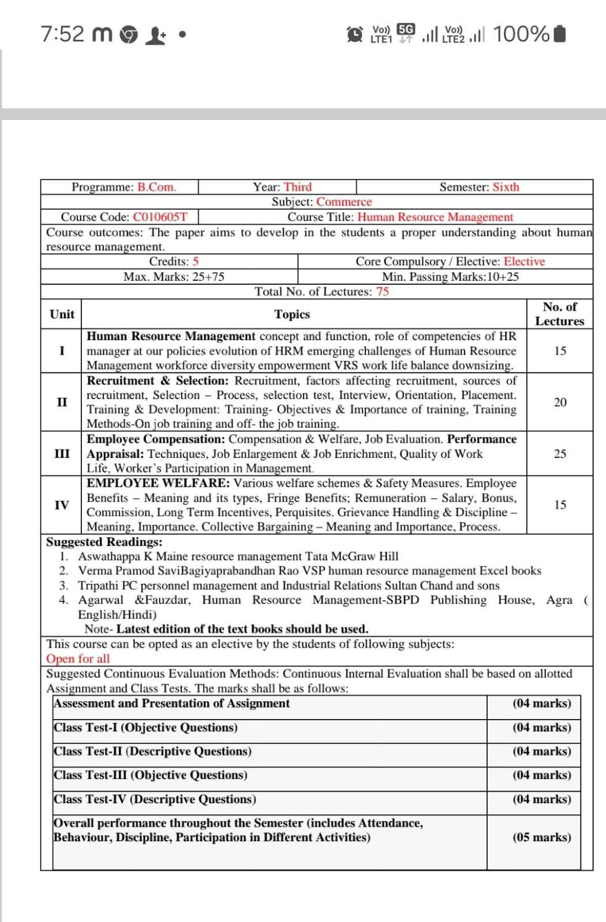
syllabus

Slide 3
Introduction to Human Resource Management
Human Resource Management (HRM) deals with managing people at work
It focuses on acquiring, developing, motivating, and maintaining employees
HRM helps in achieving organizational goals effectively
Employees are considered the most valuable asset of an organization

Slide 4
Concept of Human Resource Management
Human resources are treated as assets, not costs
Emphasis on employee development
Focus on long-term human resource planning
Integration of employee goals with organizational goals

Slide 5
Meaning of Human Resource Management
HRM is the process of managing human resources efficiently
It includes recruitment, training, compensation, performance appraisal, and employee relations
HRM aims at optimum utilization of human talent
Definition:
HRM is the planning, organizing, directing, and controlling of human resources to achieve organizational objectives.

Slide 6
Functions of Human Resource Management
Major Functions:
Recruitment and Selection
Training and Development
Performance Appraisal
Compensation and Welfare
Employee Relations
Discipline and Grievance Handling

Slide 7
Role of HR Manager
Planning manpower requirements
Recruiting suitable employees
Training and developing staff
Maintaining employee motivation
Handling grievances and disputes
Ensuring employee satisfaction

Slide 8
Competencies of HR Manager
Communication skills
Leadership ability
Decision-making skills
Knowledge of labor laws
Problem-solving ability
Interpersonal skills

Slide 9
HR Policies
HR policies provide guidelines for managing employees
They ensure consistency and fairness
Help in decision-making
Promote employee confidence

Slide 10
Evolution of Human Resource Management
Welfare Approach
Personnel Management Approach
Human Relations Approach
Human Resource Management Approach
Strategic Human Resource Management

Slide 11
Emerging Challenges of HRM
Globalization
Technological changes
Workforce diversity
Employee retention
Skill development
Work pressure and stress

Slide 12
Workforce Diversity
Workforce includes people from different backgrounds
Diversity may be based on age, gender, culture, education, and religion
HRM must manage diversity effectively
Promotes creativity and innovation

Slide 13
Employee Empowerment
Giving employees authority and responsibility
Encourages decision-making
Improves job satisfaction
Enhances organizational performance

Slide 14
Voluntary Retirement Scheme (VRS)
VRS is a method to reduce surplus employees
Employees retire voluntarily with financial benefits
Helps in cost reduction
Used mainly in public sector and large organizations

Slide 15
Work Life Balance
Balance between work and personal life
Reduces stress and burnout
Improves employee productivity
HR policies support flexible working hours and leave facilities

Slide 16
Downsizing
Planned reduction of workforce
Done to improve efficiency
May involve layoffs or voluntary retirement
Requires careful HR planning

Slide 17
Summary
HRM focuses on effective management of people
HR manager plays a crucial role in organizational success
HRM has evolved over time
Modern HRM faces several challenges
Concepts like diversity, empowerment, VRS, and work-life balance are important

Slide 18
Thank You

