Slide 1
DRUG ANALYSIS
(M. Sc. IV Sem students only)
Dr. Anil Kumar
Associate Professor,
Department of Chemistry,
HCPG College, Varanasi

Slide 2
Definition of Drug
The word drug is derived from the French word “drogue” which means a dry herb which is no complete and comprehensive definition of Drug.
According to some workers, a drug may be defined as “a substance used in prevention, diagnosis, treatment and cure of disease in animals including men”.
However according to most acceptable and comprehensive definition, a drug is substance with an abnormal effect on certain body function,e.g. strychnine stimulate the action of heart and aspirin stills its action. Since both of them affect abnormally, so these compounds are known as drugs.

Slide 3
Characteristics of Drugs
An ideal drug should posses a following requirements.
The action of ideal drug should be localised at the site where it is desired to act. However no drug has these characteristics.
It should be non toxic.
It should have minimum side effect.
It should not harmful for host tissues or physiological process.
It should be efficient.
it should not make the host cell resistant to the drug after its use for long time.
However most of the drugs do not possesses these characteristics.

Slide 4
Classification of Drugs
On the basis of their therapeutic action, drugs are classified in two main categories:
(A) Chemotherapeutic agent
These drugs are used in the treatment and cure of specific diseases like malaria, syphilis, tuberculosis, micro-organisms infection diseases, etc. Such type of drugs are known as chemotherapeutic agent.
These chemotherapeutic agents attack and destroy the invading organisms without injuring or destroying the cell of the infected host. Thus chemotherapy may be defined as the treatment of disease by chemicals which selectively inhibit the parasitic organisms. The first therapeutic agent introduced by Ehrlich in 1910 were certain organo-arsenic compounds against t-sphylis.

Slide 5
Various chemotherapeutic agents:
It may further divided into following types-
Organometallic therapeutics
Anti-malarials
Antibacterials (Sulpha drugs)
Antibacterials (Antibiotics)
Anti-protozoals
Anti-fungal
Anthelmentics
Antiseptics
Antineoplastics
Antitubercular
Antileprosy

Slide 6
(B) Pharmacodynamic agents
These drugs have characteristic effect on animal organism but are not specific remedies for particular diseases.
Although such type of drugs can assist in recovery from a specific bacterial or viral infection. Their action is not directed at the pathogenic organism which are target in chemotheraphy (This is difference from chemotherapeutic agents and it)
Classification of Pharmacodynamic agents
Non selective central nervous system (CNS) modifiers i.e. depressant.

Slide 7
(2) Selective modifiers of CNS i.e. tranquillizer.
(3) CNS stimulant i.e. antidepressant
Adrenergic stimulants i.e. blocking agent
Cholinergic and anticholinergic agents
Cardiovasculate agents
Diuretics
Anaesthetics
Antipyretics and analgesics
Antispasmodix
Antihistamines
Anticoagulant

Slide 8
Therapeutic Index
The medicinal value of the drug is generally represented by therapeutic index which is described as the ratio of amount necessary to kill the patient i.e. maximum tolerated doze (MTD) to that required for maximum curative doze (MCD).
Therapeutic index =
The value of therapeutic index = 10 means that 10 times a doze used for curative purpose would kill the patient as well as parasite

Slide 9
Analysis by spectrophotometric technique of drugs
We know that a large number of organic molecules absorb radiation in the ultraviolet and visible region.
The molecule having high molecular absorptivities may determined directly. These can be converted chemically into derivatives which have high molar absorptivity.
A single absorbing component can be determined easily by assuming the component to be analysed as the only species that absorbed in sample mixture or if it is only species in the sample that absorb at the wavelength selected analysis.

Slide 10
Experimentally the spectra of the sample is obtained and the wavelength for the measurement chosen. Generally the wavelength of maximum absorbance. e.g. a tetracyclene hydrochloride, a drug used as an antimicrobial medicine and as a broad spectrum antibiotics in animal can be determined spectrophotometrically by obtaining spectrum of this compound in which absorption maxima are obtained at 220, 268 and 355 nm.
The percentage of tetracyclene can determined by preparing a series standard between 10 ⁻⁴ to 10⁻⁵ M. In 0.10 FS solution and the absorbance is determined at 355 nm for each standards. The sample may be prepared by crushing ten tablets and mixing them homogeneously. A portion of this powder is directly weighed and diluted in.10 F-HCl and the absorbance is determined . The calculation is then calculated by comparison with standard with the help of Standard addition calibration graph.

Slide 11
Screening and analysis of drugs by Thin Layer Chromatography (TLC) method
TLC is good technique for separating and screening the drugs:
For checking purity of sample- TLC is mainly used as a check on sample obtained by other method. In this respect, it is high sensitivity often enables impurities to be observed in so called pure samples.
Analysis of antibiotics- Tetracyclene have been separated on thin layer of silical gel by using solvent system 10% citric acid, n-butanol-methanol (4:1:2), (4:2:2).

Slide 12
Penicillin have been separated on silica gel (g) by usong two solvents acetone-methanol (1:1) and isopropanol-methanol (3:7). The detecting or visualising agent is the iodine-azide reaction was employed by spraying the dried TLC plates with a 0.1N iodine solution containing 3.5% sodium azide.
Neomycin sulphate have been separated on layers of activated carbon. Both acidic and neutral layers were used. Active carbon is absorbed for separation of water soluble basic antibiotics produced by streptomyces.
Erythromycin have been separated on the layer of silica gel (g) using a solvent composed of CH₃ Cl, CH₃OH, benzene-formamide (80:20:20:2.5).

Slide 13
Analysis of Drugs by Gas Chromatography
A large number of pharmaceutical products (drugs) have been separated by Gas chromatography and identified by IR, NMR, UV and Mass spectrometer techniques.
This technique of separation is similar to liquid-liquid and liquid-solid chromatography except that in gas in chromatography the mobile phase is gas rather than liquid. The stationary phase can be powdered solid when the technique is called is called gas-solid chromatography (GSC). If the stationary phase is liquid coated on solid particle, the term gas-liquid chromatography (GLC) is used. In GLC a column is used which is packed with solid particle acting as a support for stationary liquid phase. For separating particular component, the nature of solid support and of liquid phase, method of packing the column, length, diameter and temperature of the column are the factor which must be taken into account

Slide 14
The entire column is heated to suitable constant temperature. The mobile phase is gas called carrier gas. The carrier gas used is either helium, nitrogen, argon or hydrogen. The sample solution is introduced from top of the column. The carrier gas at constant pressure regulated by flowmeter is also send through the column. The compound that is held less strongly by the stationary phase moves more rapidly along with carrier gas and then different component get separated. The gas coming out of column is sent to thermal conductivity detector which record the chromatogram showing the various component present in test sample.

Slide 15
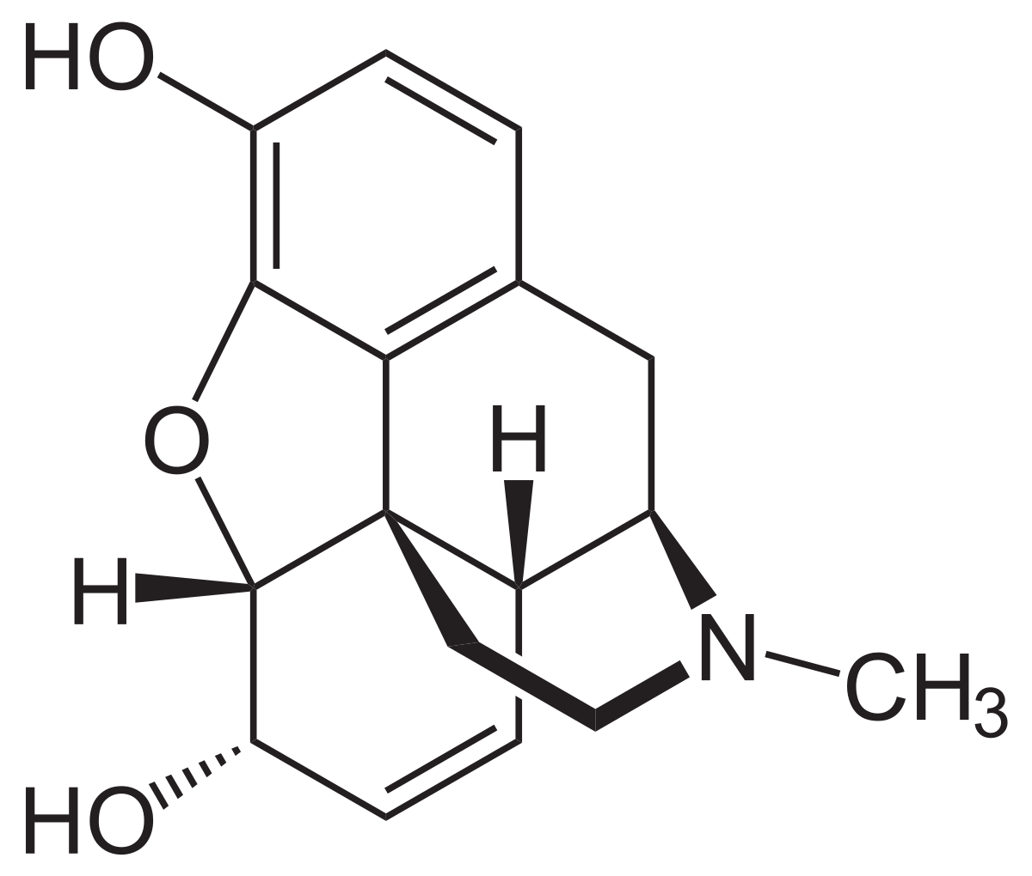
Narcotics and dangerous drugs
Narcotics analgesic
Morphine is the natural product prototype for the class of analgesic. It and its congeners are called opioids, narcotics, narcotic analgesic and centrally active analgesic. They modify the effect of pain impulse on the CNS.

Slide 16
Awareness of the pain may persist or diminished but the ability to interpret, integrate and react to pain is decrease with attendant and sedation euphoria and reduced anxiety and suffering.
The only other useful effect of opioid on CNS is cough suppression. Peripherally reduction in the propulsive movement of the intestine is useful in control of certain diarrhea but otherwise constipation of common side effect. Among the host of adverse reaction the most critical in limiting usefulness of opioids are centrally mediated tolerance, dependence, and respiratory depression, which is cause of death from opioid overdose.

Slide 17
Tolerance refer to the need to increase the over doze of opioid over a period of time to achieve same level of analgesia or euphoria. A return toward normal sensitivity occurs after a free drug period.
Psychological and physical dependence developed upon extended use of narcotics. Psychological dependence is characterized by drug seeking behaviour directed toward achieving euphoria and escape from psycho-socio-economic pressure.
They derive may become so consuming that normal social, legal and ethial consideration offer no difference to inwardy and outwardy, directed destructive behaviour and crabing. Physical behaviour is gradually manifested after stopping narcotics use. Depending upon the drug to which its dependence have been established and the duration of use and dose, symptoms of withdrawal vary in number and kind duration and severity.

Slide 18
The most common symptoms include annorexia, weight loss, pupillary dilation, chills, alternatively with excessive sweating, abdominal cramps, vomiting , lachrymation and increase heart rate.
Narcotics antagonists are valuable adjunct to therapy. They are used in monitoring and assuring patient , compliance during and after counselling because they block euphoria but its overdose is dangerous for health.

Slide 19
Use Mask and maintain social distancing
And join Arogya Setu App
THE END
THANKS

