Slide 1
COMPANY LAW
B.Com 3rd Semester
Formation of company
Presented by,
Dr. Vandana Pandey
Associate professor
Department of commerce
HCPG College Varanasi

Slide 2

Formation of company

Slide 3
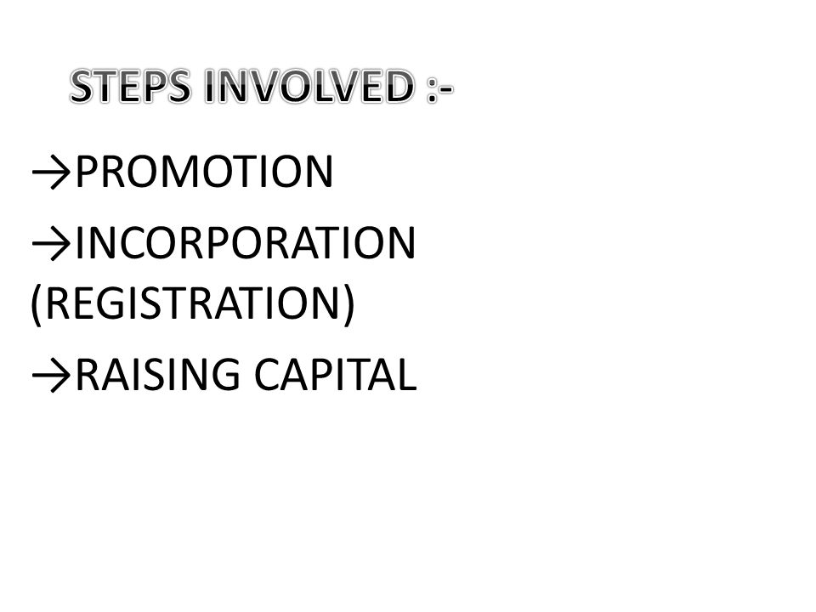
Formation of company

Slide 4
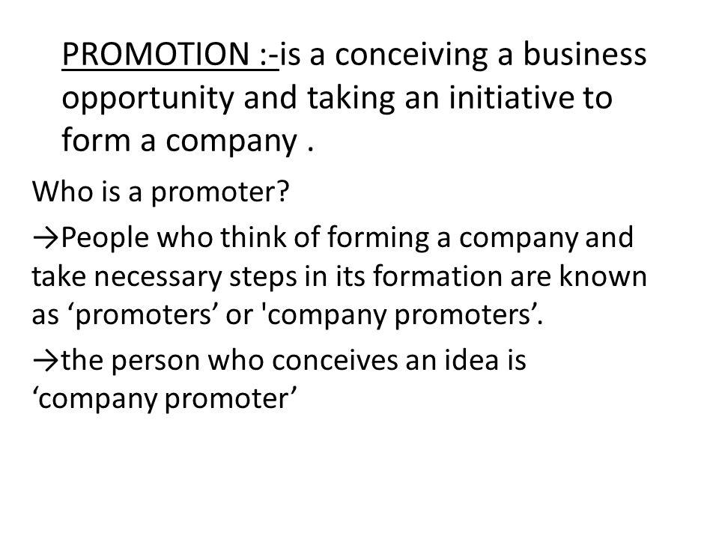
Promotion of company

Slide 5
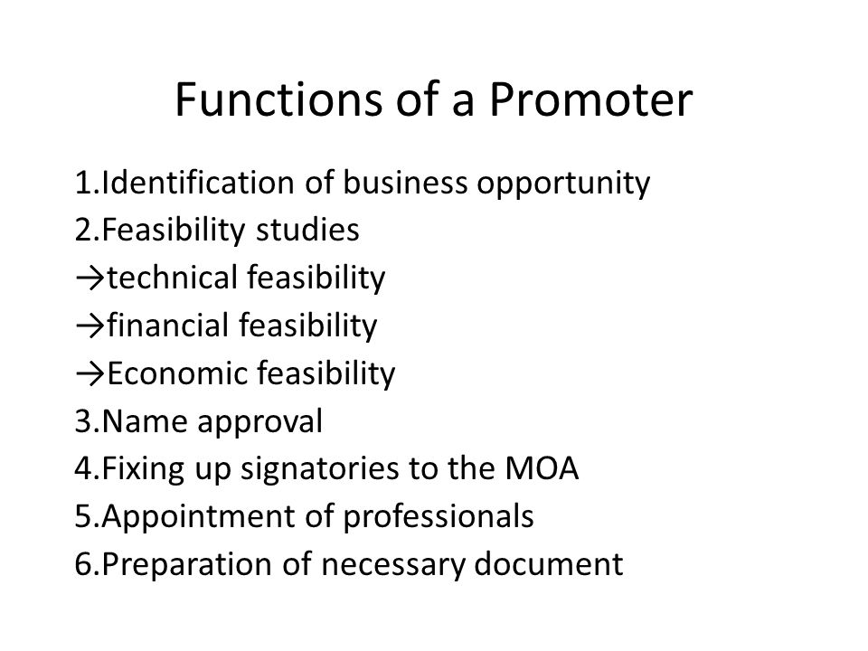
FUNCTIONS

Slide 6
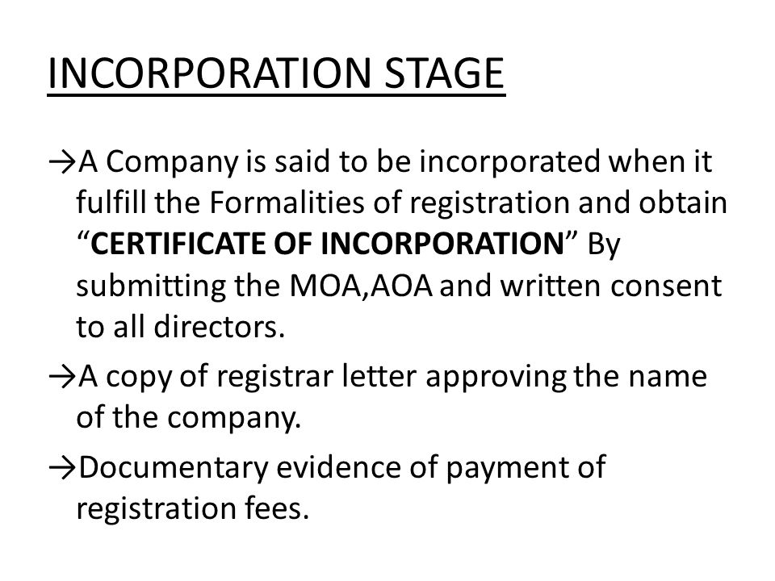
INCORPORATION

Slide 7
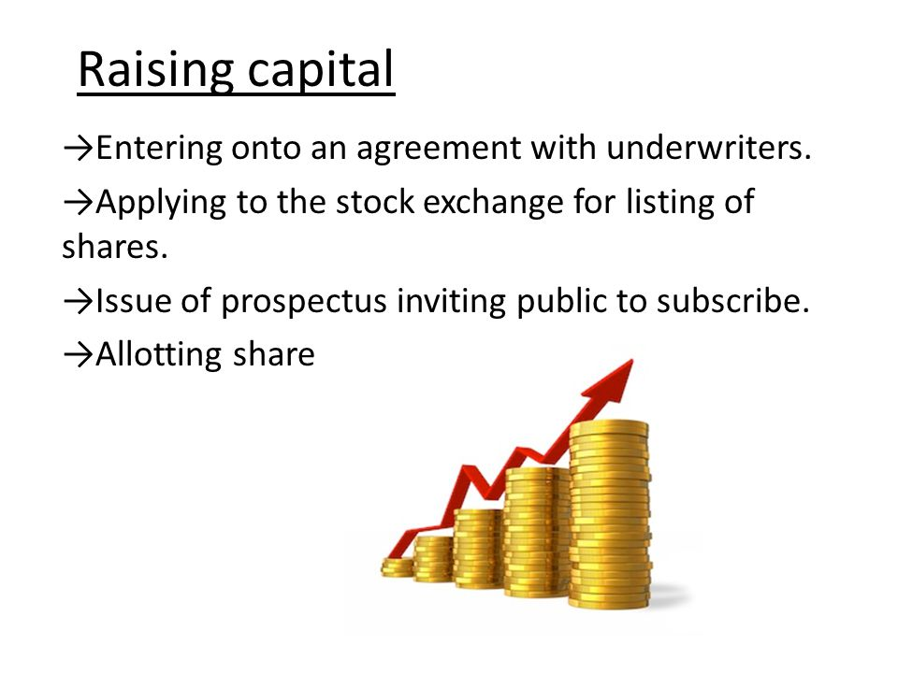
INCORPORATION

Slide 8
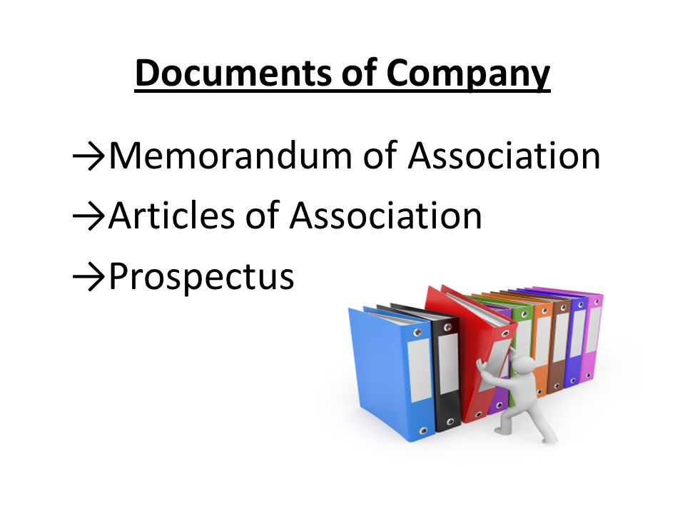
DOCMENTS

Slide 9
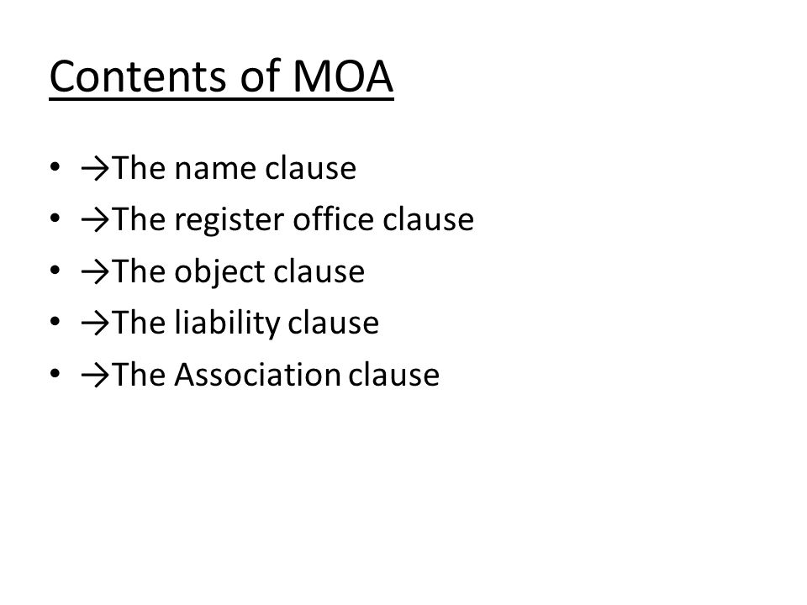
MOA

Slide 10
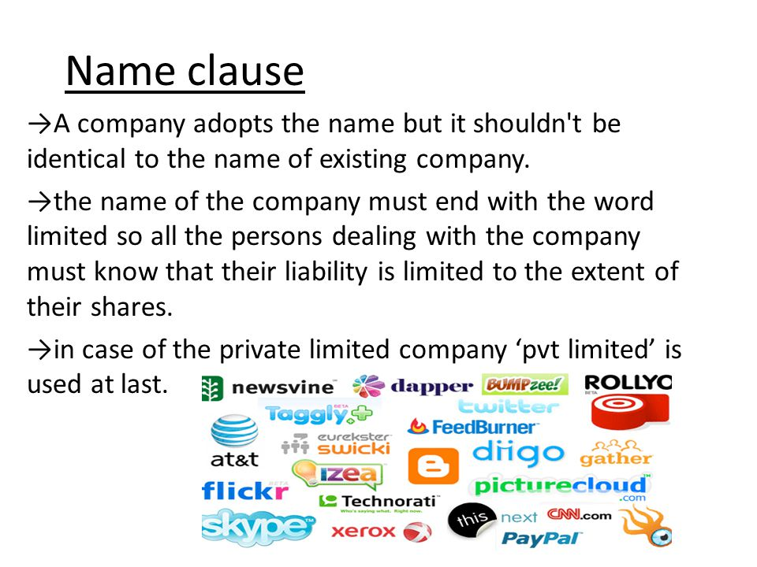
NAME CLAUSE

Slide 11
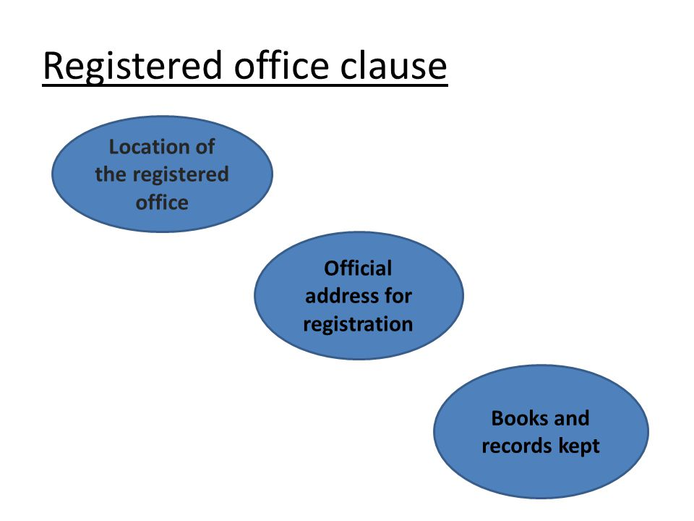
REGISTERED OFFICE

Slide 12
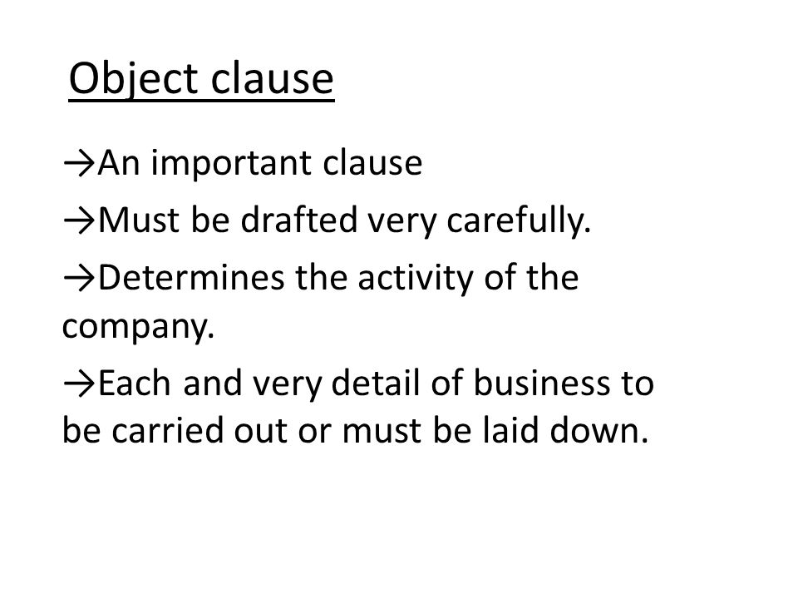
OBJECT CLAUSE

Slide 13
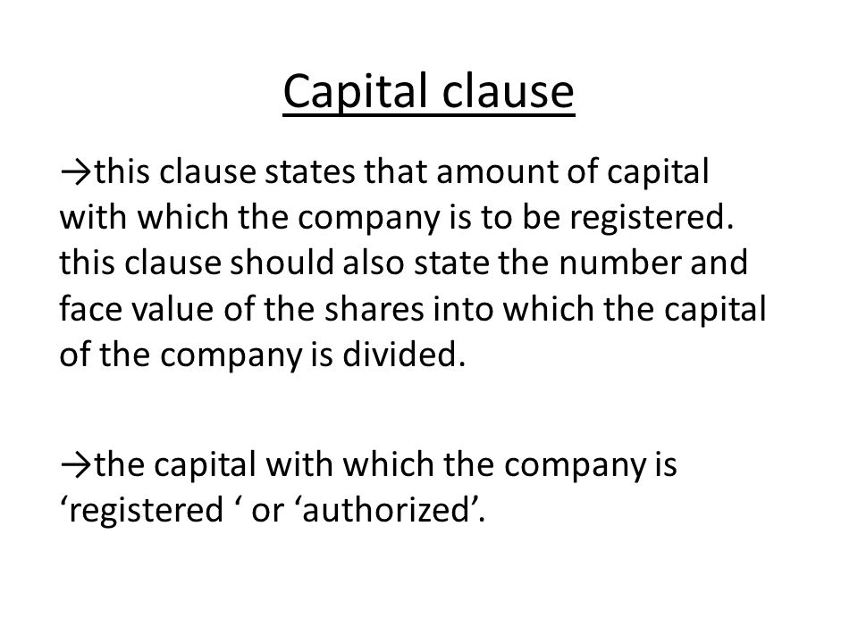
CAPITAL CLAUSE

Slide 14
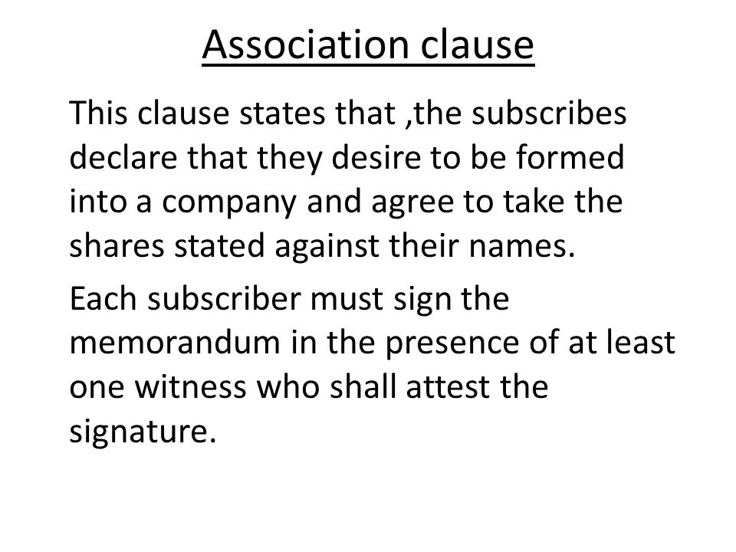
Association clause

Slide 15
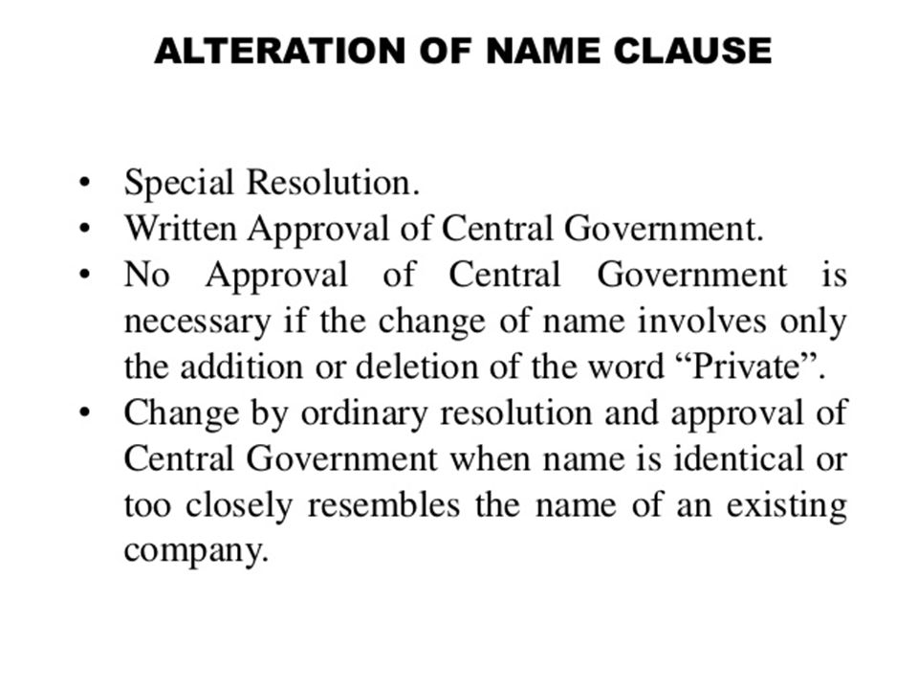
Alteration

Slide 16
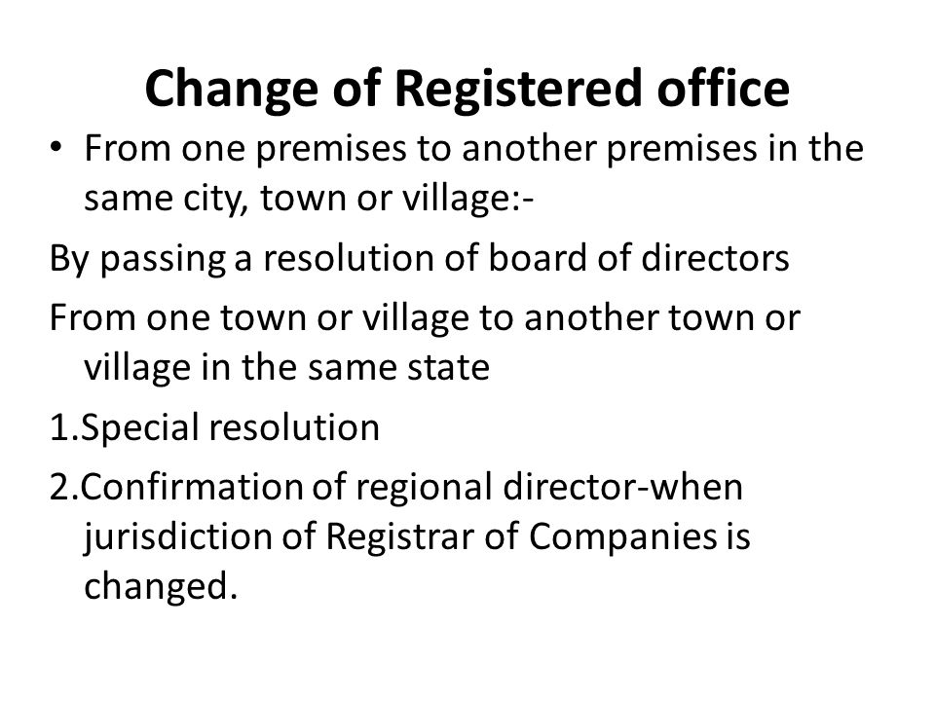

Slide 17
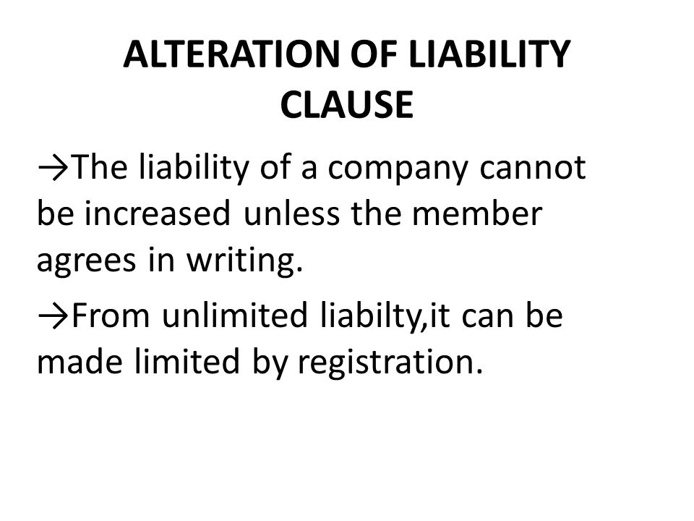

Slide 18
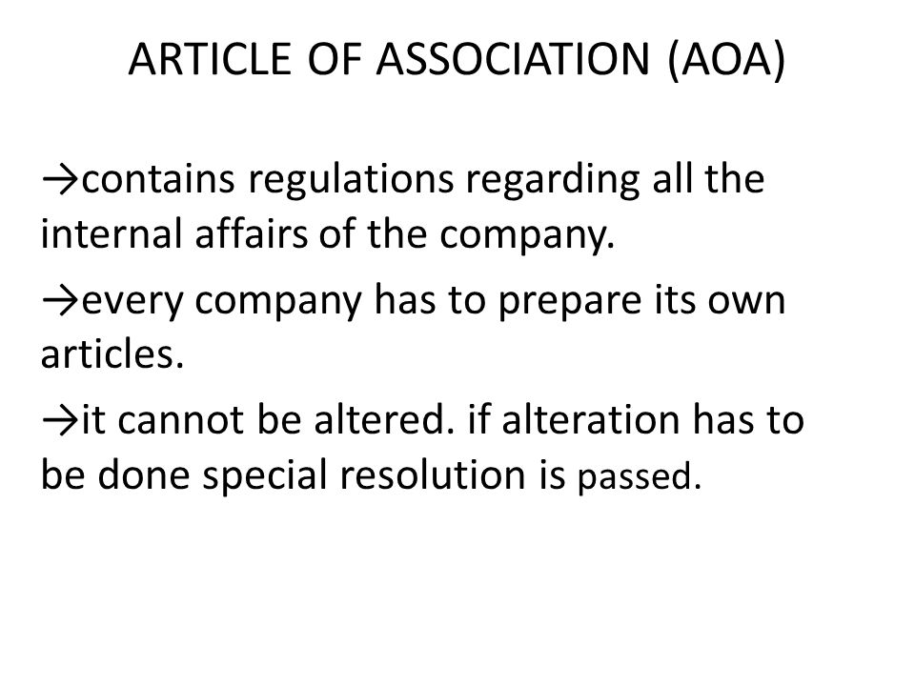

Slide 19
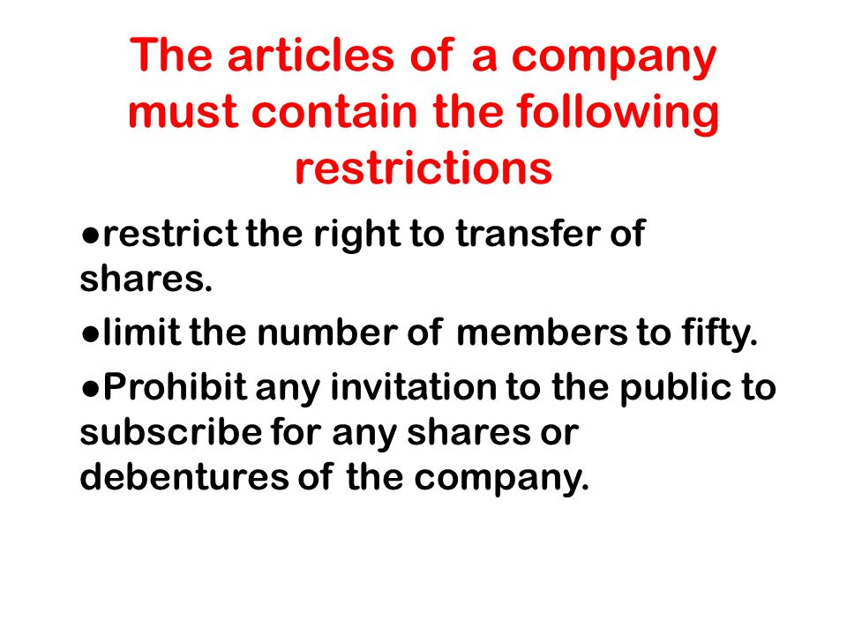
AOA

Slide 20
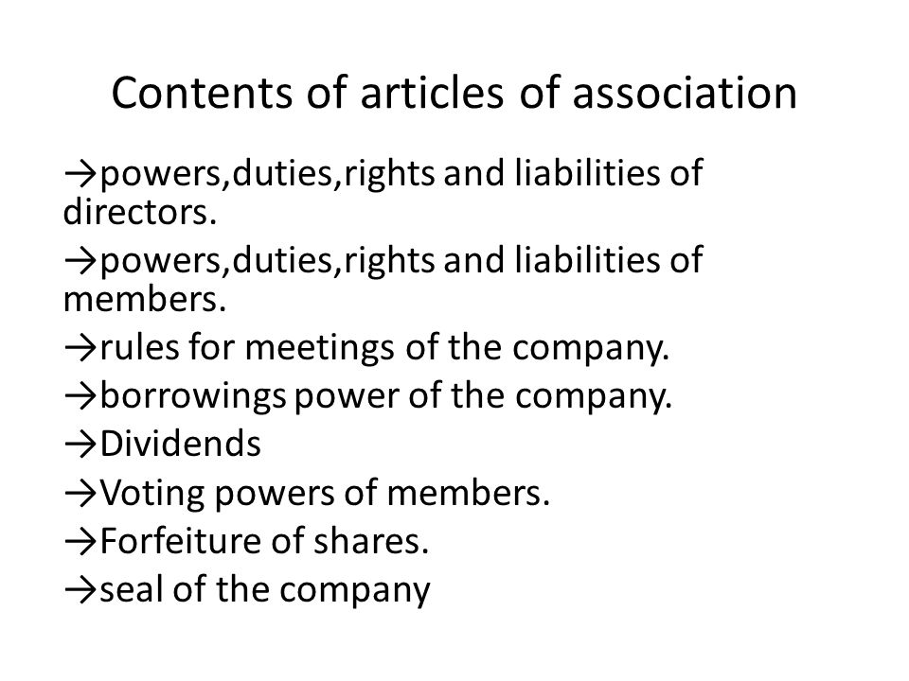
CONTENT OF ARTICLES OF ASSOCIATION

Slide 21
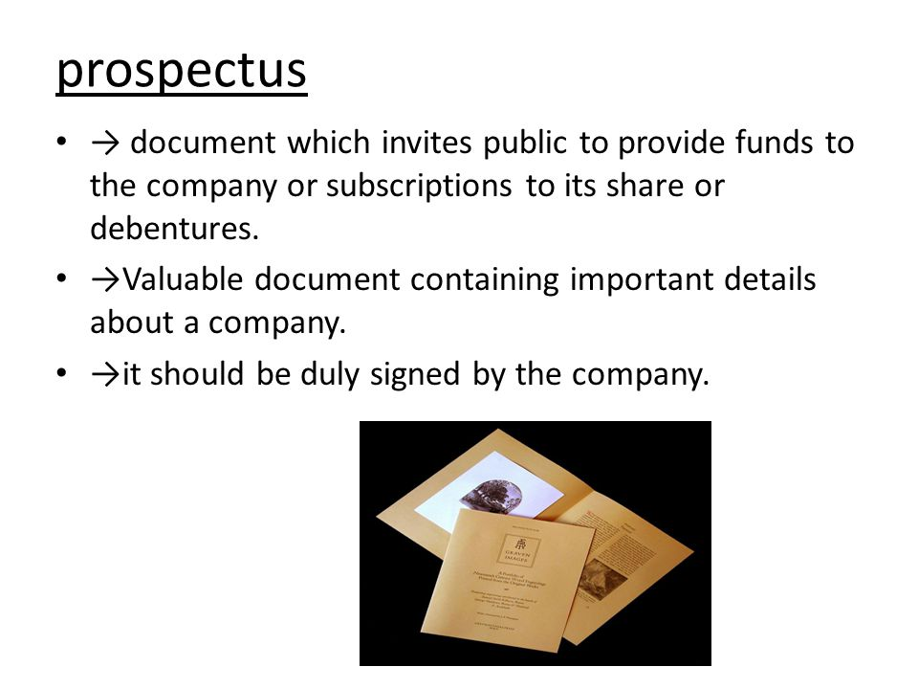
PROSPECTUS

Slide 22
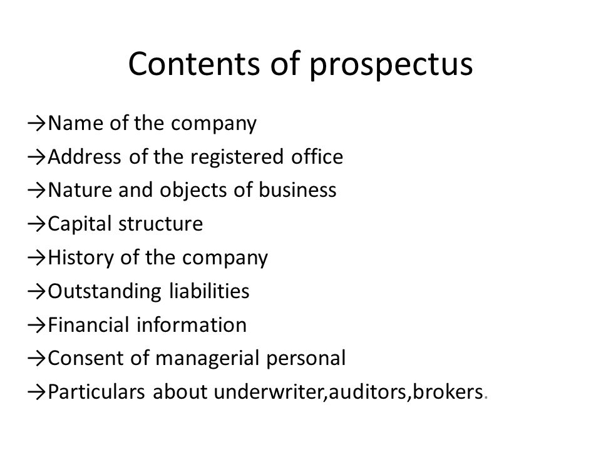
CONTENTS OF PROSPECTUS

Slide 23
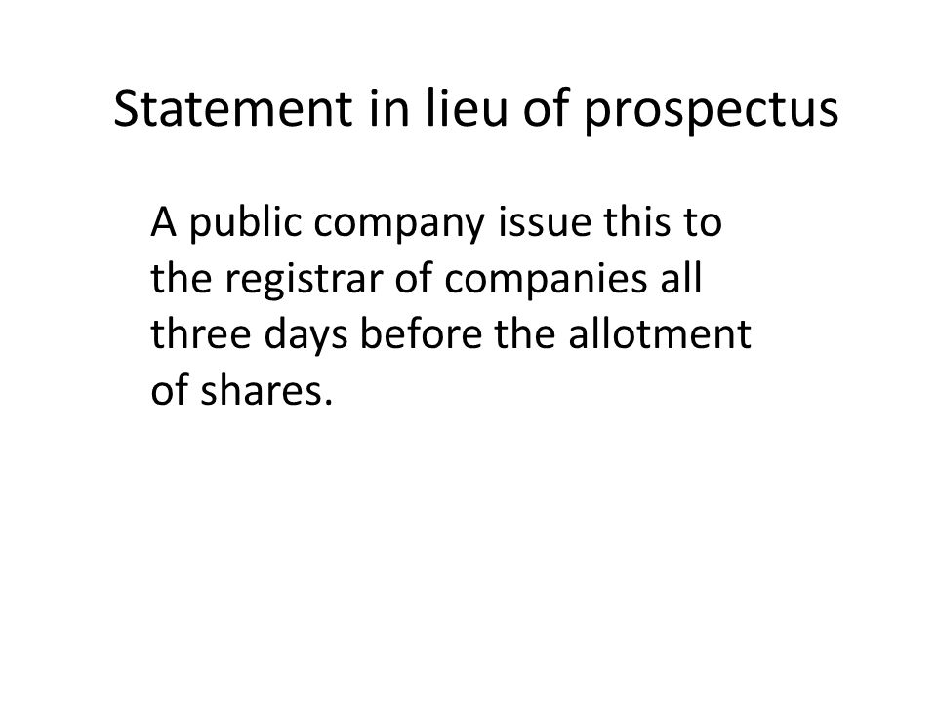
STATEMENT IN LIEU OF PROSPECTUS

Slide 24
THANK YOU

