Slide 1
COLLECTIVE BARGANING
Maj. (Dr.) P.K. Pandey
We try to understand
The meaning.
Concept.
Function.
Approaches.
Approaches.
Characteristics.
Barganing theory.
Its process.
Collective agreements.
And emerging issues.

Slide 2
MEANING.

Slide 3
CHARACTERISTICS.

Slide 4
CONCEPT.
There are three concepts.
Marketing concepts: which labour is bought and sold in the market place
Government concepts: rule make process which determines relation between management and trade union
Industrial relations: institution as participative decision making between the employees and employers. Bothe party interest

Slide 5
FUNCTION.
Five important function by Johan Dunlop and Derek Bok
Establishing the rule of work place
Determining of the form of compensation.
Standardizing compensation.
Determining priorities on each other side.
Redesigning the machinery of bargaining

Slide 6
BARGAINING THEORIES.
Walton and McKersie theory: four sub process
A.C.Pigou: barganing range theory
Chamberlain model: barganing power

Slide 7
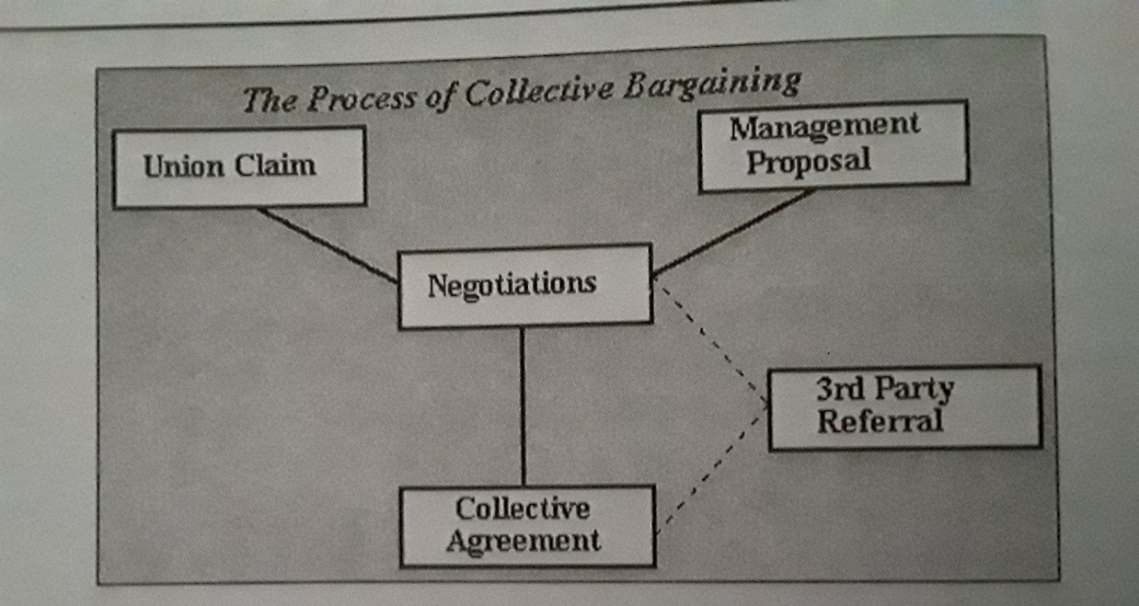
IT’S PROCESS.

Slide 8
APPROACHES.
Industry bargaining
Enterprise bargaining
Concession bargaining

Slide 9
COLLECTIVE AGREEMENTS.

Slide 10
EMERGING ISSUES.

