Slide 1
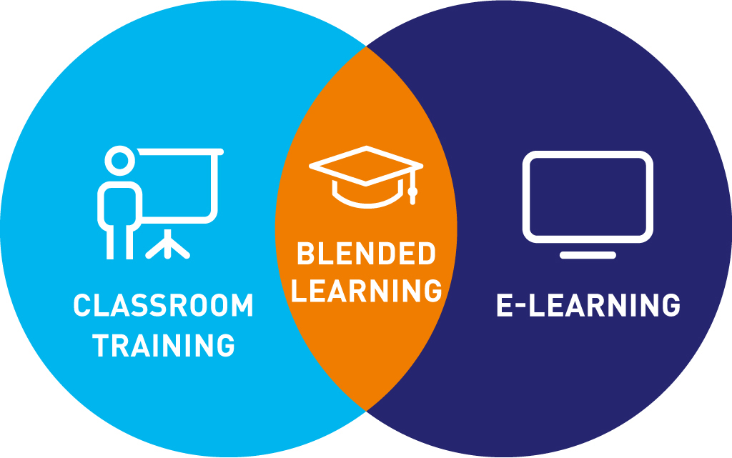
Blended Mode of Teaching & Learning
By –
Shephali Pal (Asst. Professor)
Department of Teacher Education (B.Ed.)
Harish Chandra P.G. College, Varanasi

Slide 2
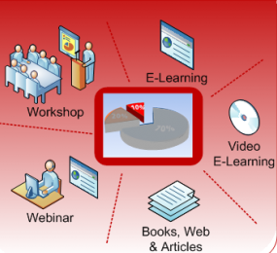
Meaning :
Blended Learning is a term increasingly used to describe the way E-Learning is being combined with traditional classroom methods and independent study to create a new hybrid, integrated teaching methodology.
NEP – 2020 recommends for use of Blended Models of Learning in which the ratio of traditional and online learning should be 60% and 40% respectively.

Slide 3
Benefits | Challenges
More effective than purely face-to face and purely online. | It has a strong dependence on the technical resources or tools.
Teacher act as a facilitator here. | IT literacy can server as a significant barriers for students.
Teachers can now streamline their instructions to help all students with their full potentials. | Using E-Learning platform can be more time consuming than traditional methods and can also come with new cost.
Blended mode is to be used nation-wide to help learners develop 21th Centaury skills along with the effective learning and skill development related to the subject domains. Every institute should strive to be a model institute to demonstrate a successful implementation of blended learning in higher education of our Country.

