Slide 1
B.Sc I Paper I Unit 4 YEAST (Sachharomyces) (with audio support)
Dr. Sanjay Srivastava
Botany Dept.
Harish Chandra P.G.College
Varanasi

Slide 2
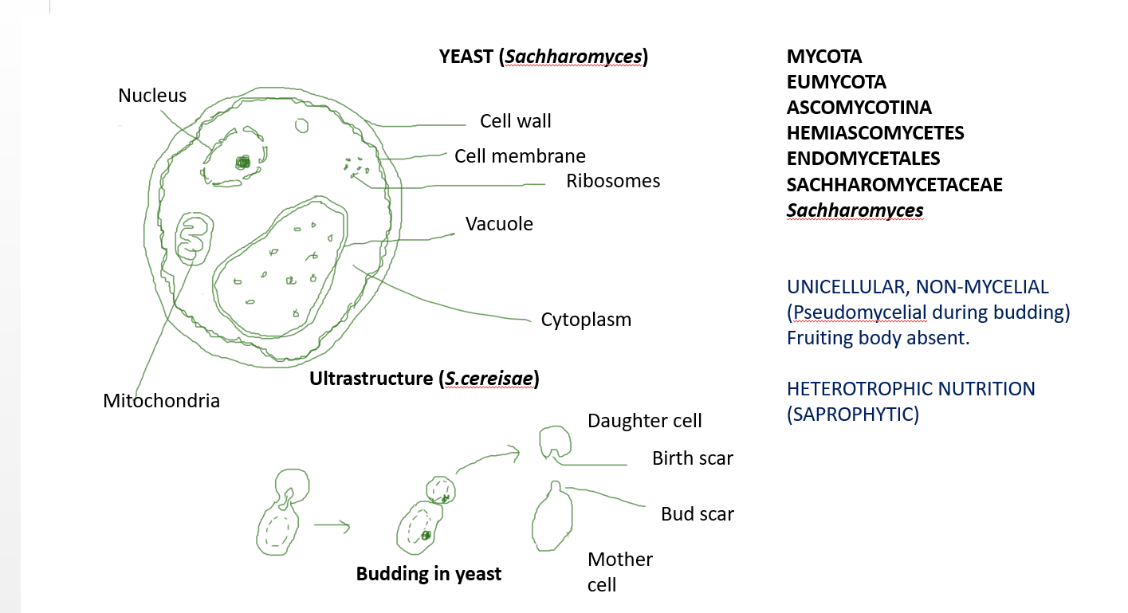

Slide 3
Kinds Of Yeast :
1.Budding Yeast – Multiply by budding eg., Sachharomyces cerevisae , S. ellipsoideus (wine making)
2. Fission Yeast – Multiply by fission eg., S. octosporus
3. Helobial Yeast – Multiply both by a mode of division intermediate between budding and fission eg., S. ludwigii

Slide 5
REPRODUCTION:
ASEXUAL: i) By budding: Occurs under favourable conditions
ii) By Fission (In Schizosachharomyces “Fission Yeast”)
iii) By Endospore formation: Under unfavourable conditions, thick walled resting spores formed.
SEXUAL: Sex organs, antheridia and oogonia are absent. Sexual life-cycle consists of three phases or phenomena- Plasmogamy, Karyogamy and Meiosis. Three types of life-cycle reported in different species of Yeast
i) Haplodiplobiontic life-cycle
ii) Diplobiontic life-cycle
iii) Haplobiontic life-cycle

Slide 6
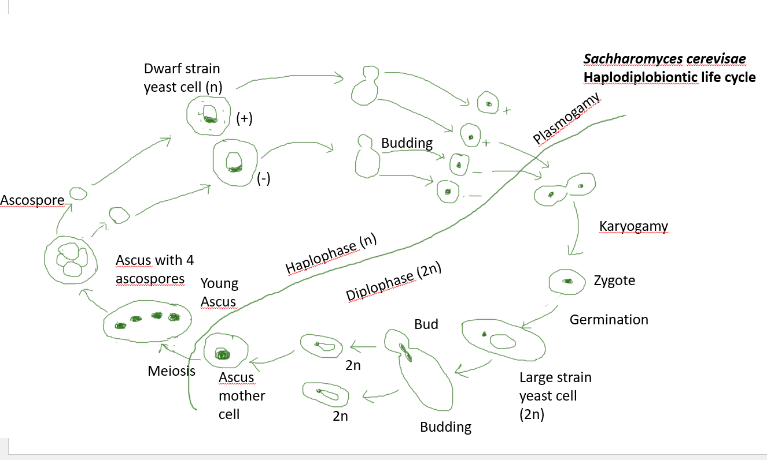

Slide 7
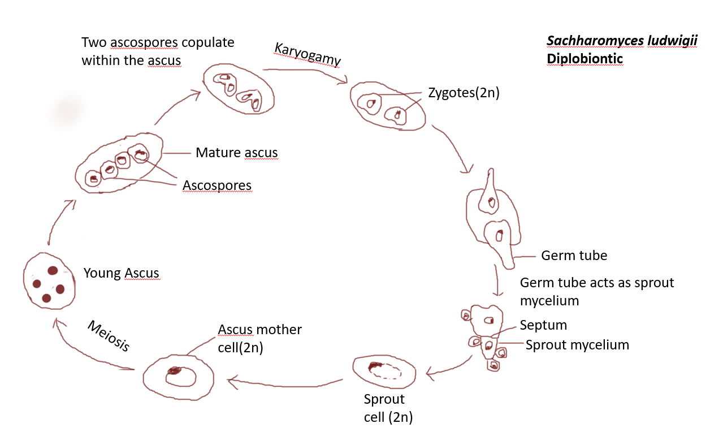

Slide 8
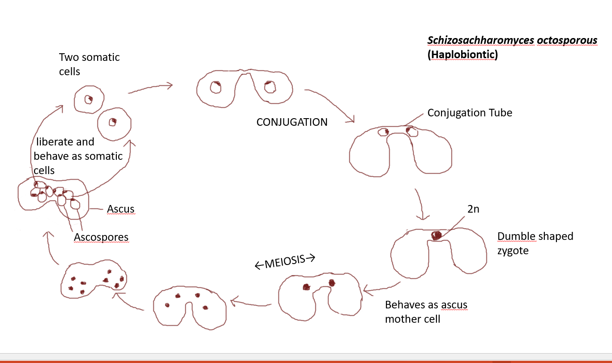

Slide 9
Ascospore structure : Ascospores are produced as a result of meiosis. Each ascospore is thick walled, globose structure. The number of wall layers are three. The outer and inner wall layers are electron dense. The middle wall layer is electron transparent and thick.
Ascospore germination : Optimal conditions for the germination of ascospores are as follows :
Temperature of 30ºC
Glucose in medium
pH range 5.4-8.2

Slide 10
Alternation of generation : In Sachharomyces cerevisae, the dwarf strain represents the haplod or gametophytic phase. The large strain represents the diploid or sporophytic phase. The sexual life cycle is of haplodiplobiontic type. Here, both haploid and diploid phases have almost equal shares in the life-cycle.
In S.ludwigii, haploid or gametophytic phase is represented by the ascospores only. The rest of the life-cycle is diploid and is therefore called Diplobiontic life-cycle.
In S.octosporous, diploid phase is restricted to zygote only. The rest of the life-cycle is haploid and therefore called haplobiontic life-cycle.

