Slide 1
IMMUNOLOGY

Slide 2
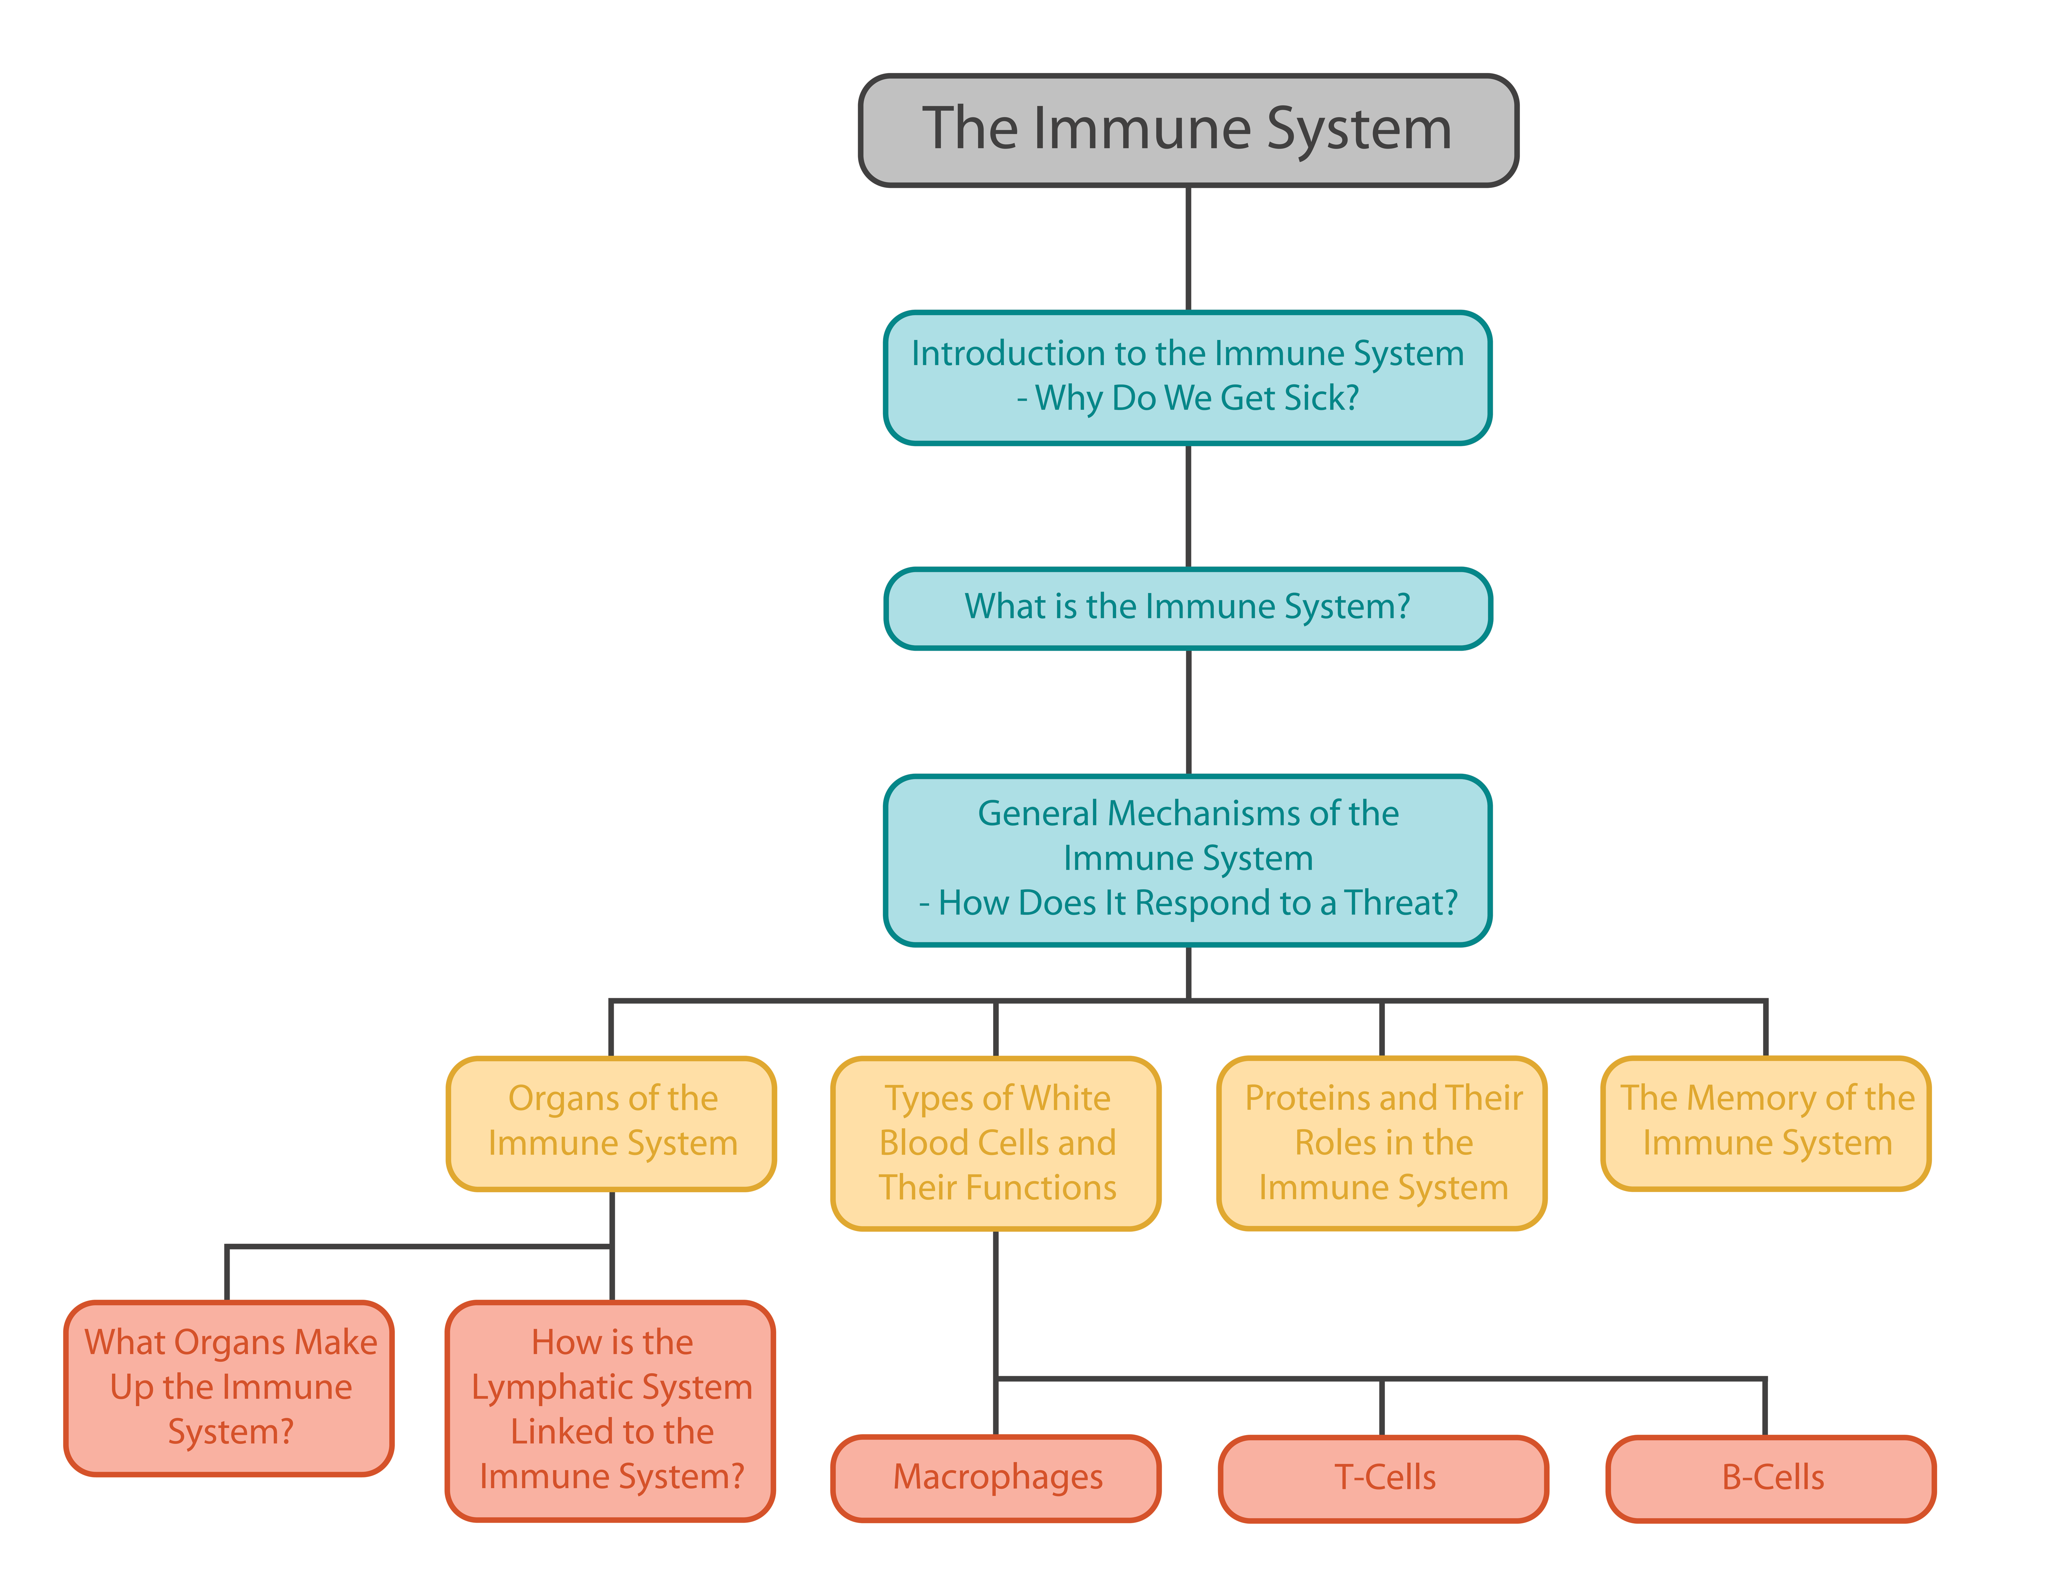

Slide 3
IMMUNITY
It is defined as the general ability of the body to recognize, neutralize, destroy and eliminate disease producing agents.
➢ The term immunity was coined by Burnet.

Slide 4
IMMUNOLOGY
It is the science which deals with the study of immune system, immune responses to Foreign substances and their role in resisting infection
.➢ Father of immunology is Emil Von Behring who discovered antibodies.

Slide 5
Defence Mechanism
Non Specific Defence
Internal Defence
Specific Defence
Immune system
External Defence

Slide 6
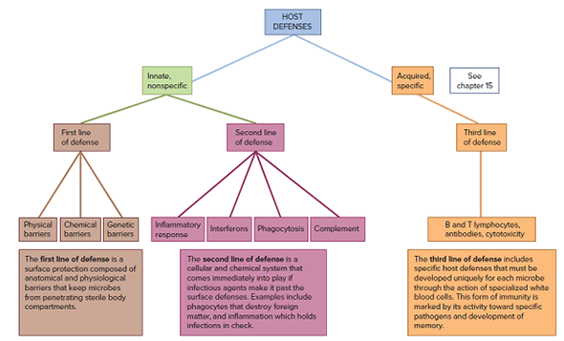

Slide 7
NON - SPECIFIC DEFENCE
LINE OF DEFENCE
FIRST LINE OF DEFENCE
SECOND LINE OF DEFENCE

Slide 8
FIRST LINE OF DEFENCE
It is an external defense and prevents entry of microorganisms in blood.
➢ It includes two barriers:
PHYSICALBARRIERS
CHEMICAL BARRIERS

Slide 9
PHYSICAL BARRIER
These are also called structural/anatomical barrier.
➢ These includes skin and mucous membrane.
SKIN
Intact skin is the largest defensive organ.
➢ Hard keratin of skin is waterproof.
MUCOUS MEMBRANE
It lines respiratory tract, G .I. tract, urogenital tract and exposed part of eyeball(conjunctiva).
➢ It consists of epithelium along with underlying connective tissue.
.

Slide 10
CHEMICAL BARRIERS
These are also called functional/physiological barriers.
➢ These include secretions from skin, mucous membrane and glands.
Skin has Sweat or sudoriferous glands. Oil or sebaceous glands.
➢ Sweat glands produce sweat which keeps skin pH acidic.
➢ Acidic pH minimizes growth of harmful bacteria.
➢ Oil glands produce oil which keeps skin soft.

Slide 11
CHEMICAL BARRIERS
Tears (lacrimal fluid), saliva and mucous secretions contain enzyme called isozyme.
➢ Lysozyme breaks down cell wall of gram+ bacteria.
Oxyntic cells of gastric glands of stomach secrete HCl.
➢ It is a potent killer of typhoid bacteria (Salmonella typhi).
➢ People who regularly take antacids are more susceptible to typhoid.
Throughout reproductive life of female, vagina contains bacteria Lactobacillus acidophilus.
➢ This bacteria converts glycogen into lactic acid which keeps vaginal pH acidic.
➢ Acidic pH minimizes chances of vaginal infection.

Slide 12
SECOND LINE OF DEFENCE
It is an internal defense and prevents spread of microorganisms in the body.
➢ It includes:
○ White Blood Cells.
○ Macrophages.
○ Interferons.
○ Inflammatory reaction.
○ N.K. Cells.
○ Complement proteins.

Slide 13
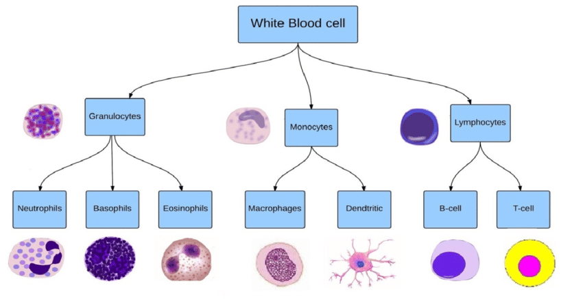

Slide 14
WHITE BLOOD CELL
Leucocytes are also known as white blood cells (WBC) as they are colourless due to lack of hemoglobin.
➢ They are nucleated and are relatively lesser in number which averages 6000-8000 mm–3 of blood
.➢ These are generally short lived.
Number of leucocytes increases in response to infection.
➢ Increase in WBC count is called leukocytosis.
➢ These squeeze out of capillaries to fight infection (diapedesis).

Slide 15
