Slide 1
RIEMANN INTEGRATION
B. Sc. III First Paper
Real Analysis (Unit 3)
Dr. Sangita Srivastava,
Associate Professor,
Department of Mathematics,
H.C.P.G.College,Varanasi.
Notes:
Dr Sangita Srivastava,
Associate Professor, Department of Mathematics,
H.C.P.G.College, Varanasi

Slide 2
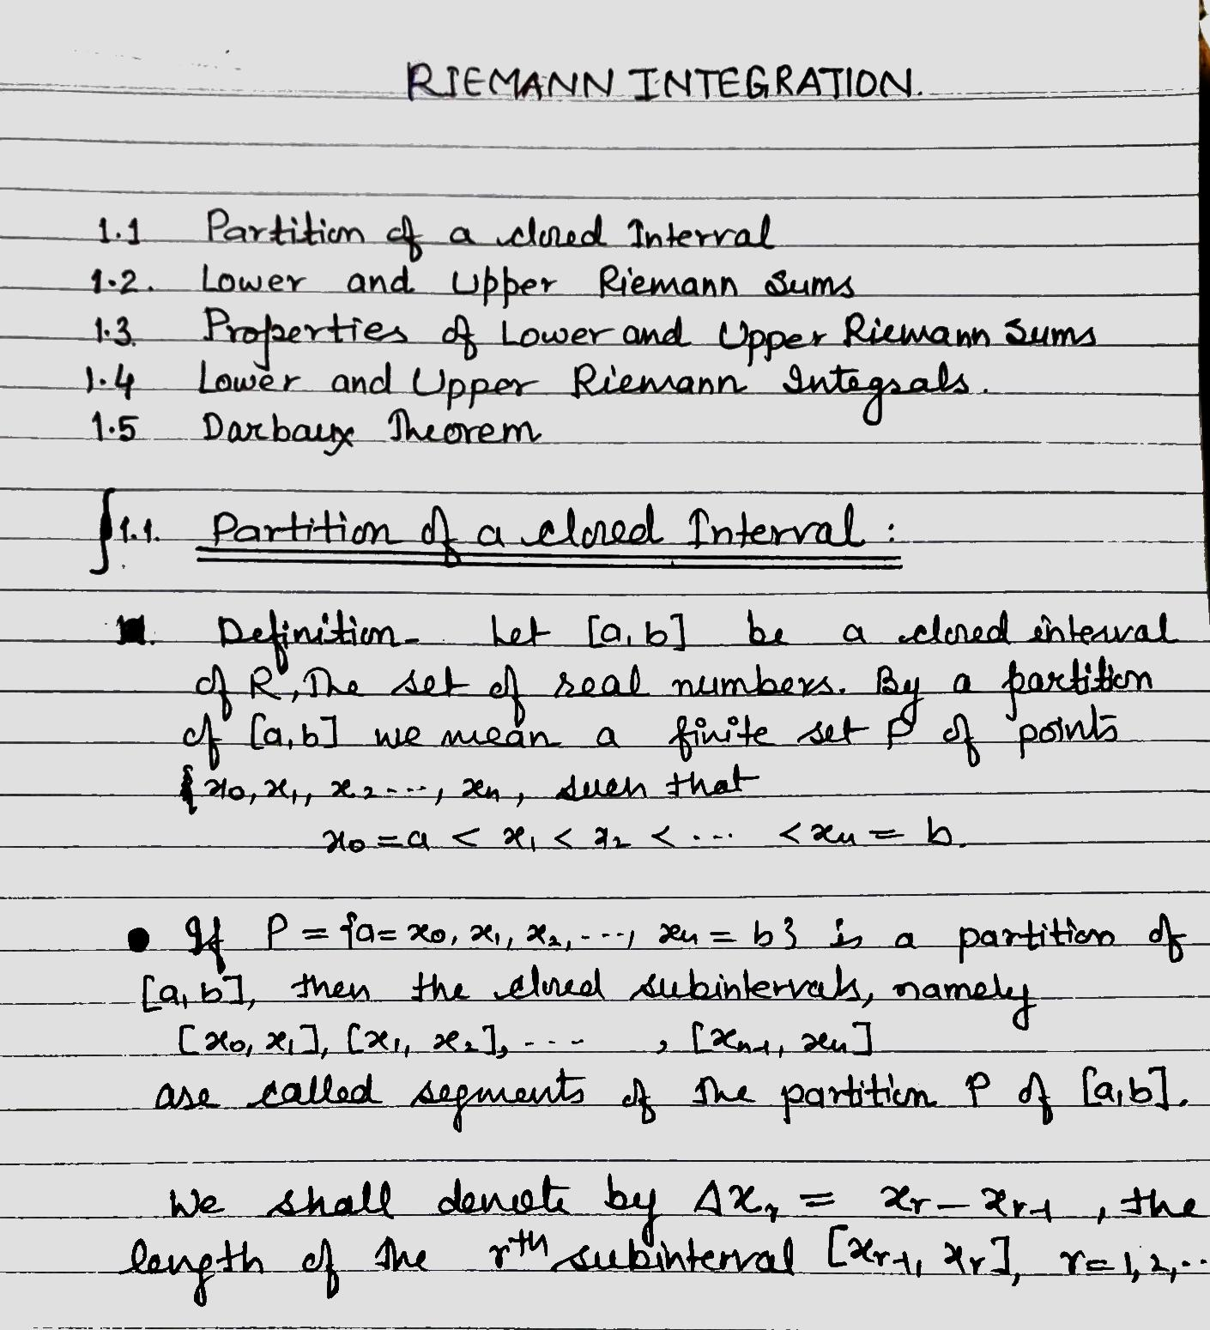

Slide 6
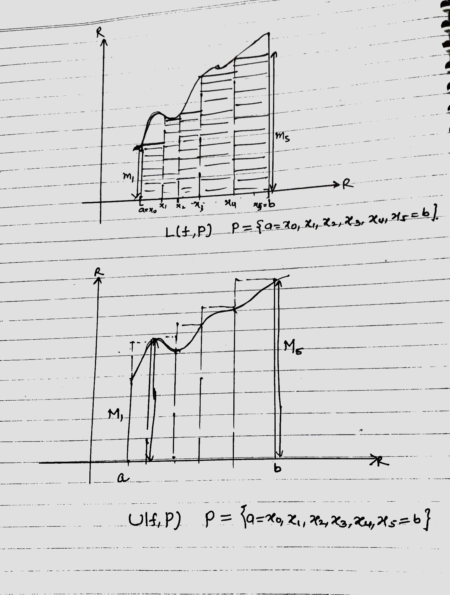

Slide 7
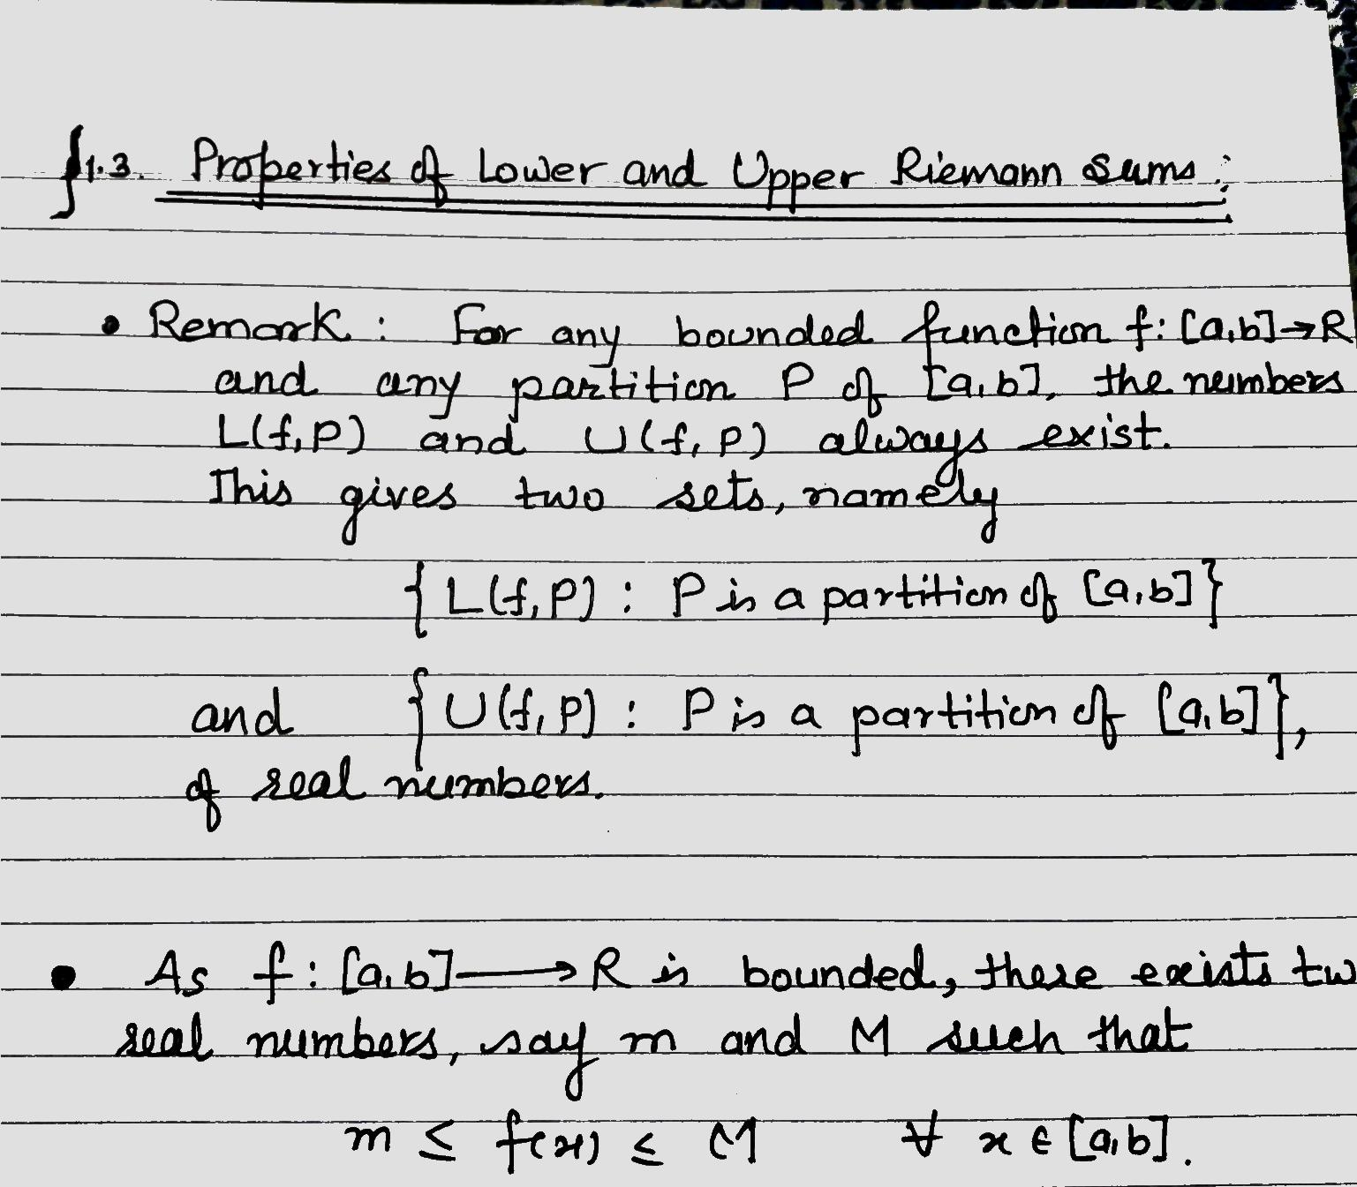

Slide 8
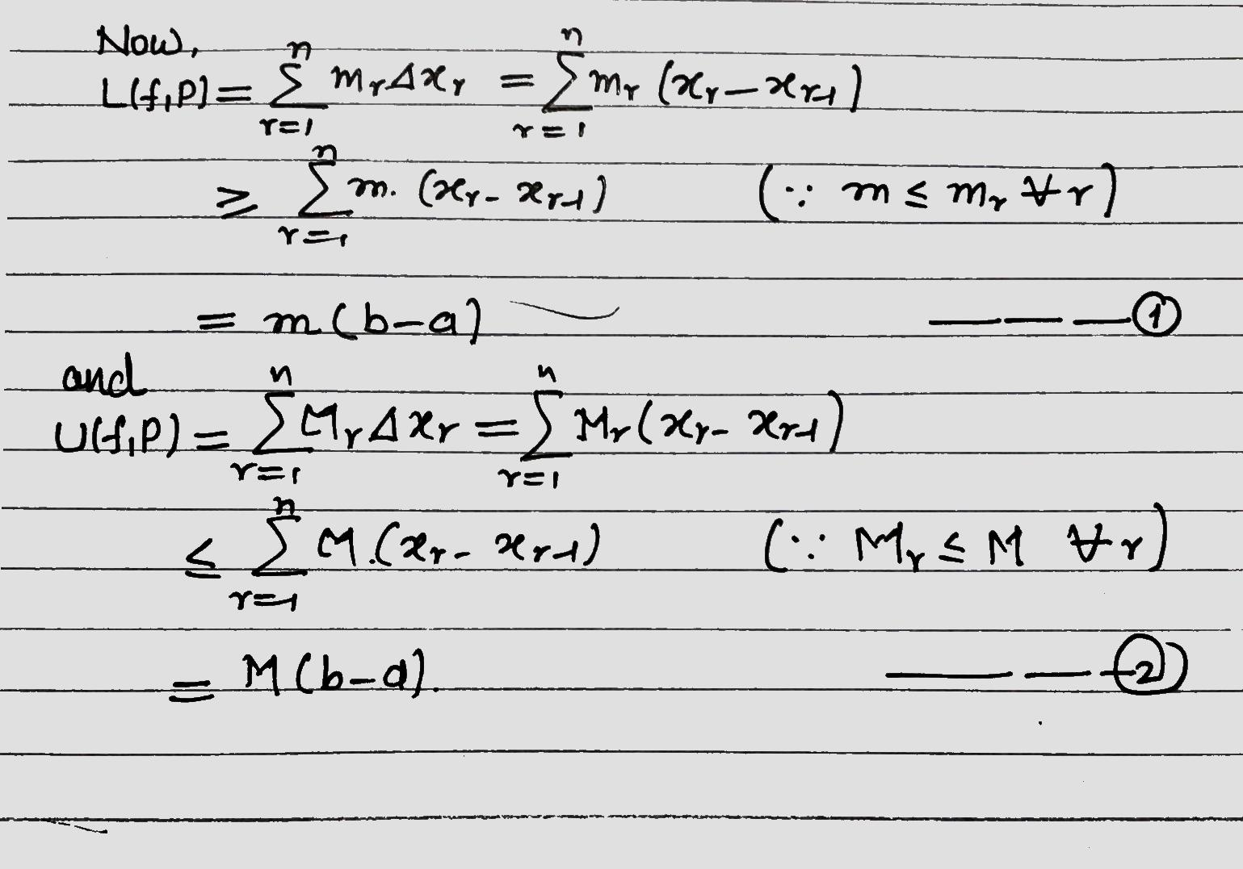

Slide 13
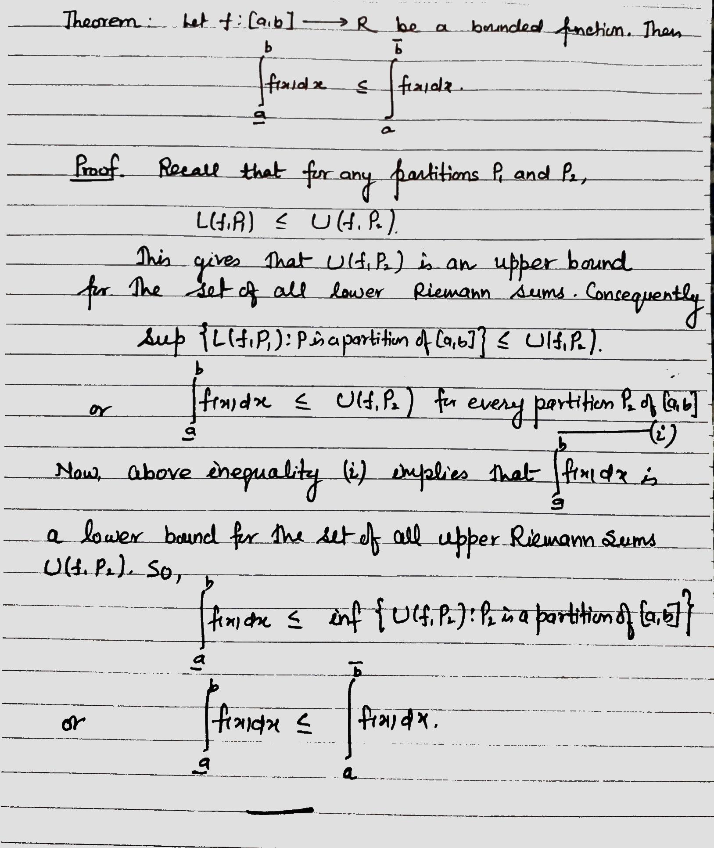

Slide 14
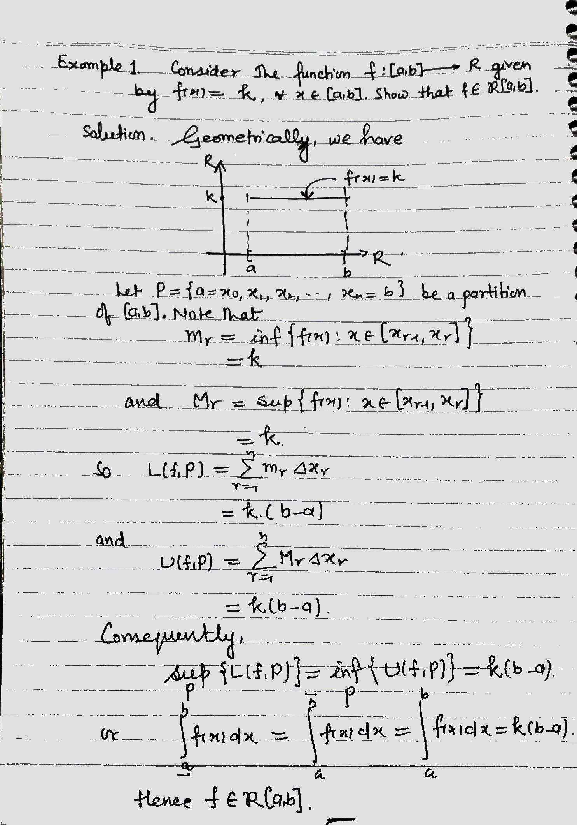

Slide 15
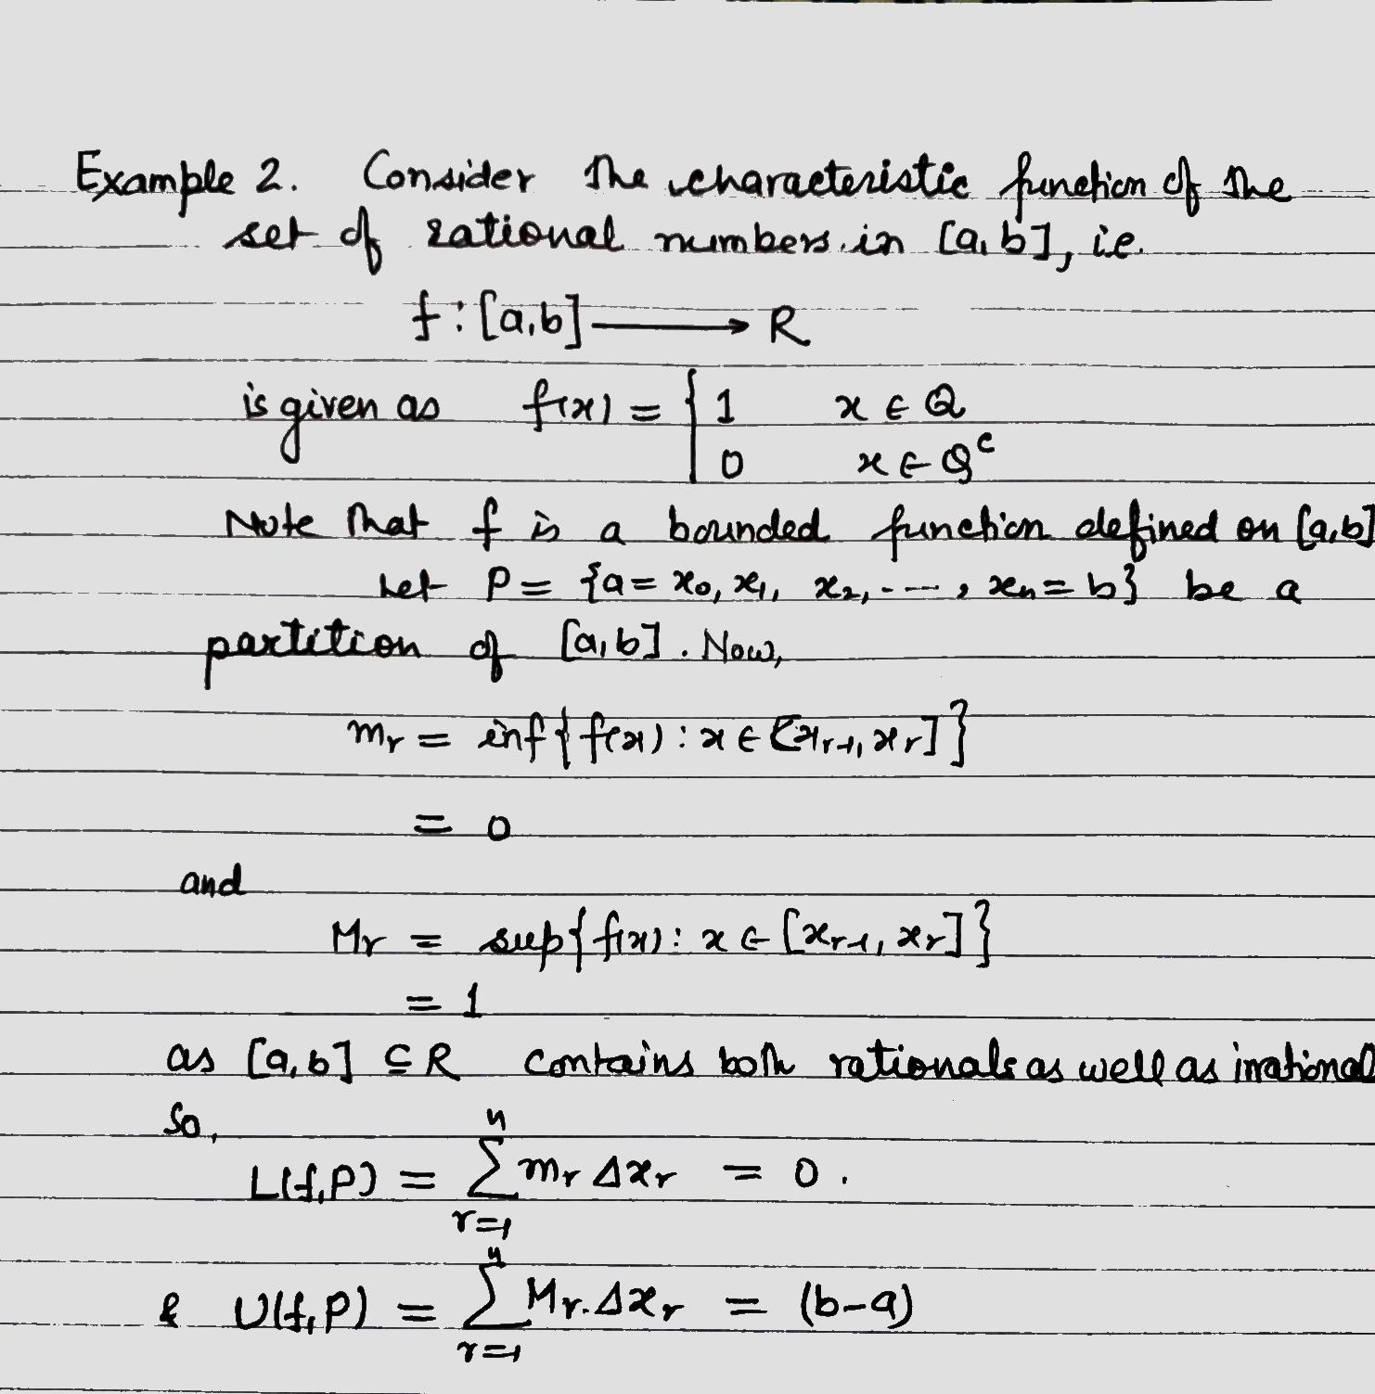

Slide 16
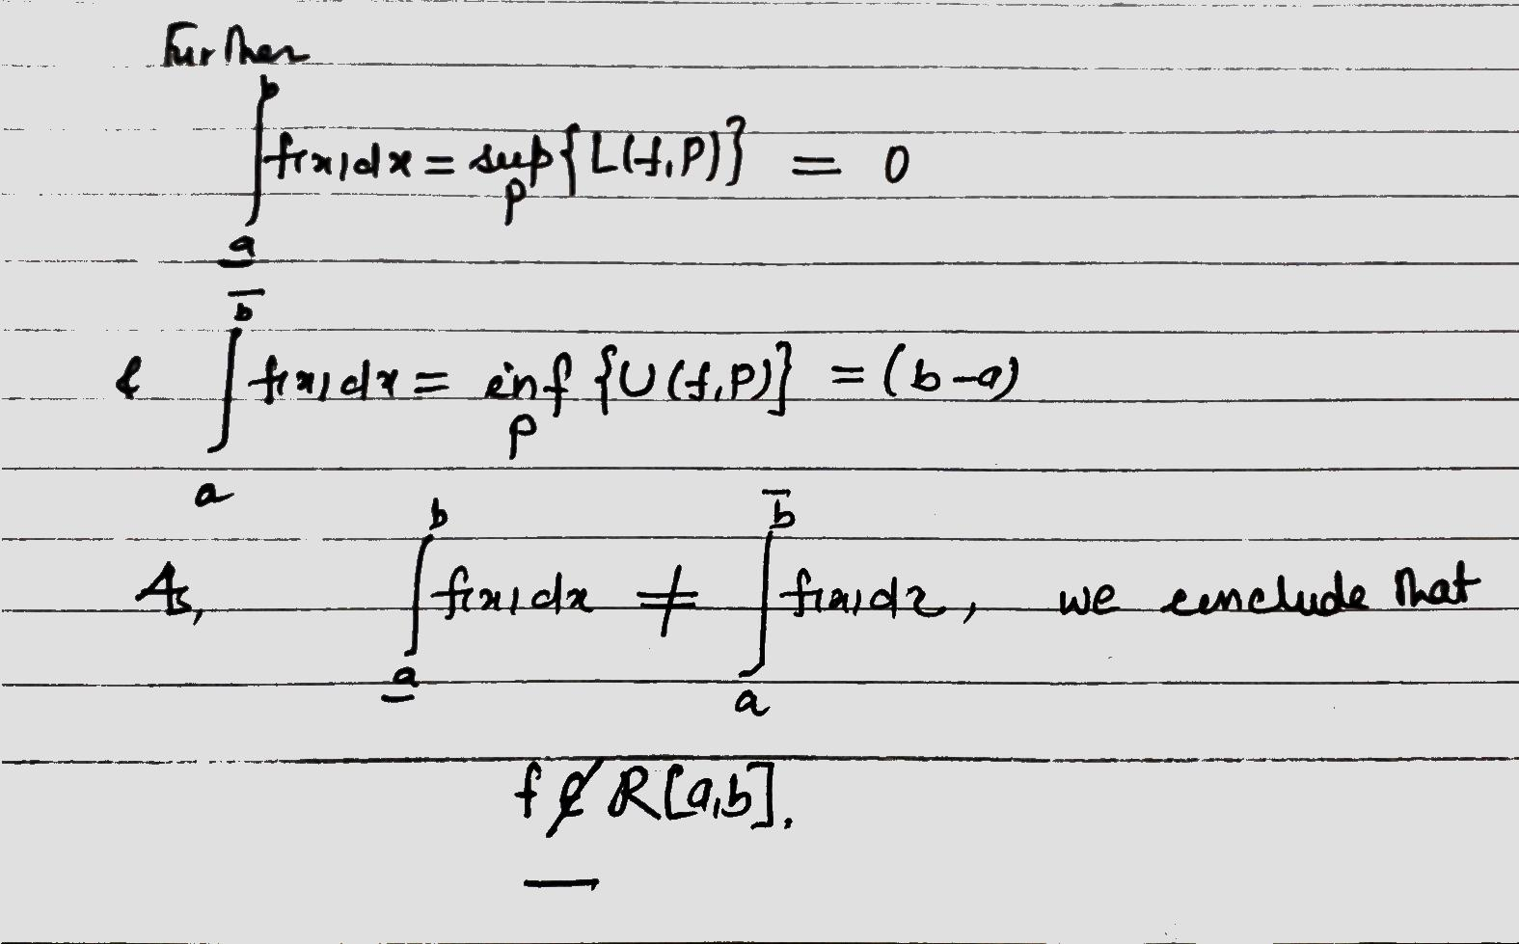

Slide 17
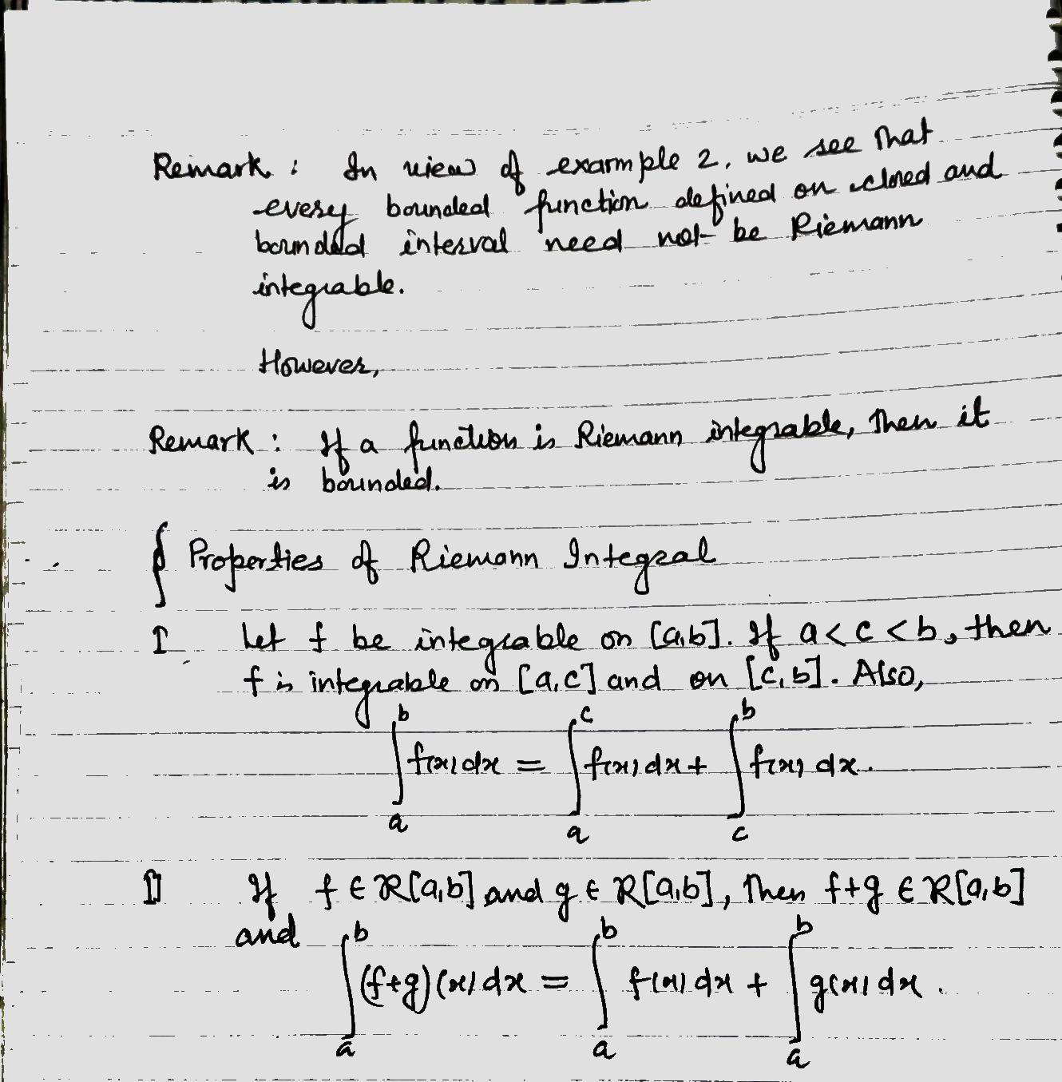

Slide 18
