Slide 1
ACCOUNTING FOR PLANNING AND CONTROL PART V
DR. ANIL PRATAP SINGH
HEAD, DEPARTMENT OF COMMERCE
HARISH CHANDRA POST GRADUATE COLLEGE VARANASI

Slide 2
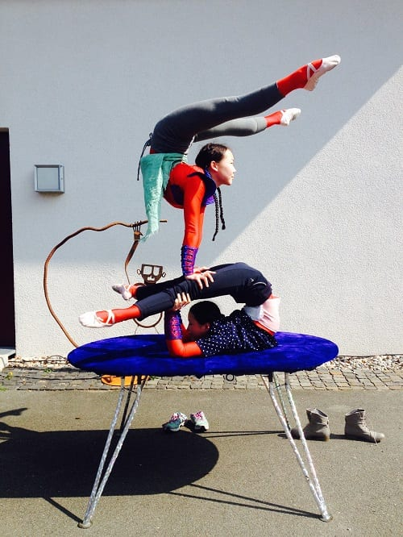
FLEXIBLE BUDGET
A flexible budget is a budget that adjusts or flexes with changes in volume or activity. The flexible budget is more sophisticated and useful than a static budget. (The static budget amounts do not change. They remain unchanged from the amounts established at the time that the static budget was prepared and approved.)For costs that vary with volume or activity, the flexible budget will flex because the budget will include a variable rate per unit of activity instead of one fixed total amount. In short, the flexible budget is a more useful tool when measuring a manager's efficiency.
Thi
This Photo by Unknown Author is licensed under CC BY-NC

Slide 3
Flexible budget is also called variable budget or sliding scale budget .The expenses are divided into three categories fixed variable and semi variable. It is an important tool of cost control as it facilitate comparison of actual results with the budgeted figures. According to institute of Cost and management accountants, London ,“ a flexible budget is a budget which by recognising the difference between fixed, semi fixed and variable costs is designed to change in relation to the level of activity attained." A flexible budget is a dynamic budget. It is a budget which is designed to change in accordance with the level of activity. It is a budget that adjusts or flexes for changes in the volume of activity

Slide 4
FEATURES OF FLAXIBLE BUDGET
WIDE RANGE
FLEXIBILITY
CHANGE IN
THE VOLUME
OF
ACTIVITY
PERFORMANCE
MEASUREMENT
AND
EVALUATION
REPLACE
STATIC
BUDGET

Slide 5
IMPORTANCE OF FLEXIBLE BUDGET
The main importance of flexible budget is that it reflects the expenditure appropriate to various levels of output. The expenditure established through a flexible budget is suitable for comparison of the actual expenditure incurred with the budgeted level applicable for that particular level of activity attained . Budget estimate is presented for any level of activity through flexible budget. The usefulness or importance of a flexible budget depends very much on the accuracy of the classification of expenses into fixed, semi-fixed and variable ones.
CONTD…..

Slide 6
ENABLE THE MANAGEMENT TO ANALYZE THE DEVIATION
MANAGEMENT CAN COMPARE BUDGETED COST AT THE ACTUAL VOLUME
CORRECT BASIS FOR COMPARISION
FULFILL THE OBJECTIVES OF COST CONTROL

Slide 7
HELPFUL IN PRICE FIXATION
COST ASCERTAINMENT IS POSSIBLE
HELPFUL IN ASSESSING THE PERFORMANCE OF HEADS
LOGICAL COMPARISON

Slide 8
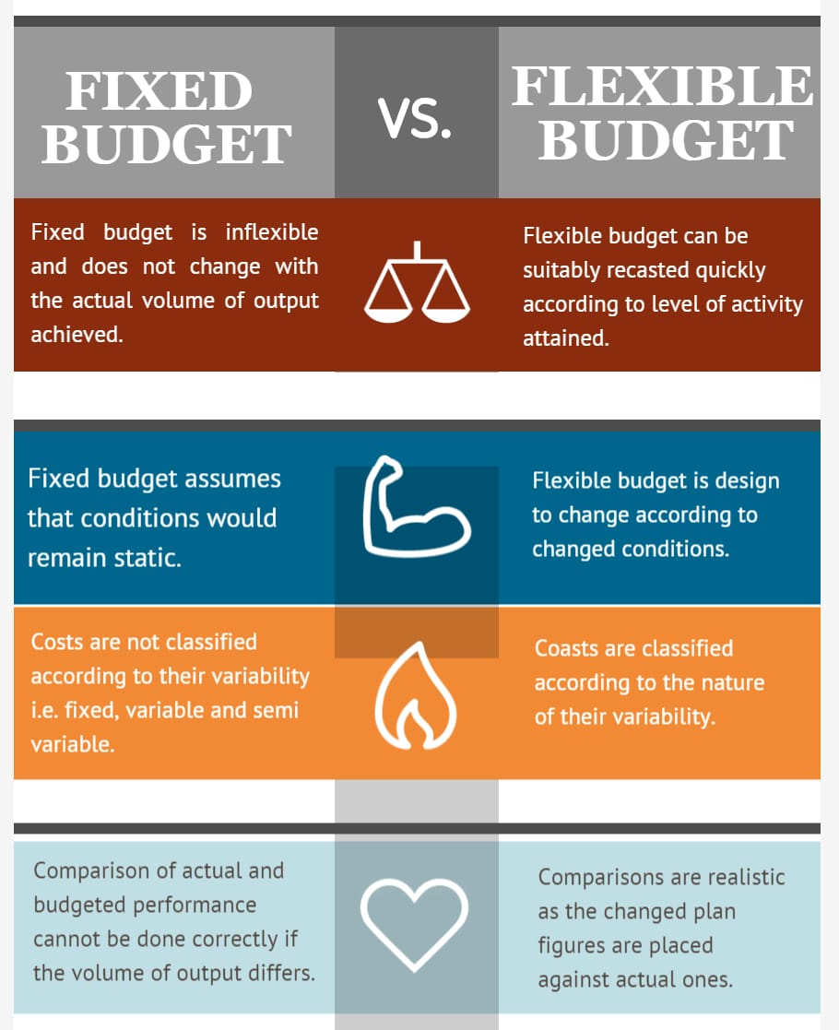

Slide 9
NEED OF FLEXIBLE BUDGET
1.GENERAL CHANGE IN SALES
2.SEASONAL FLUCTUATION IN PRODUCTION
3.AN INDUSTRY WHICH IS INFLUENCED BY CHANGE IN FASHION.
4.INDUSTRIES ENGAGED IN MAKE-TO-ORDER BUSINESS
5.A COMPANY WHICH MAKES CHANGE IN THE DESIGN OF ITS PRODUCTS FREQUENTLY.

Slide 10
DISADVANTAGES OF FLEXIBLE BUDGET
1. IT IS VERY EXPENSIVE
2. REQUIRES THE SYSTEM OF STANDARD COSTING
3. NEED OF PERFECT KNOWLEDGE ABOUT THE VARIOUS BUSINESS CIRCUMSTANCES.
4. LABOUR INTENSIVE
5.BASED ON ESTIMATION

Slide 11
ILLUSTRSTION
With the help of following data for 60% activity, prepare a budget for production at 80% and 100%. capacity
Production at 60% capacity 1200 unit
Material Rs.50 per unit
Labour Rs.20 per unit
Expenses Rs.05 per unit
Factory expenses Rs.40,000 (40% fixed)
Administration expenses Rs.30,000 (60% fixed)

Slide 12
SOLUTION
Particulars | 60% 1200 unit | 80% 1600unit | 100% 2000
Material Rs. 50 per unit | 60000 | 80000 | 100000
Labour Rs. 20 per unit | 24000 | 32000 | 40000
Expenses Rs.05 per unit | 6000 | 8000 | 10000
Factory expenses:
( I )Fixed | 16000 | 16000 | 16000
( II )Variable | 24000 | 32000 | 40000
Administrative Expenses:
( I )Fixed | 18000 | 18000 | 18000
(II)Variable | 12000 | 16000 | 20000
TOTAL | 160000 | 202000 | 244000
COST PER UNIT | 133.33 | 126.25 | 122.00

Slide 13
PROBLEMS & SOLUTION
The expenses budget for production of 10000 units in a factory are furnished below:
Rs. per unit
MATERIAL 70
LABOUR 25
VARIABLE OVERHEAD 20
FIXED OVERHEAD (Rs.100000 ) 10
VARIABLE EXPENSES (direct) 5
SELLING EXPENSES (10% FIXED) 13
DISTRIBUTION EXPENSES (20% FIXED) 7
ADMINISTRATION EXPENSES (Rs.50000) 5
PREPASRE A BUDGET FOR THE PRODUCTION OF (A)8000 UNITS AND (B)6000 UNITS.
A SSUME THAT ADMINISTRATION EXPENSES ARE RIGID FOR ALL LEVELS OF PRODUICTION. (C.A.INTER)

Slide 14
PARTICULARS | PER UNIT 6000 UNIT | TOTAL | PER UNIT 8000 UNIT | TOTAL | PER UNIT 10000 UNIT | TOTAL
MATERIAL | 70.00 | 4,20,000 | 70.00 | 5.60.000 | 70.00 | 7,00,000
LABOUR | 25.00 | 1,50,000 | 25.00 | 2,00,000 | 25.00 | 2,50,000
DIRECT EXP. | 5.00 | 30,000 | 5.00 | 40,000 | 5.00 | 50,000
VARIABLE EXP. | 20.00 | 1,20,000 | 20.00 | 1,60,000 | 20.00 | 2,00,000
FIXED OVEFHEAD | 16.67 | 1,00,000 | 12.50 | 1,00,000 | 10.00 | 1,00,000
SELLING EXP. :
FEXED | 2.17 | 13,000 | 1.63 | 13,000 | 1.30 | 13,000
VARIABLE | 11.77 | 70,200 | 11.70 | 93,600 | 11.70 | 1,17,000
DISTRIBUTION EXP.:
FIXED | 2.33 | 14,000 | 1.75 | 14,000 | 1.40 | 14,000
VARIABLE | 5.60 | 33,600 | 5.60 | 44,800 | 5.60 | 56,000
ADMIN. EXP. :FIXED | 8.33 | 50,000 | 6.25 | 50,000 | 5.00 | 50,000
TOTAL | 166.80 | 10,00,800 | 159.42 | 12,75,400 | 155.00 | 15,50,000

Slide 15
THE END
This Photo by Unknown Author is licensed under CC BY-SA-NC

