Slide 1
ACCOUNTING FOR PLANNING AND CONTROL PART IV
DR.ANIL PRATAP SINGH
HEAD DEPARTMENT OF COMMERCE
HARISH CHANDRA POST GRADUATE COLLEGE ,VARANASI

Slide 2
CLASSIFICATION OF BUDGETS
Managerial accounting approaches a company's financial situation in an operational way, giving information in a manner that supports managers in planning and control procedures. Various budget formats in managerial accounting influence how a manager forecasts department activity and how he addresses progress or shortfall to meet goals. Companies may use several types of managerial budgets concurrently.
Cntd…

Slide 3
Budgeting process is chronological in nature, and consists of many budgets that are roughly classified according to methods and techniques of an organization in generating and spending its money. Different budgets are used for different applications. Some of these mentioned budgets deal with income coming from dividends, sales and interest. Consequently, other budgets give details of sources of expenditures like labor, selling costs, purchases, and factory costs. Some unique types of budgets are chiefly concerned with investments and forecast for company productivity and performance. These budgets are classified according to their usage.

Slide 4
CLASSIFICATION OF BUDGETS
On the basis of time
Current
Short Term
Long Term

Slide 5
On the basis of fIexibility
Fixed Budget
Flexible Budget

Slide 6
On the basis of Functions
Sales Budget
Materials Budget
Labour Budget
Production Budget
Overhead Budget
Research &
Development
Budget
Capital Budget
Cash Budget

Slide 7
Other Budget
Master Budget
Supplementary
Budget
Zero Base
Budget

Slide 8
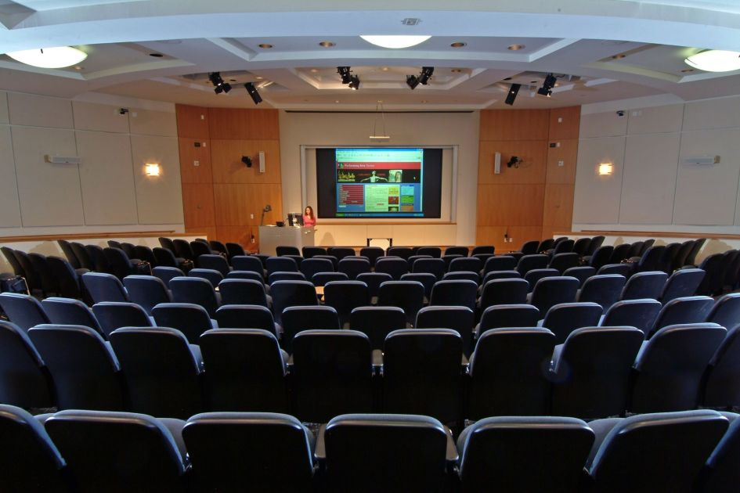
THE END
BE POSITIVE
This Photo by Unknown Author is licensed under CC BY-NC-ND

