Slide 1
B.A English Part I First Paper- Poetry
The Sonnet
Dr.Seema Singh
Department of English
H.C.P.G.College

Slide 2
The word ‘Sonnet’ has been derived from the Italian word ‘Sonneto’ meaning a little sound or strain.
Sonnet is a short poem expressing one main idea or thought.
It has fourteen decasyllabic lines. There is an exception of curtailed sonnet.
Sonnet is chiefly associated with famous Italian poet Petrarch.
The Sonnet is found in two forms e.g.
(i) Italian or Petrarchan Sonnet (ii) English or Shakespearean Sonnet

Slide 3
The Italian Sonnet
The Petrarchan or Italian sonnet characteristically treats its theme in two parts. The first eight lines, the octave, state a problem, ask a question, or express an emotional tension. The last six lines, the sestet, resolve the problem, answer the question, or relieve the tension. The octave is rhymed abbaabba. Therhyme scheme of the sestet varies; it may be cdecde, cdccdc, or cdedce. The Petrarchan sonnet became a major influence on English poetry. The octave may be divided into two quatrains, the sestet into two tercets. At the end of the octave there is a pause or Caesura often represented by a space followed by a volta or turn in thought but it was never necessory.

Slide 4
The English Sonnet
The sonnet was introduced to England, by Thomas Wyatt and Henry Howard Earl of Surrey , in the 16th century.
The new form precipitated the great Elizabethan flowering of lyric poetry, and the period marks the peak of the sonnet’s English popularity.
In the course of adapting the Italian form to a language less rich in rhymes, the Elizabethans gradually arrived at the distinctive English sonnet, which is composed of three quatrains, each having an independent rhyme scheme, and is ended with a rhymed couplet.
The rhyme scheme of the English sonnet is abab cdcd efef gg. Its greater number of rhymes makes it a less demanding form than the Petrarchan sonnet, but this is offset by the difficulty presented by the couplet, which must summarize the impact of the preceding quatrains with the compressed force of a Greek epigram.

Slide 5
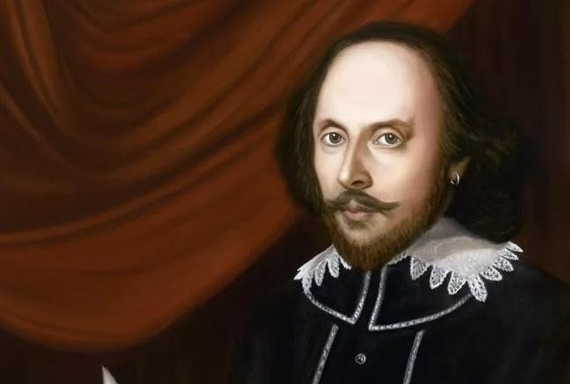
Thank You

Slide 6
The typical Elizabethan use of the sonnet was in a sequence of love poems in the manner of Petrarch.
Although each sonnet was an independent poem, partly conventional in content and partly self-revelatory, the sequence had the added interest of providing something of a narrative development.
Among the notable Elizabethan sequences are Sir Philip Sidney’ Astrophel and Stella (1591), Samuel Daniel’s Delia (1592), Michael Drayton’s Idea’s Mirrour (1594), and Edmund Spenser’s Amoretti (1591).
Spenser used a common variant of the sonnet (known as Spenserian) that follows the English quatrain and couplet pattern but resembles the Italian in using a linked rhyme scheme: abab bcbc cdcd ee.
Perhaps the greatest of all sonnet sequences is Shakespeare’s, addressed to a young man and a “dark lady.” In these sonnets the supposed love story is of less interest than the underlying reflections on time and art, growth and decay, and fame and fortune.

Slide 7
Let me not to the marriage of true minds Admit impediments. Love is not love Which alters when it alteration finds, Or bends with the remover to remove: Oh, no! it is an ever-fixéd mark, That looks on tempests and is never shaken; It is the star to every wandering bark, Whose worth’s unknown, although his height be taken. Love’s not Time’s fool, though rosy lips and cheeks Within his bending sickle’s compass come; Love alters not with his brief hours and weeks, But bears it out even to the edge of doom. If this be error and upon me proved, I never writ, nor no man ever loved.
Shakespeare’s Sonnet CXVI:

