Slide 1
M.A English- IIIrd Semester Paper –X Contemporary Literary Theory
‘Northrop Frye 'The Archetypal Criticism’
Dr.Nripendra Singh
Department of English
H.C.P.G.College

Slide 2
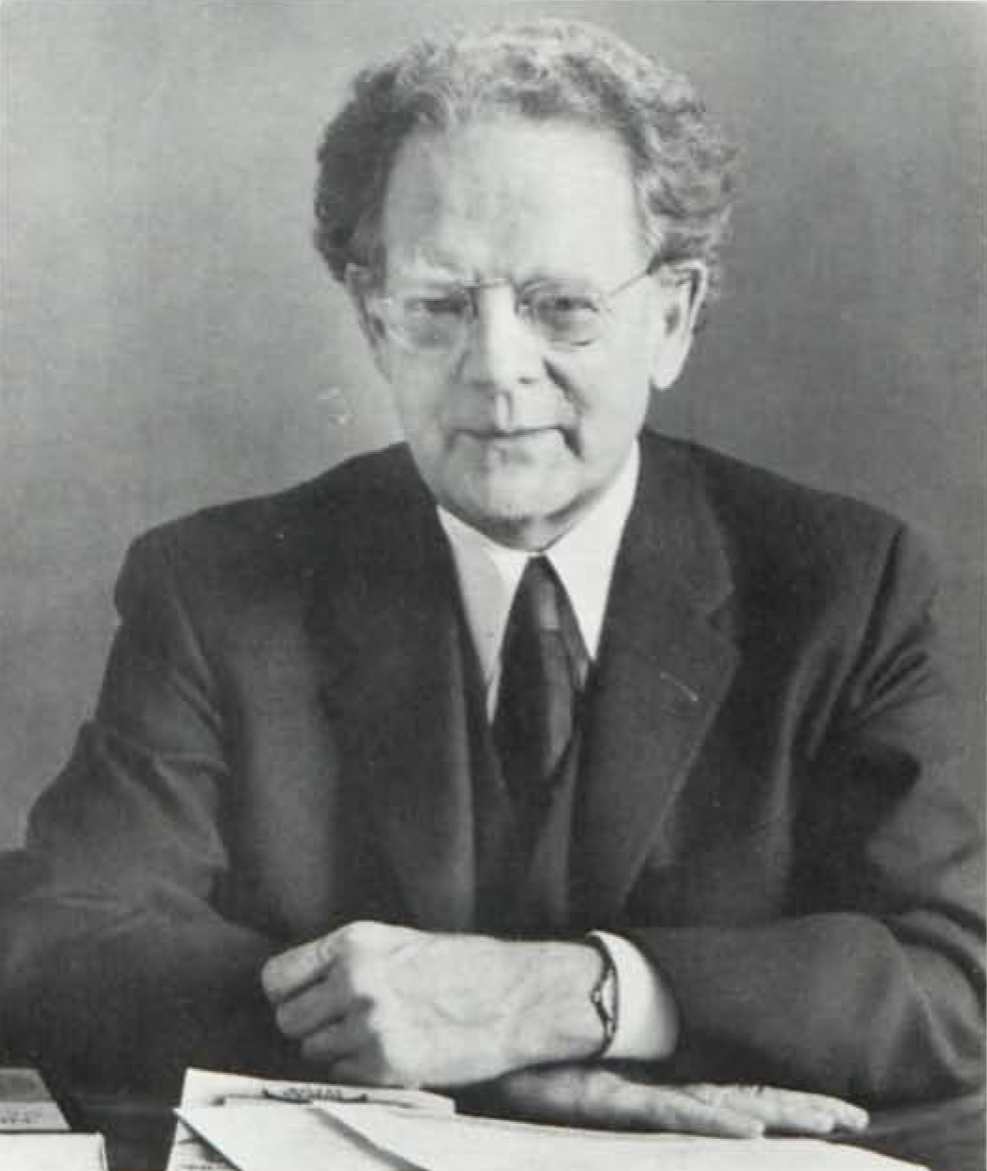
Northrop Frye (July 14, 1912 – January 23, 1991) was a Canadian literary critic, considered one of the most influential of the 20th century.
Frye gained international fame with his first book, Fearful Symmetry (1947), which led to the reinterpretation of the poetry of William Blake. His lasting reputation rests principally on the theory of literary criticism that he developed in Anatomy of Criticism (1957), one of the most important works of literary theory published in the twentieth century. The American critic Harold Bloom commented at the time of its publication that Anatomy established Frye as "the foremost living student of Western literature."[ Frye's contributions to cultural and social criticism spanned a long career during which he earned widespread recognition and received many honours.

Slide 15
Thank you

